Slide 1



Sofia Lonardi
PhD candidate at the University of Freiburg
RTG 3186 member “Looking for signposts towards the New Standard Model of particle physics (NewSM)”
Higgs boson pair production in bb-ττ channel
with the ATLAS Experiment
Experimental particle physics group – Brian Moser
HEP School – Bad Honnef, 5th Septemper 2026

Slide 2

Searching for the N-naturalness tower of neutrinos
Sofia Lonardi
Master’s thesis project + paper in review
With Dr. Manuel Ettengruber
Supervised by Philipp Eller,
Prof. Elisa Resconi and Prof. Georgi Dvali
https://arxiv.org/abs/2607.14243
HEP School – Bad Honnef, 5th Septemper 2026

Slide 3
Motivation
Many hints that physics beyond the Standard Model is needed
Many theories developed with phenomenology
Signatures in the neutrino sector can be measured
MATTER-ANTIMATTER ASYMMETRY
DARK MATTER
NEUTRINO MASSES
HIERARCHY PROBLEM

Slide 4
N-Naturalness theory
This theory is part of a larger group of ir solutions to neutrino mass generation
Its phenomenology for neutrino sectors is recent, so these are the first constraints using public data
We aim at constraining the key parameters of the theory using the public data from neutrino experiments

Slide 5
The theory Aim
N-Naturalness
Hierarchy Problem
Neutrino Mass
Non fine-tuned Higgs mass
Neutrino mass suppression
5

Slide 6
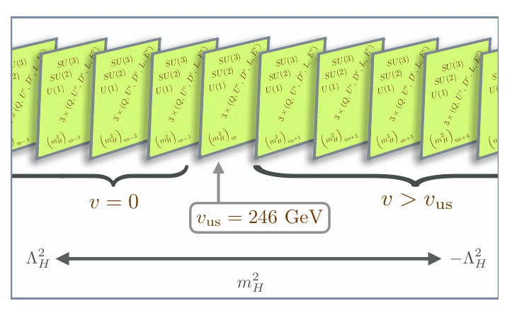

THE MECHANISM
N sectors with varying Higgs mass parameter in [-Л_{H}², + Л_{H}²]
The Higgs mass is suppressed by N
r parameter measures the fine-tuning ( r=1 non-fine-tuned )

Slide 7
our goal
There are several realisations of this mechanism which can suppress both the Higgs and the neutrino masses
We focus on the realisation with N=10⁴ and r=1 (non-fine-tuned)
We aim at constraining the N and r parameters using the public data from neutrino experiments

Slide 8
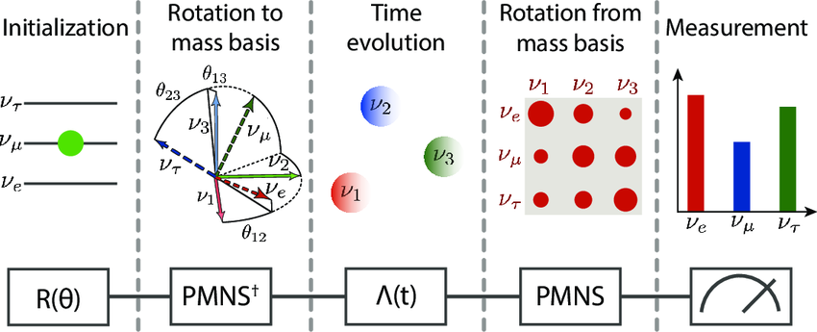
Neutrino oscillations
3 flavours eigenstates do not correspond to 3 mass eigenstates
Probability that one flavour oscillates in one of the others
The probability depends on energy and on distance
The neutrinos of other sectors can oscillate into our sector ones

Slide 9
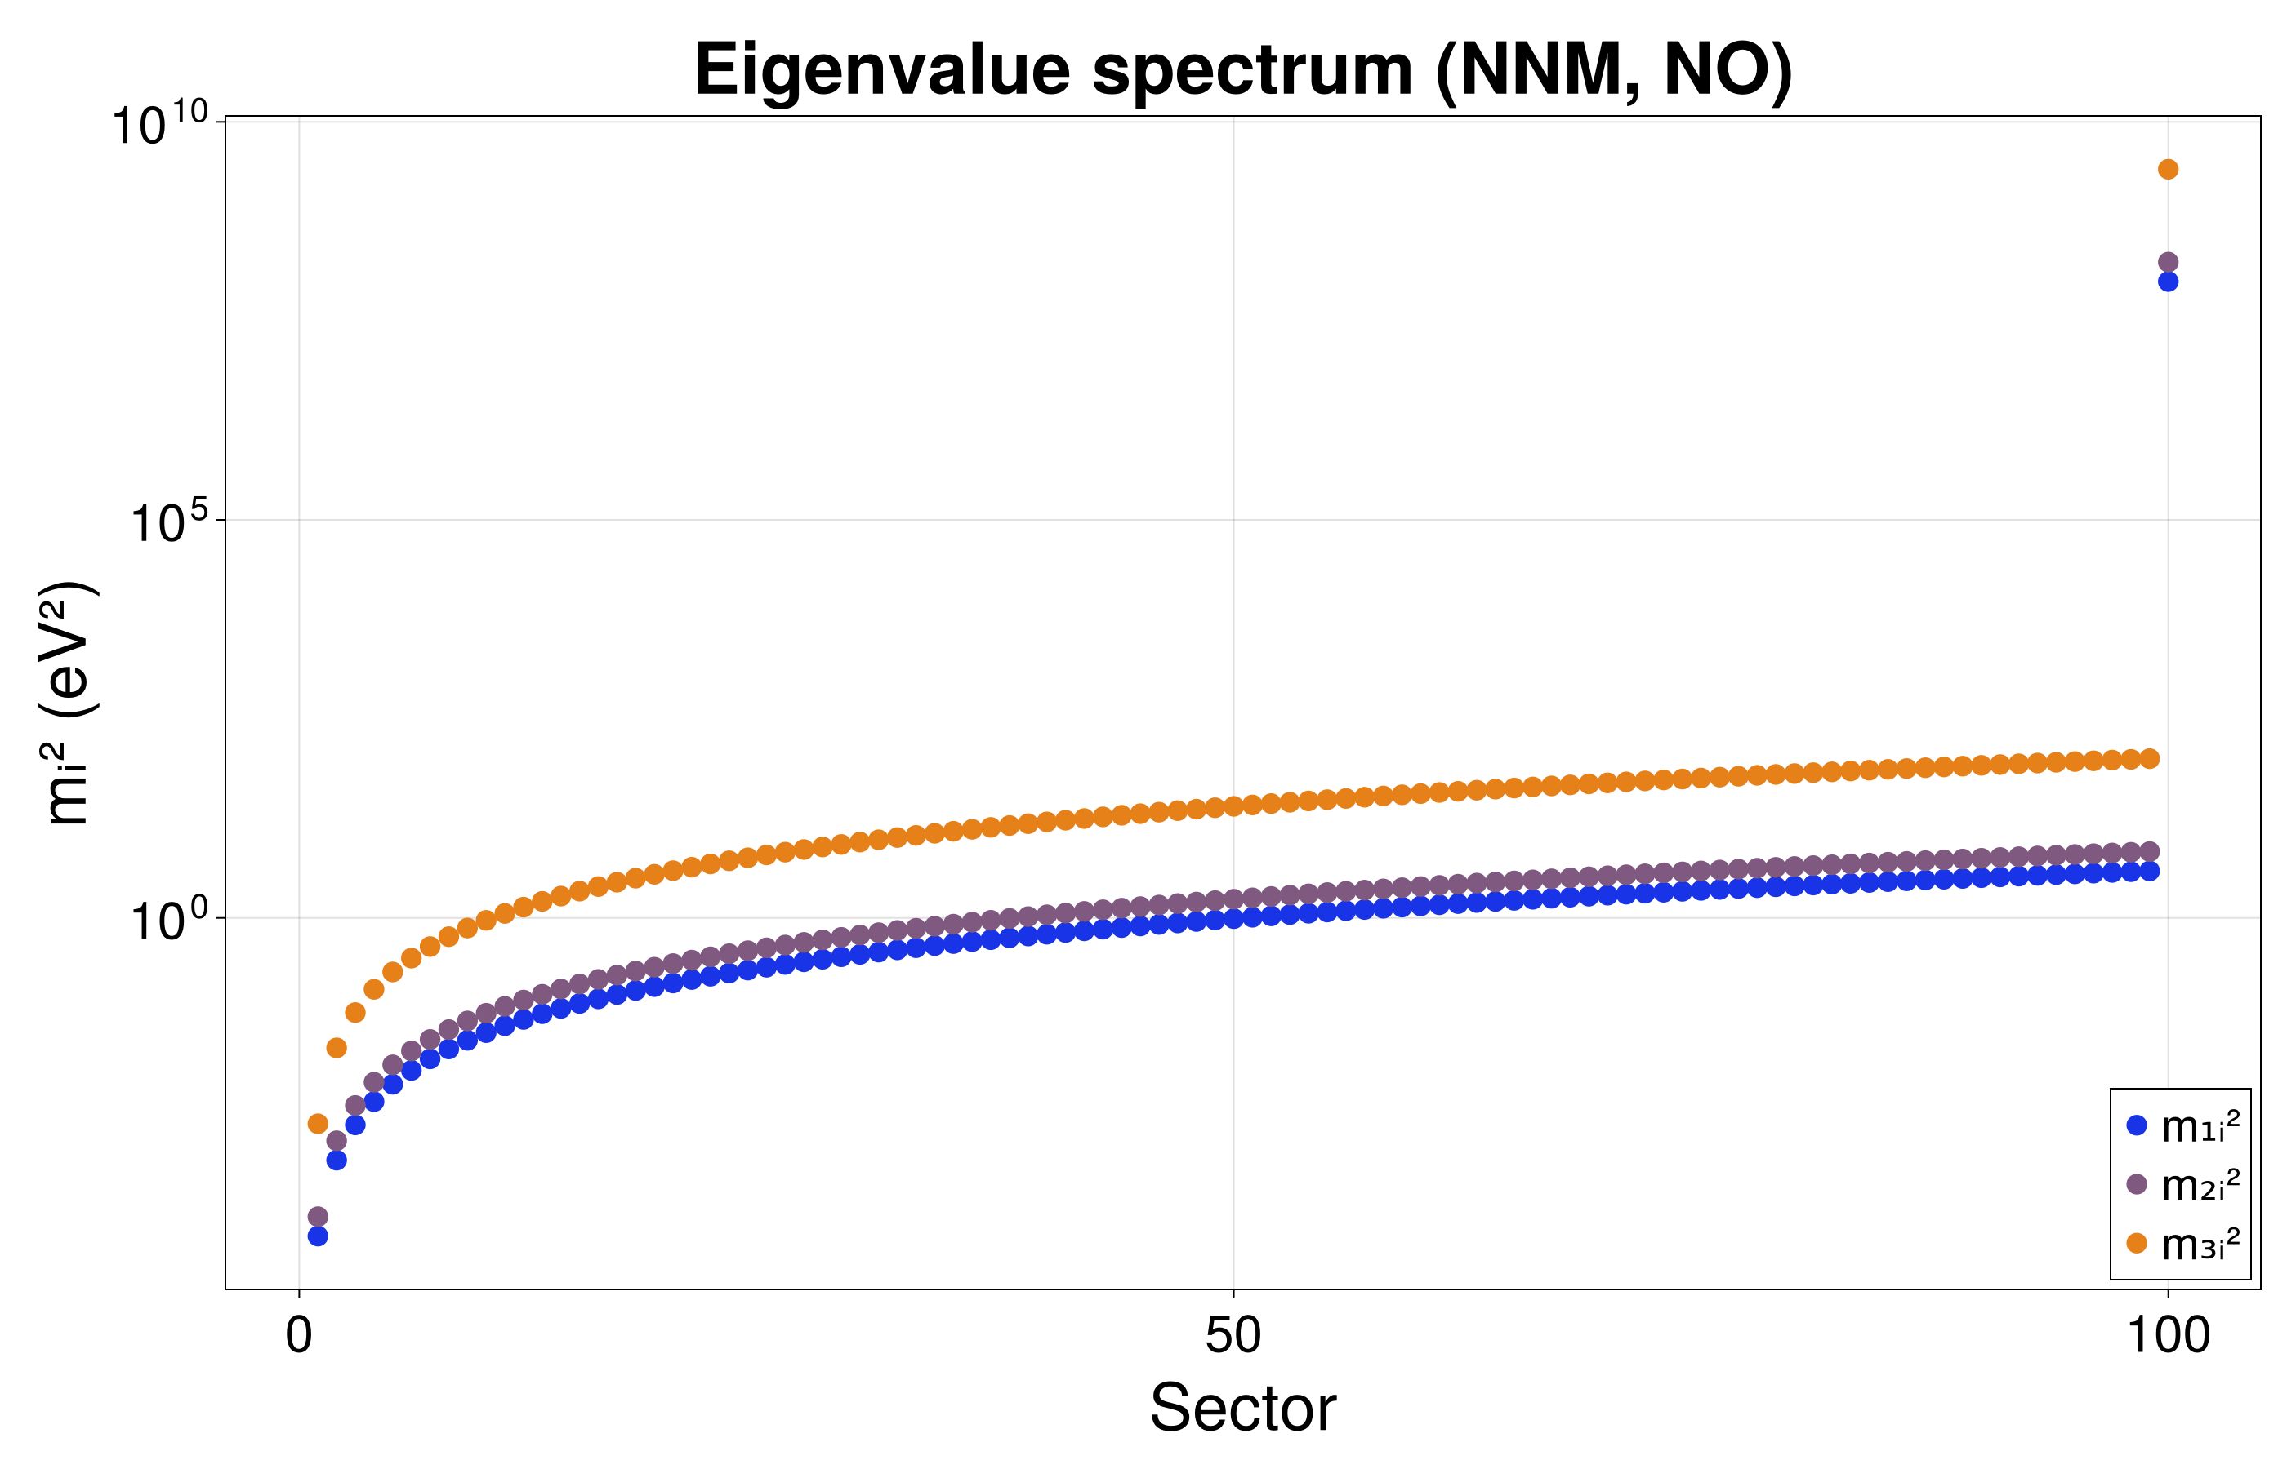


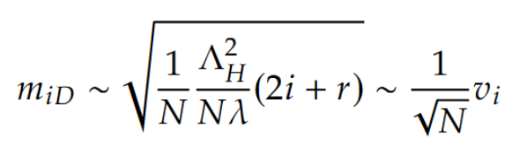
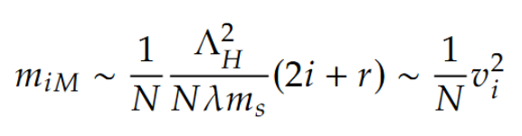
N-Naturalness and Neutrinos
In every sector, there is a right-handed neutrino that can interact with other sectors
Mass term mixes all sectors and produces a neutrino tower
Dirac
Majorana
Mass matrix
Neutrino masses

Slide 10
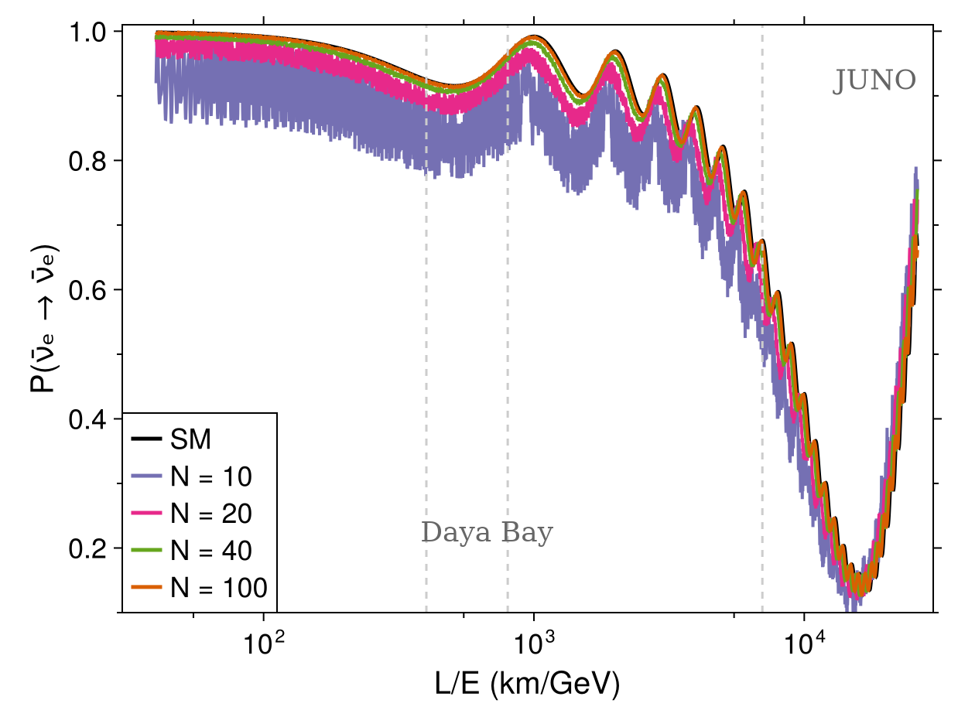
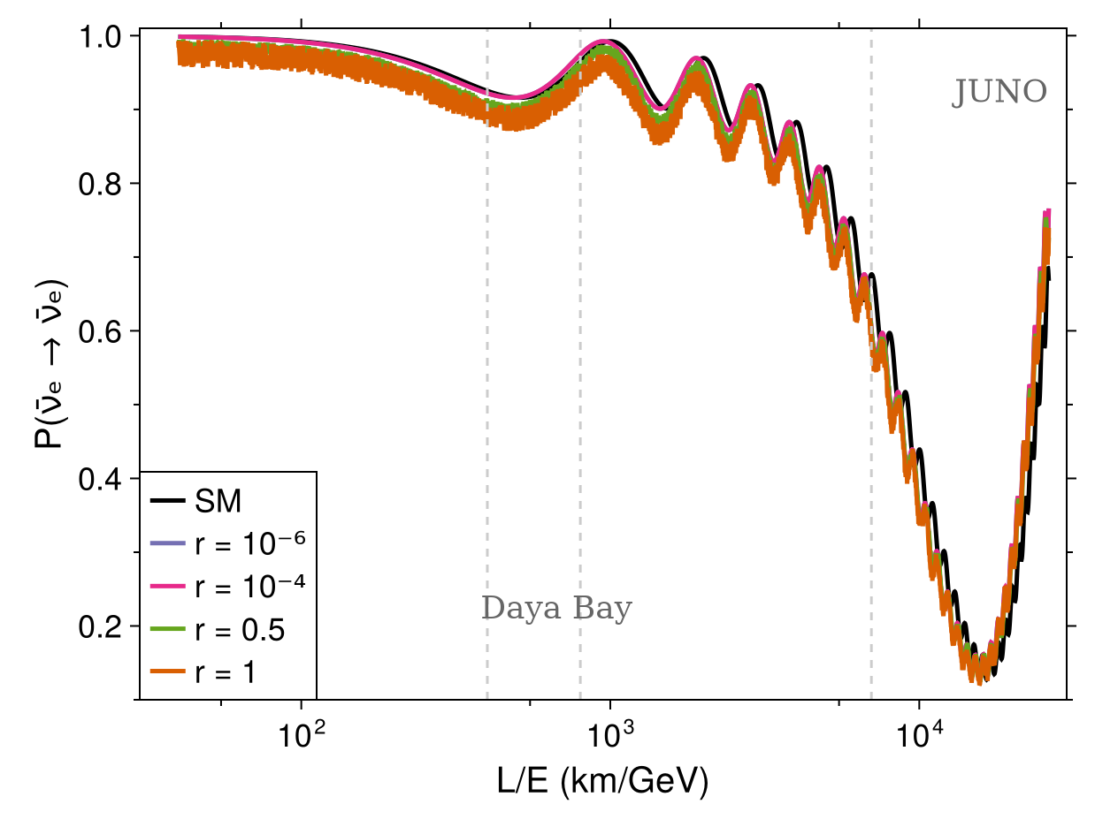
SIGNATURE IN OSCILLATIONS

Slide 11

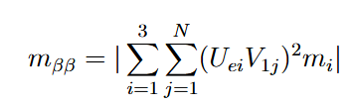
Signature in Mass Scale
N-Naturalness modifies the estimation for the effective mass of the neutrino
We can use the neutrinoless double beta decay 0𝜈𝛽𝛽 half-life time to get an estimate for the effective Majorana mass
Effective Majorana mass
SM:
NN:

Slide 12
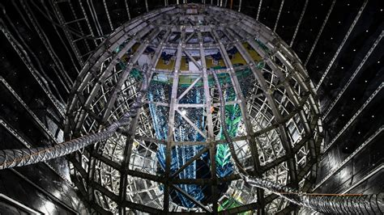
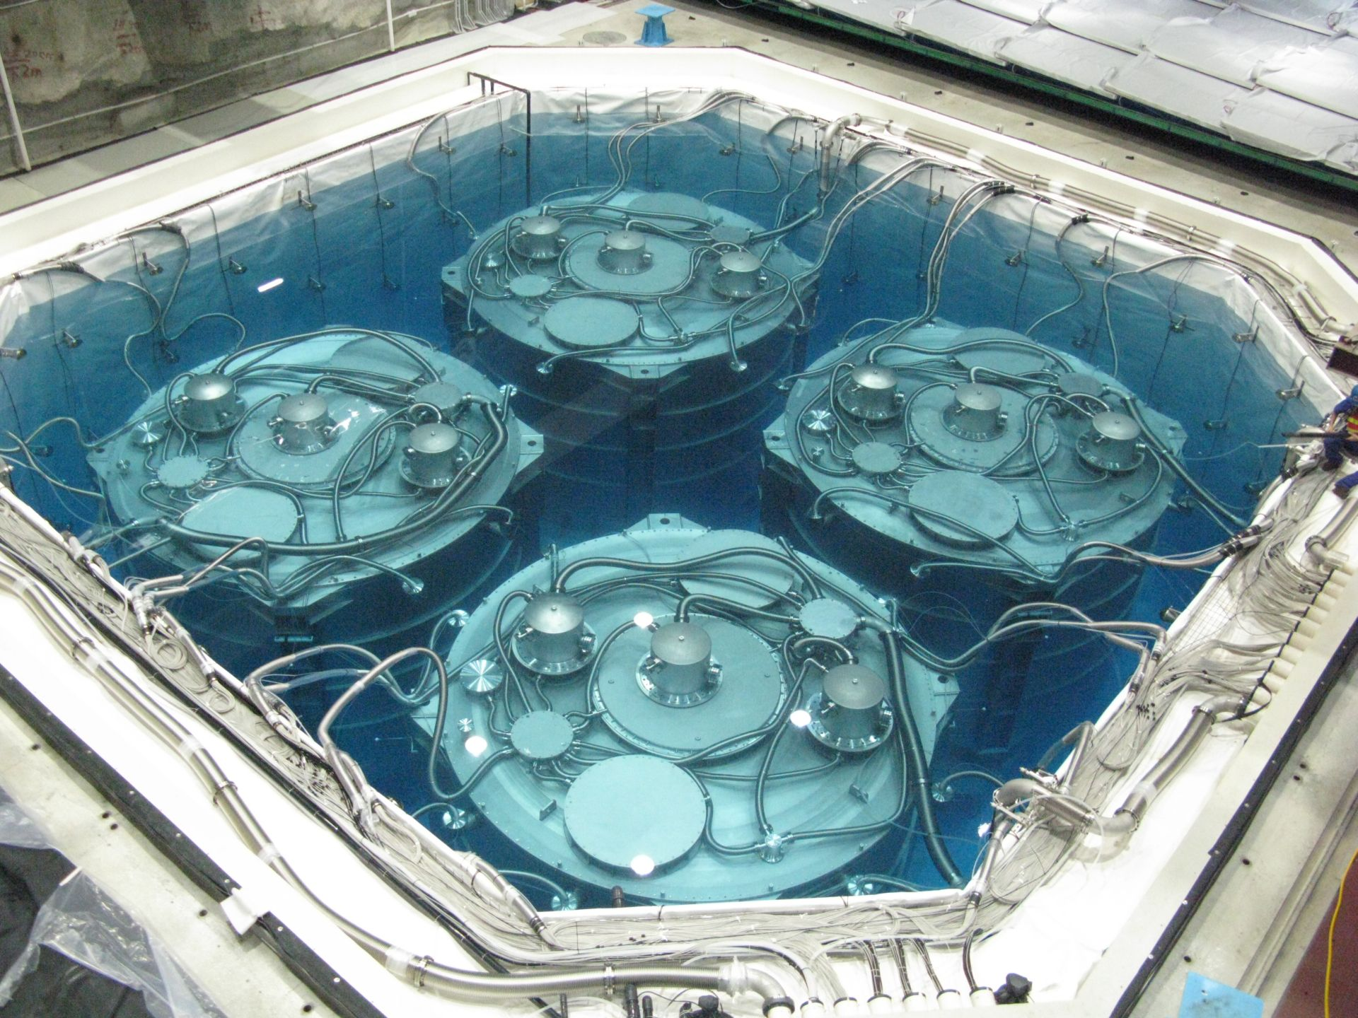
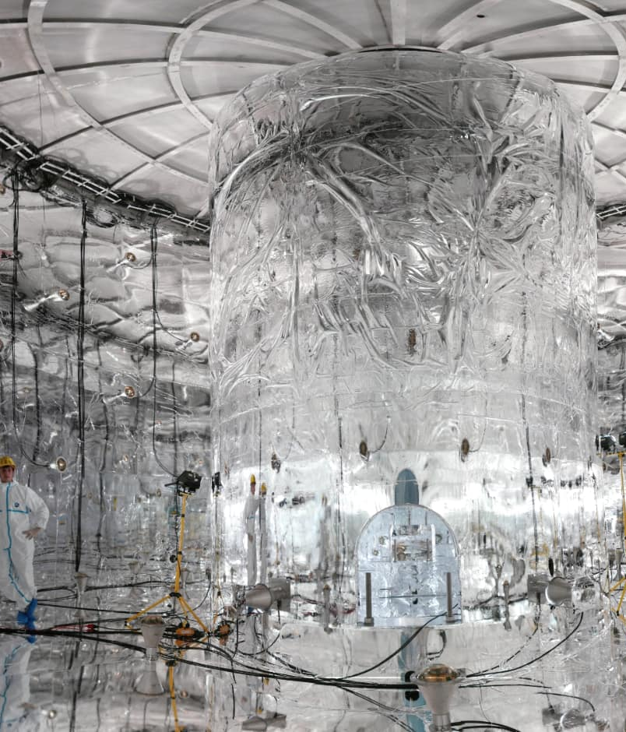
experiments
JUNO
Build a forward model for each experiment in Newtrinos.jl
Include all the backgrounds and systematics
From theoretical models to realistic predictions
Compare them with the public data provided
DAYA BAY
GERDA - LEGEND
12

Slide 13
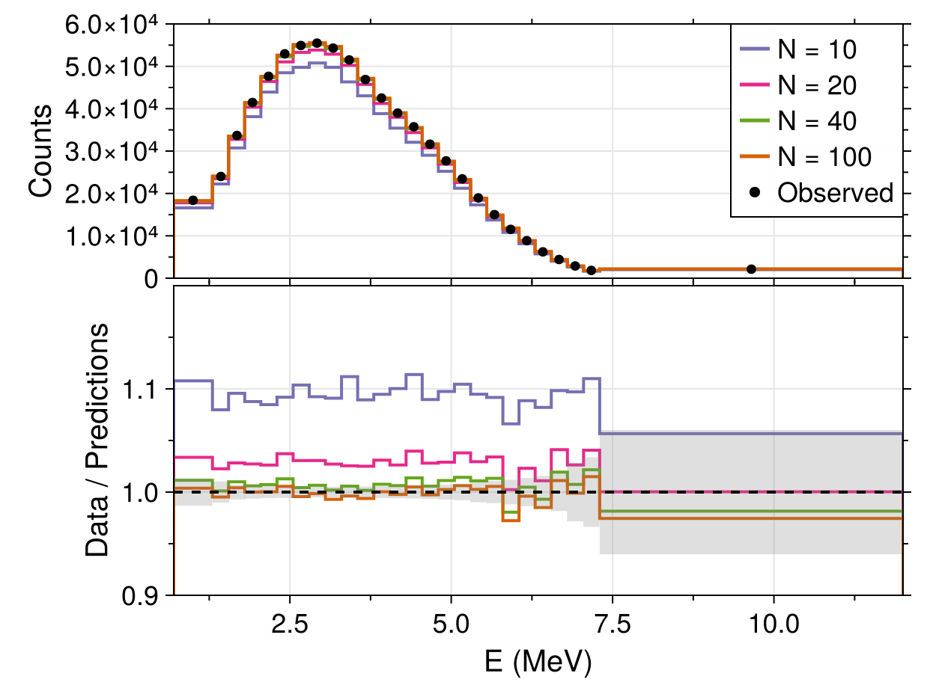
Analysis
For oscillations:
  Fitting of the model predictions to the public data
For effective mass:
  Fitting of the model mass prediction with the limit given by the experiment
  It is a point-like comparison

Slide 14
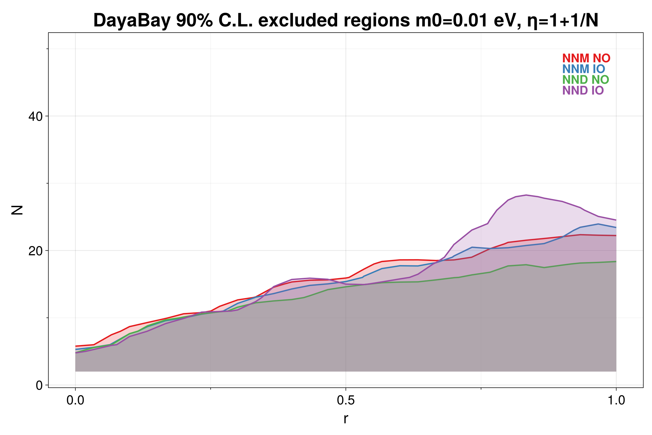
Scan over parameters r & N
The 90% C.L. excluded regions are computed
For each model and ordering
For each experiment, singularly and as a global fit

Slide 15
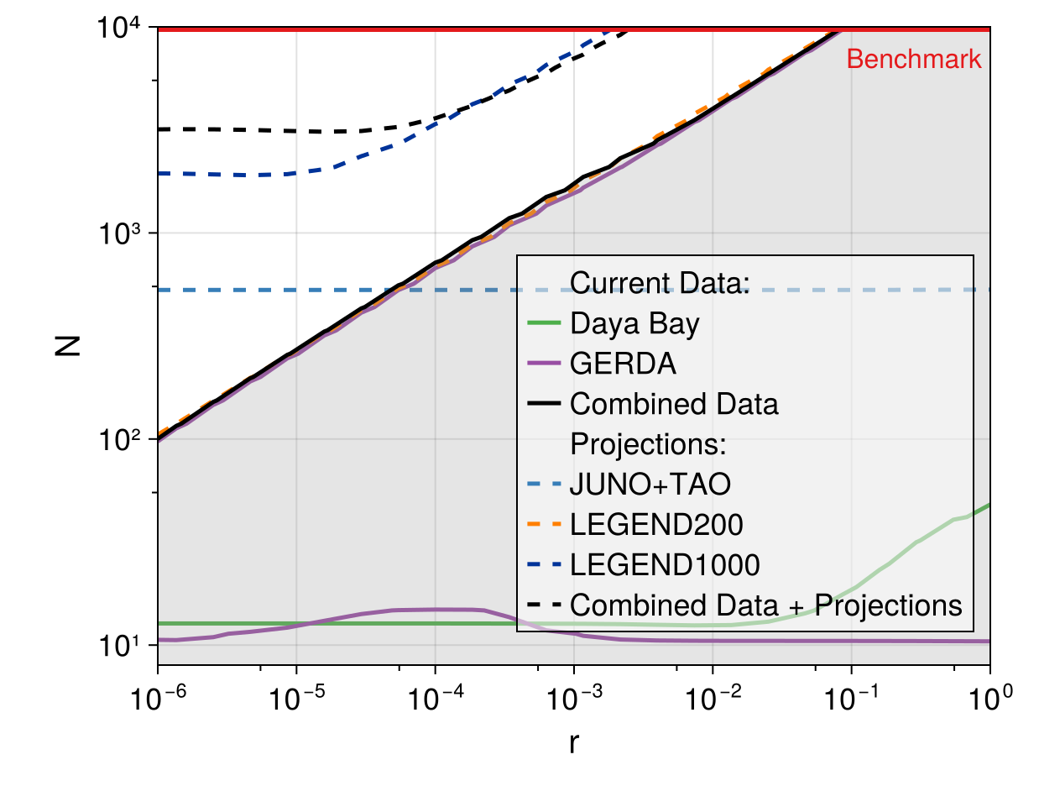
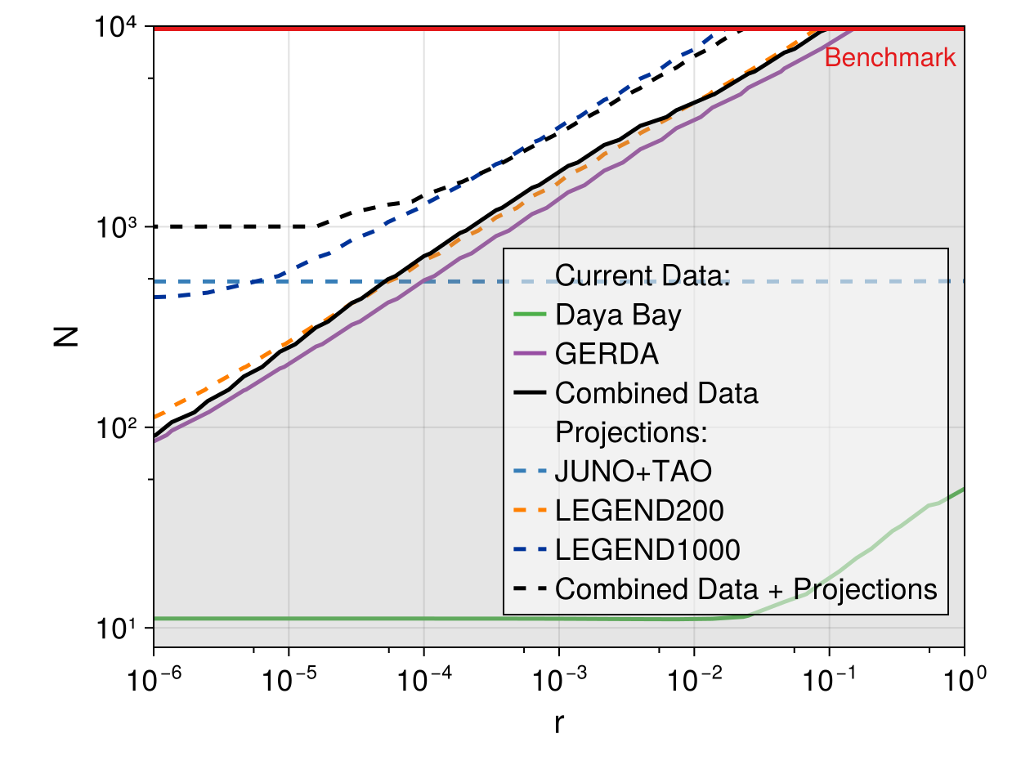
Results for MAJORANA case

Slide 16
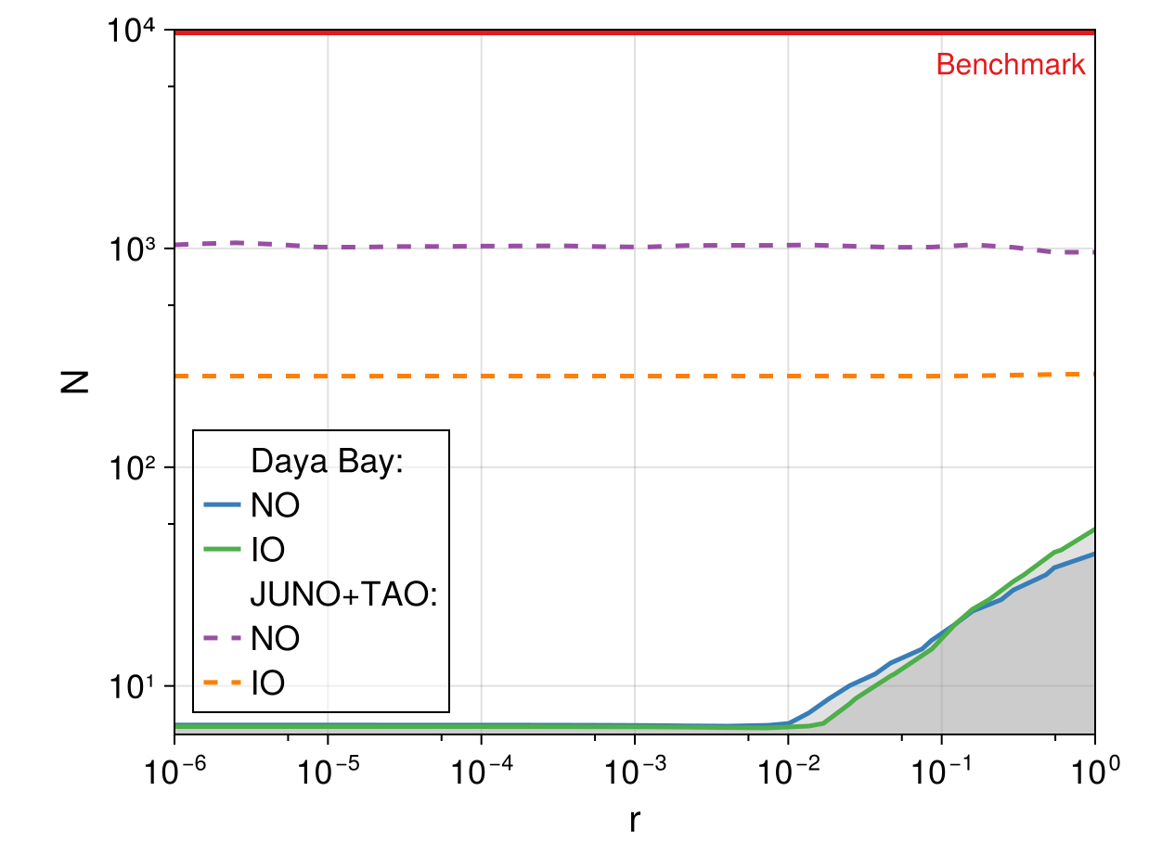

Results FOR DIRAC case

Slide 17
Conclusions
We exclude non-fine-tuned scenarios with N=10⁴ and r=1 in the Majorana case NO and IO (benchmark of the theory)
In the Dirac case we exclude non-fine-tuned scenarios only up to N~50
We set the first bounds on N and r from the public data of neutrino experiments

Slide 18
Thank you for your attention!
Time for questions

Slide 19
Backup

Slide 20
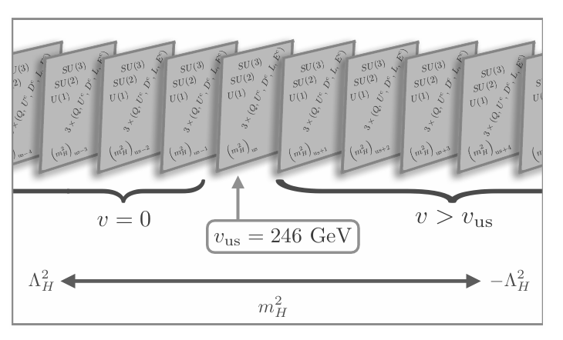

N-Naturalness theory – The mechanism
N sectors with varying Higgs mass parameter in [-Л_{H}², + Л_{H}²]
The Higgs mass is suppressed by N
r parameter measures the fine-tuning (r=1 non fine-tuned)
10^4 GeV (SUSY)
The effective scale of gravity is lowered
10^19 GeV
10^2 GeV
10^4

Slide 21
Why are we exactly in sector 0?
A cosmological mechanism populates mainly the sectors with a lower Higgs mass
Reheaton field couples to all sectors equally and decays
The branching ratio is inversely proportional to the Higgs mass
Different model for the reheaton (scalar, fermion, with additional heavy leptons)
The mass must be small (~1-100 GeV)

Slide 22
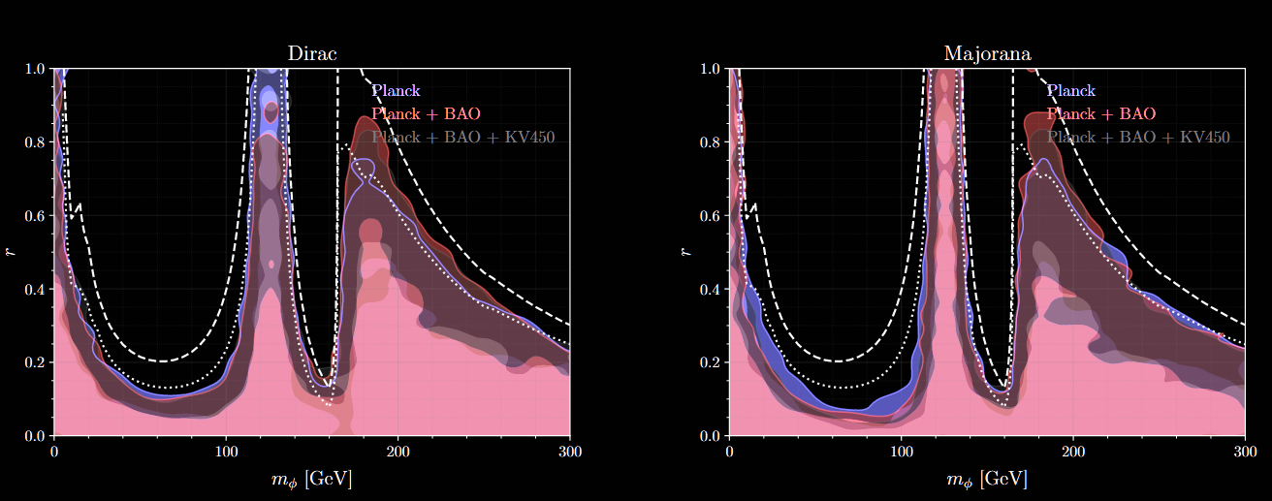
Signatures IN cosmology
New photon-like species and new neutrino-like species can be detected through the CMB and in LSS data

Slide 23
Other Signatures
Reheaton direct production or through Higgs decay in colliders is very suppressed
Signatures heavily dependent on the reheaton model (vector-like lepton)
If N ~10^4, supersymmetry or new physics should appear at 10 TeV

Slide 24
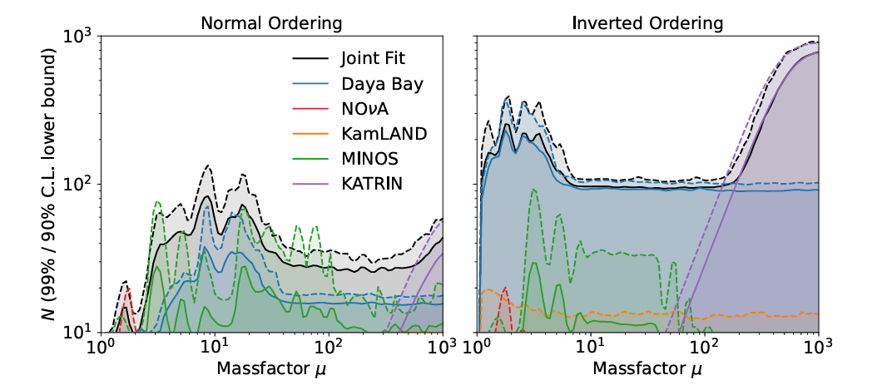
Similar work – Many copies

Slide 25
Newtrinos.jl - The framework
Experiments
Daya Bay
Minos
Kamland
NOvA
T2K
IceCube Deepcore
Katrin
Gerda
Juno-Tao
Legend
Physics (oscillations/mass models)
Experiments (forward models)
Analysis (profiled likelihood)
Available on Github:
Newtrinos.jl

Slide 26
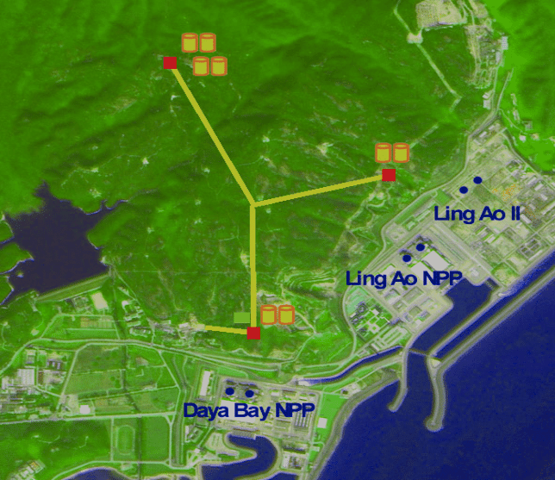
Daya Bay
Reactor Neutrino experiment in China
6 nuclear reactor cores and 8 detectors (4 near and 4 far)
Baseline of 1.6 km
Energy range [1,10] MeV
It detects electron antineutrino oscillations
Mostly sensitive to θ₁₃ and Δm²₃₁

Slide 27
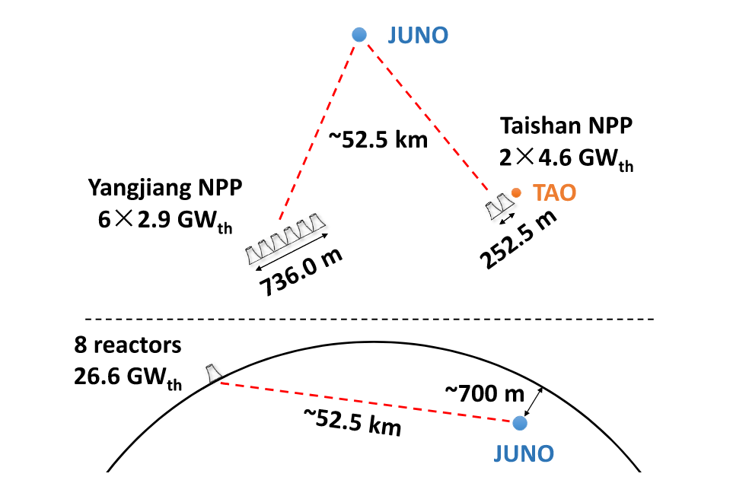
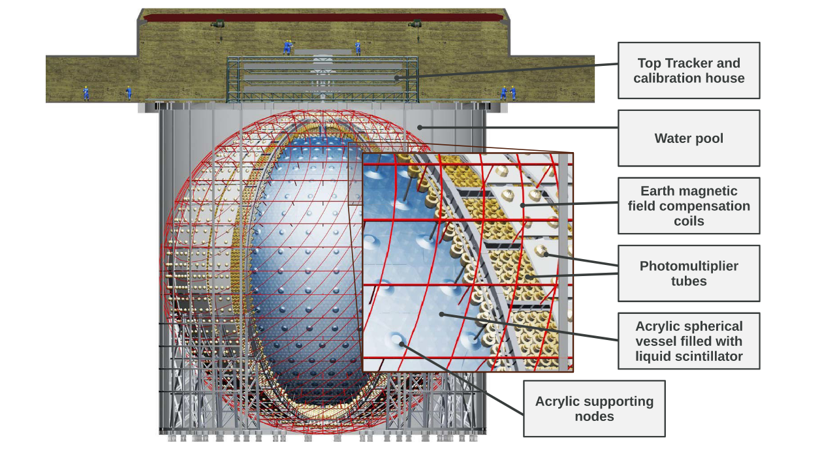
JUNO-Tao
Reactor Neutrino experiment in China
It detects electron antineutrino
8 nuclear reactor cores and 2 detectors (TAO near and JUNO far)
Baseline of ~50 km
Energy range [1,10] MeV
Mostly sensitive to Δm²₃₁, Δm²₂₁, θ₁₂
Started its operation on the 26th of August

Slide 28
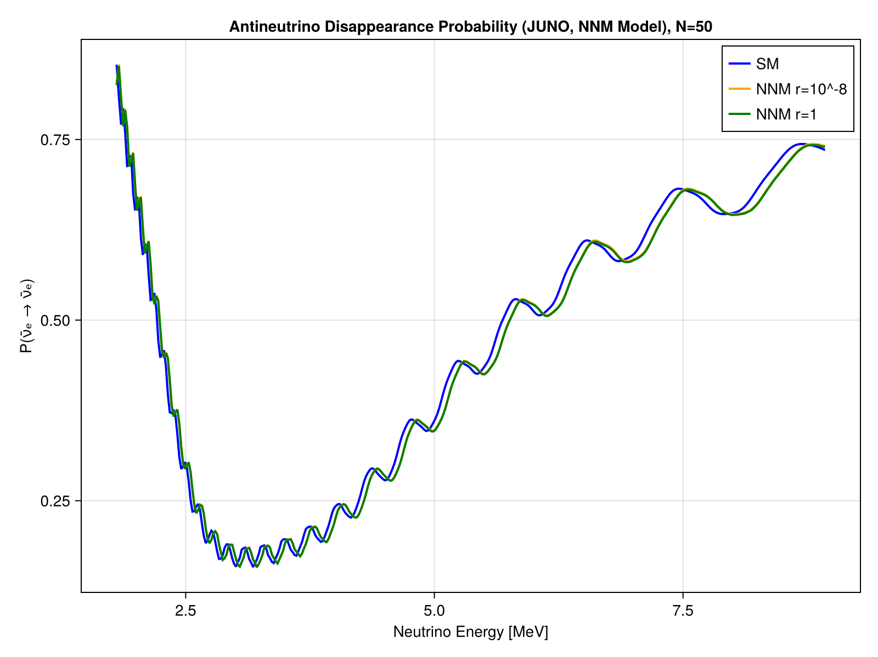
JUNO OSCILLATIONS PREDICTIONS

Slide 29
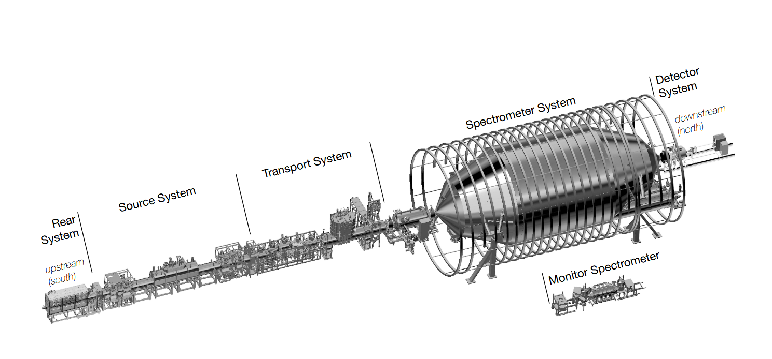
Katrin
Mass spectrometer
Measures the end-point of
the electron spectrum from
ϐ decay of Tritium
The latest result given by Katrin in 2025 is the upper limit 𝑚𝜈 < 0.45 eV at 90% C.L.
Can in principle also be used but it would require a full spectrum analysis

Slide 30
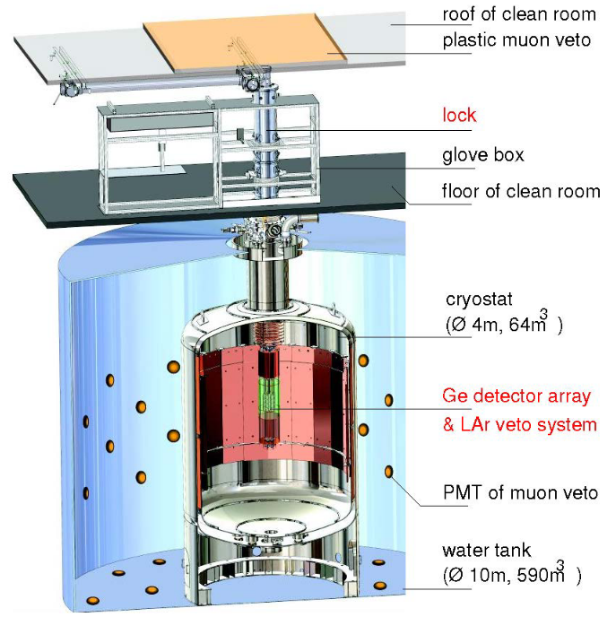
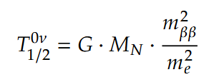
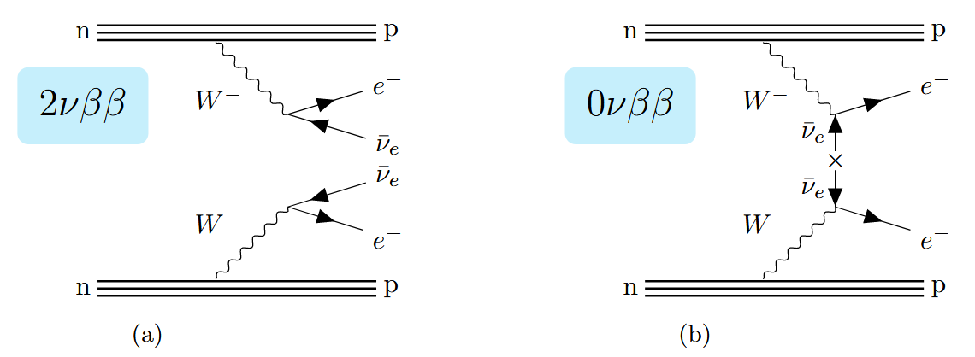
GERDA - LEGEND
Looks for neutrinoless double 𝛽-decay 0𝜈𝛽𝛽 of 76Ge
All the energy is carried away by the electrons: a very distinct peak at the 𝑄𝛽𝛽 energy
Measure of half-life time
𝑇 ≥ 1.8 · 1026 yr 90% C.L. and
𝑚𝛽𝛽 < 79 –180 meV at 90% C.L.

Slide 31
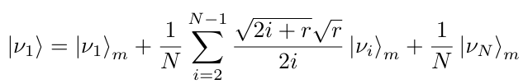
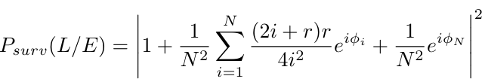
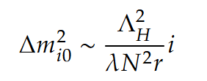
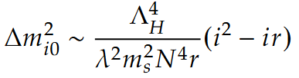
Signatures in Oscillations
The neutrino of our sector can oscillate into the ones of other sectors
The mass squared differences scale differently for Dirac and Majorana
Dirac
Majorana

Slide 32
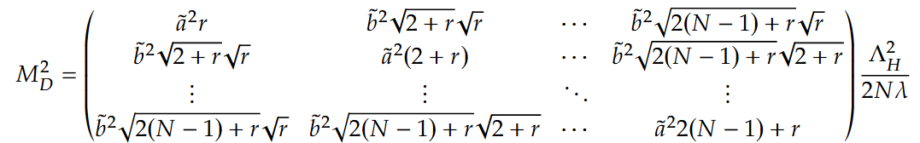
Parametrising the mass matrix
We need neutrino masses, mass splittings and mixing matrices
intra-sector coupling
energy cutoff
fine-tuning
Higgs self-coupling
inter-sector coupling
# sectors

Slide 33


Generalisation to a realistic three-flavour scenario 3 matrices
We want to constrain N and r
3 flavours have different couplings a and b 10 free parameters
Parameters to fix:
3 available constraints:
The perturbation approach used in the analytical solution is suboptimal

Slide 34

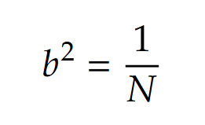
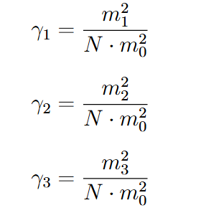
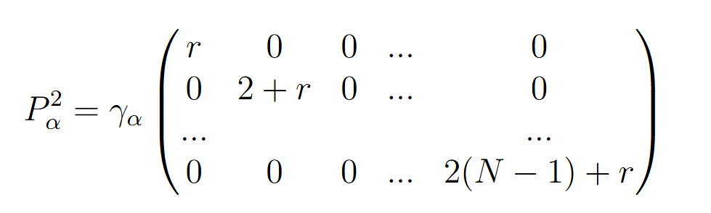

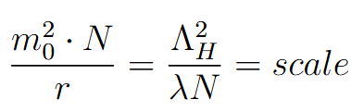
Perturbation approach
Unperturbed, a=b
+
Perturbation, depends on (a-b) and so on the flavor
Assumptions

Slide 35
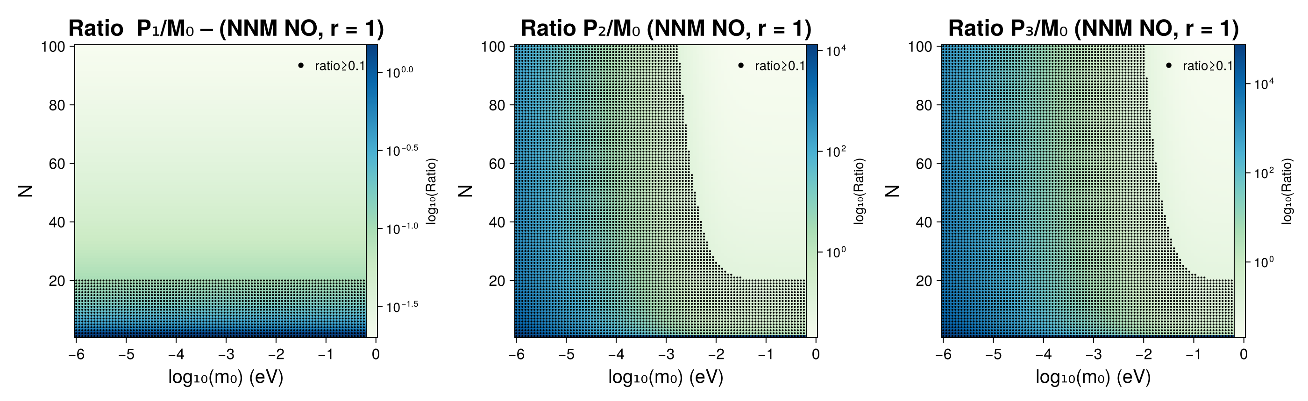
Perturbation limitation
Pertubation dependent on the flavors
Many assumptions to fix the parameters

Slide 36
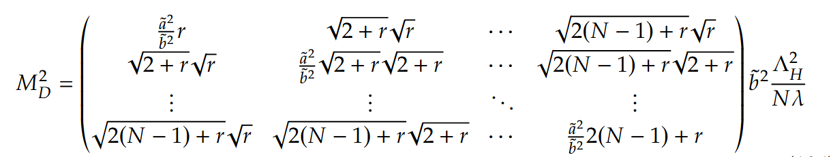
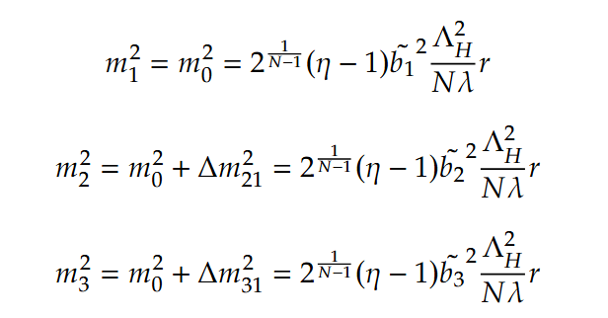
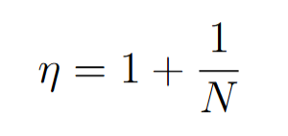
Full matrix approach
η
Overall factor
η is the same for all the three flavors
The overall factors are proportional to the absolute masses

Slide 37
Full matrix approach
The overall factors are are proportional to the three absolute masses
We find a more precise formula for mass eigenvalues

Slide 38
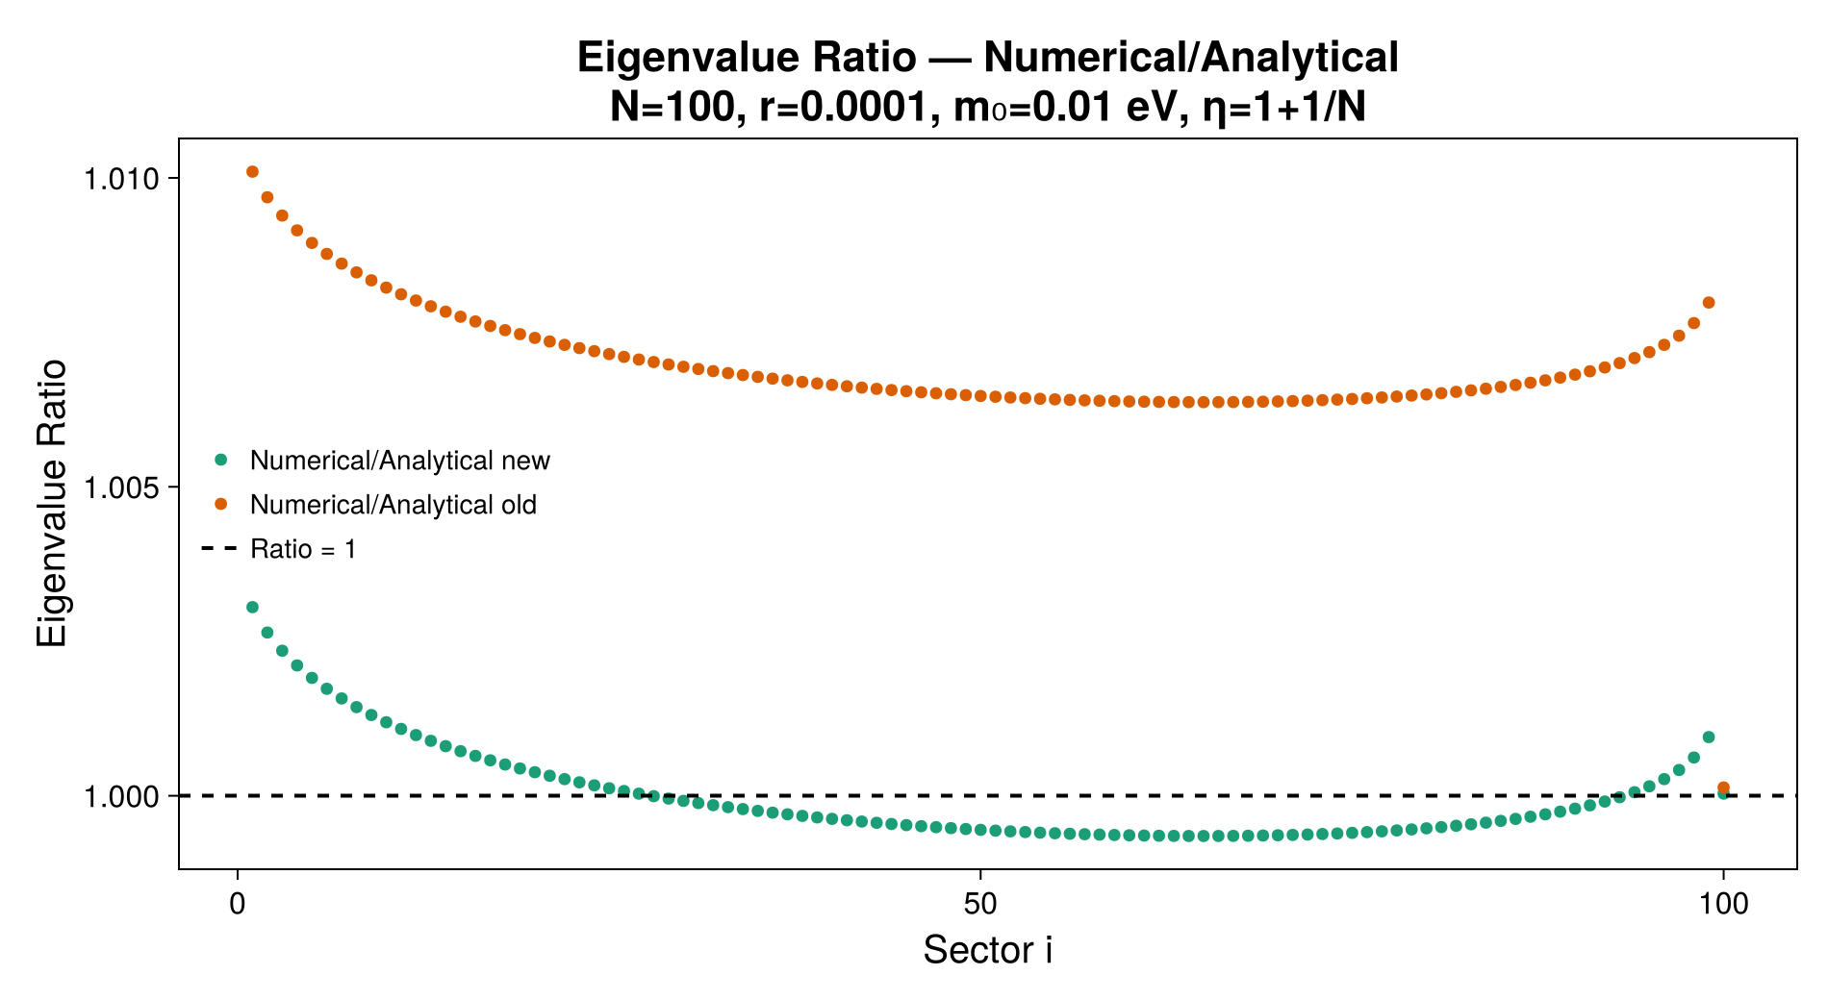
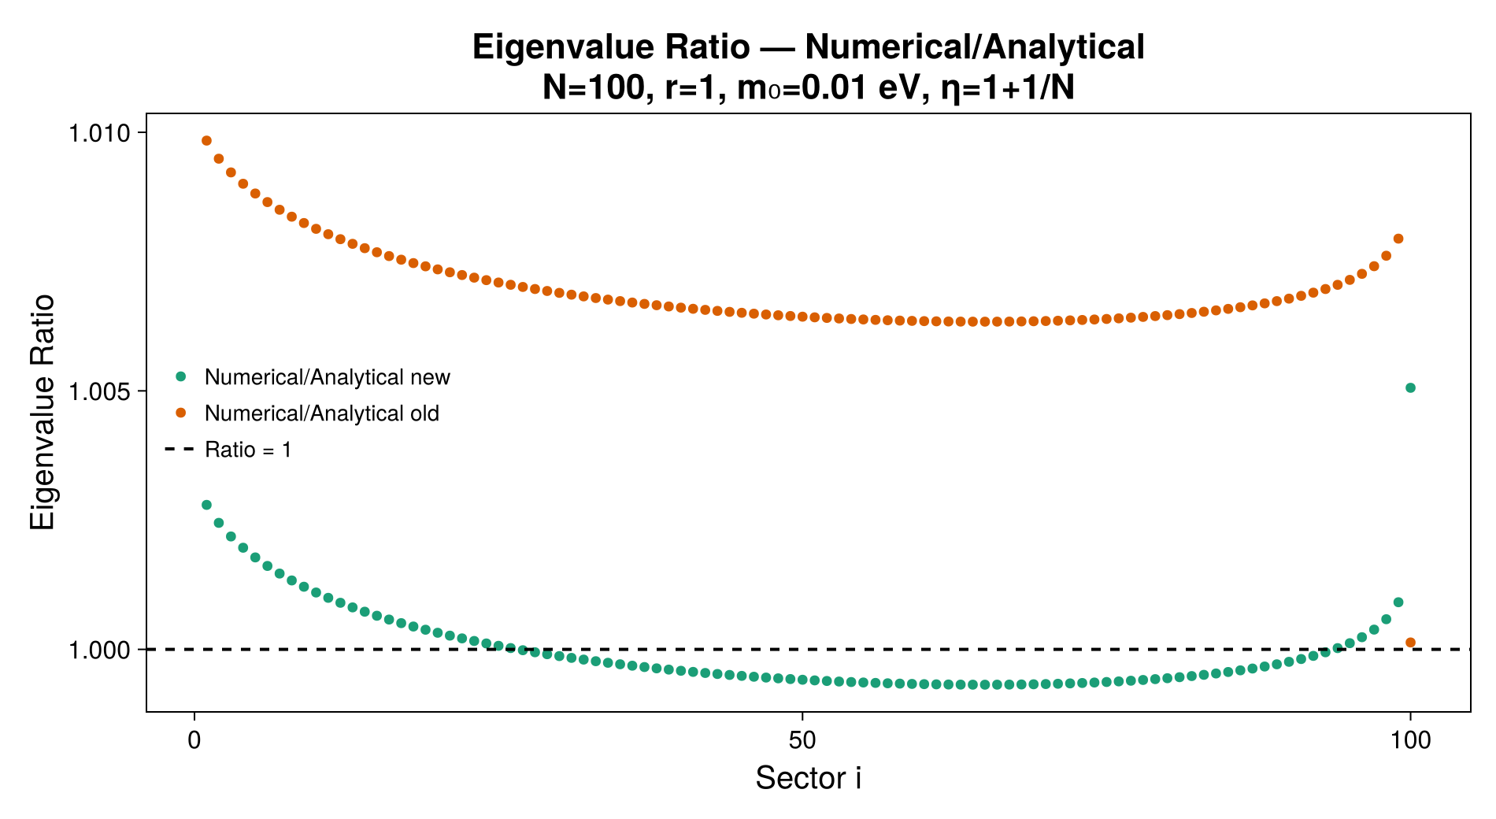
Full matrix eigenvalues
The new analytical formula gives eigenvalues closer to the numerical ones
Depending on r, the highest eigenvalue is more or less in agreement
We are mostly interested in the first eigenvalue because it is used to set the scale for the tower
The highest eigenvalue coefficient is calculated by diagonalising the matrix numerically

Slide 39
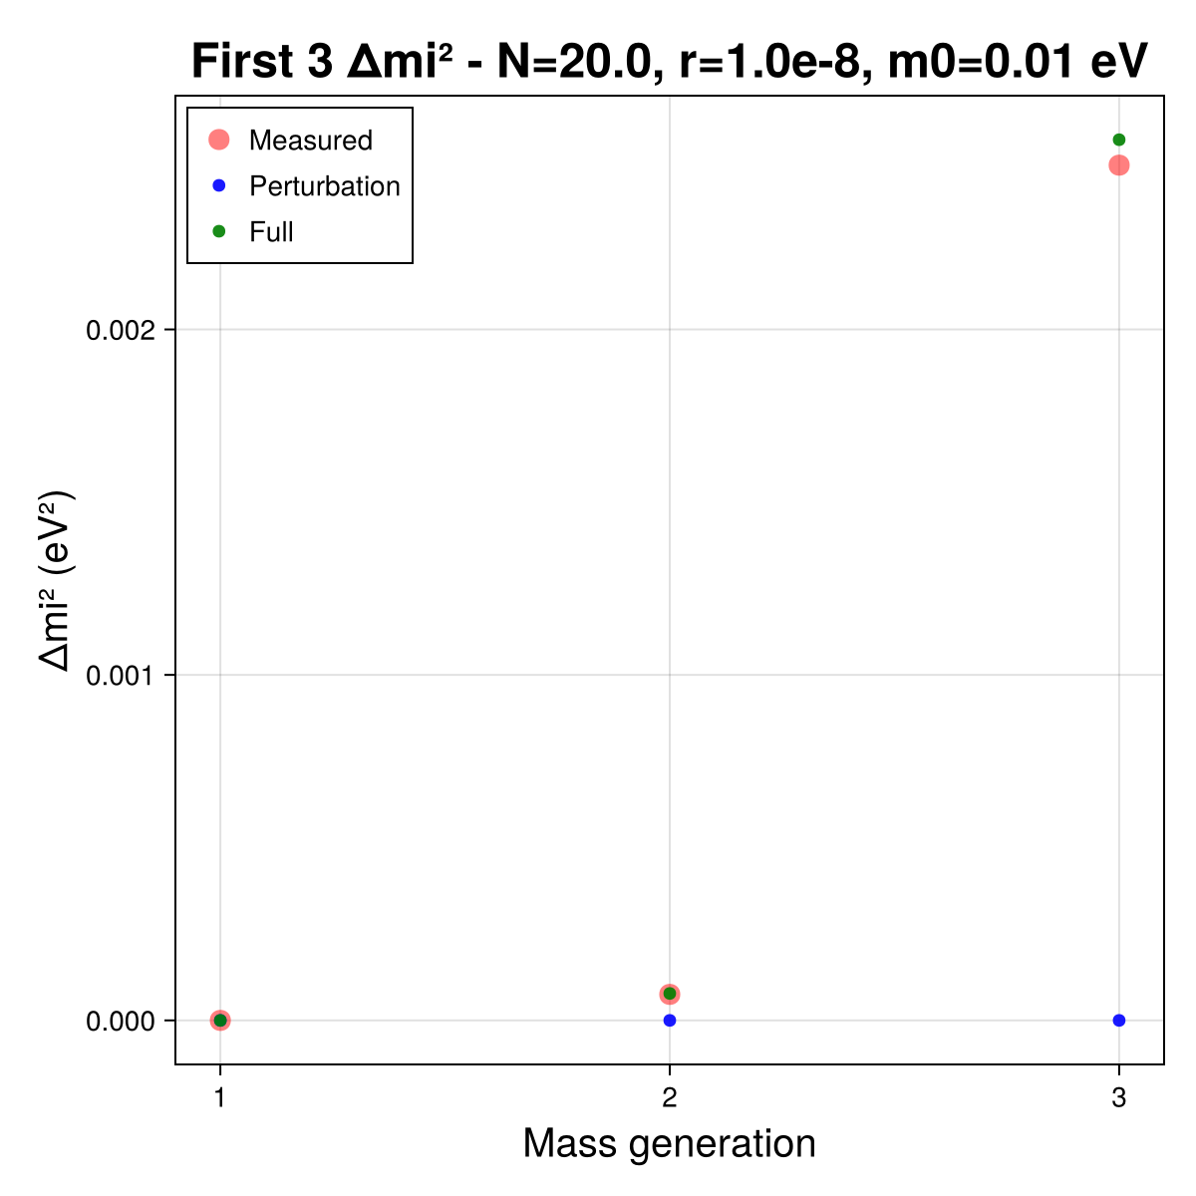
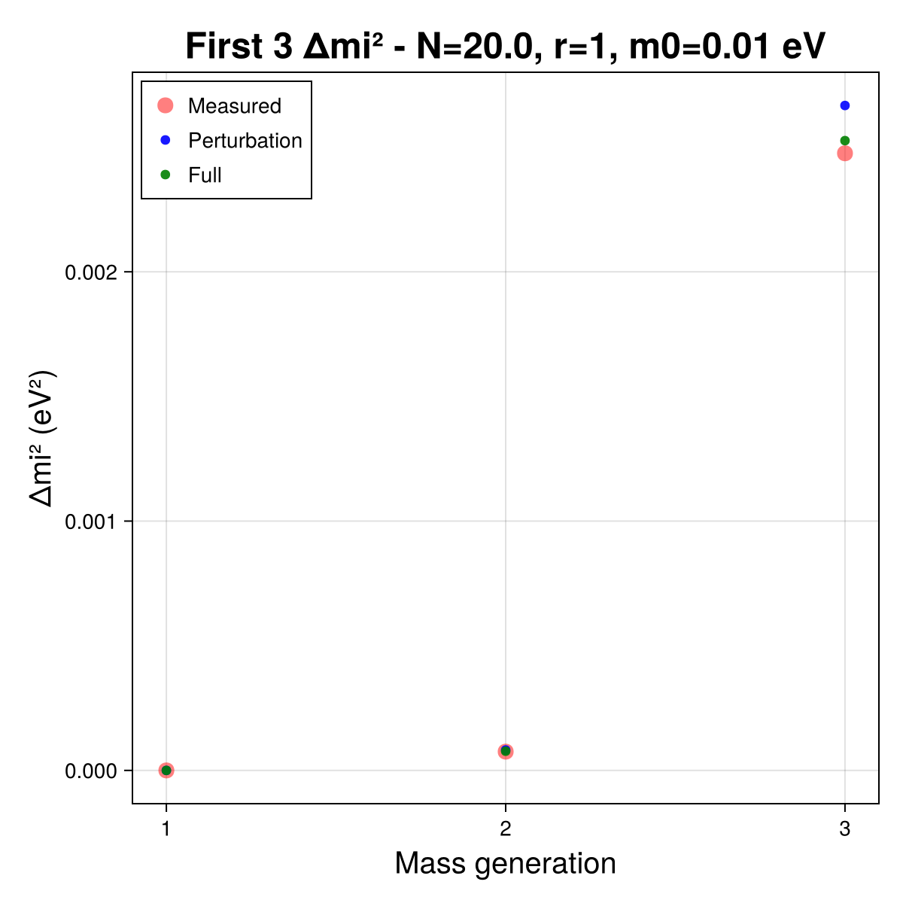
Comparison perturbation - full matrix

Slide 40
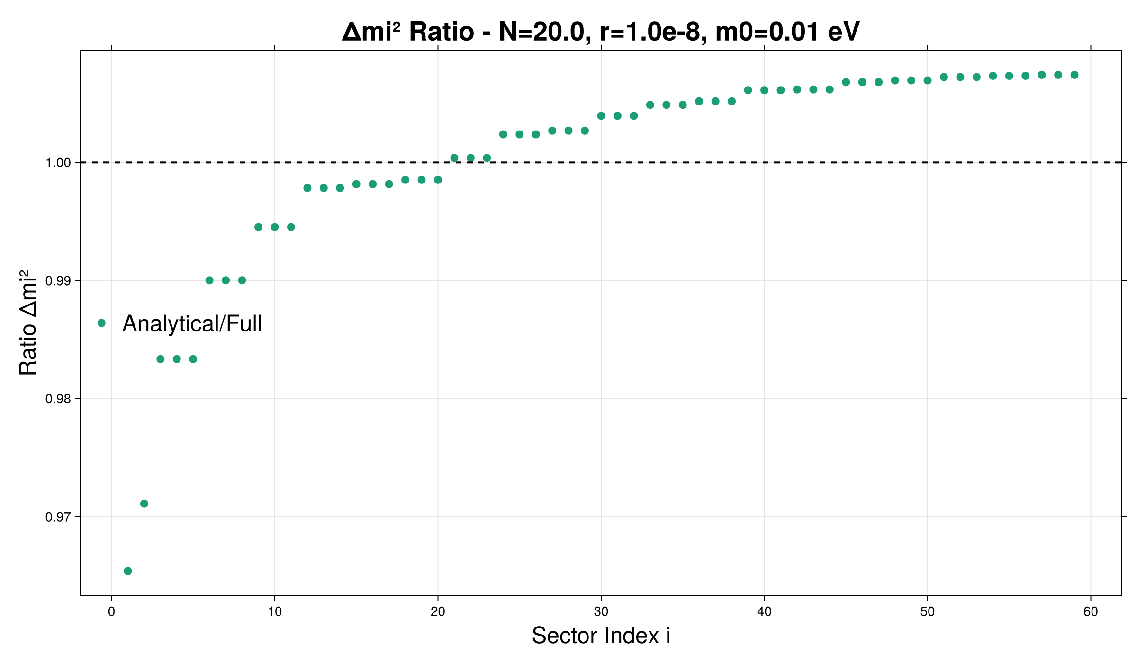
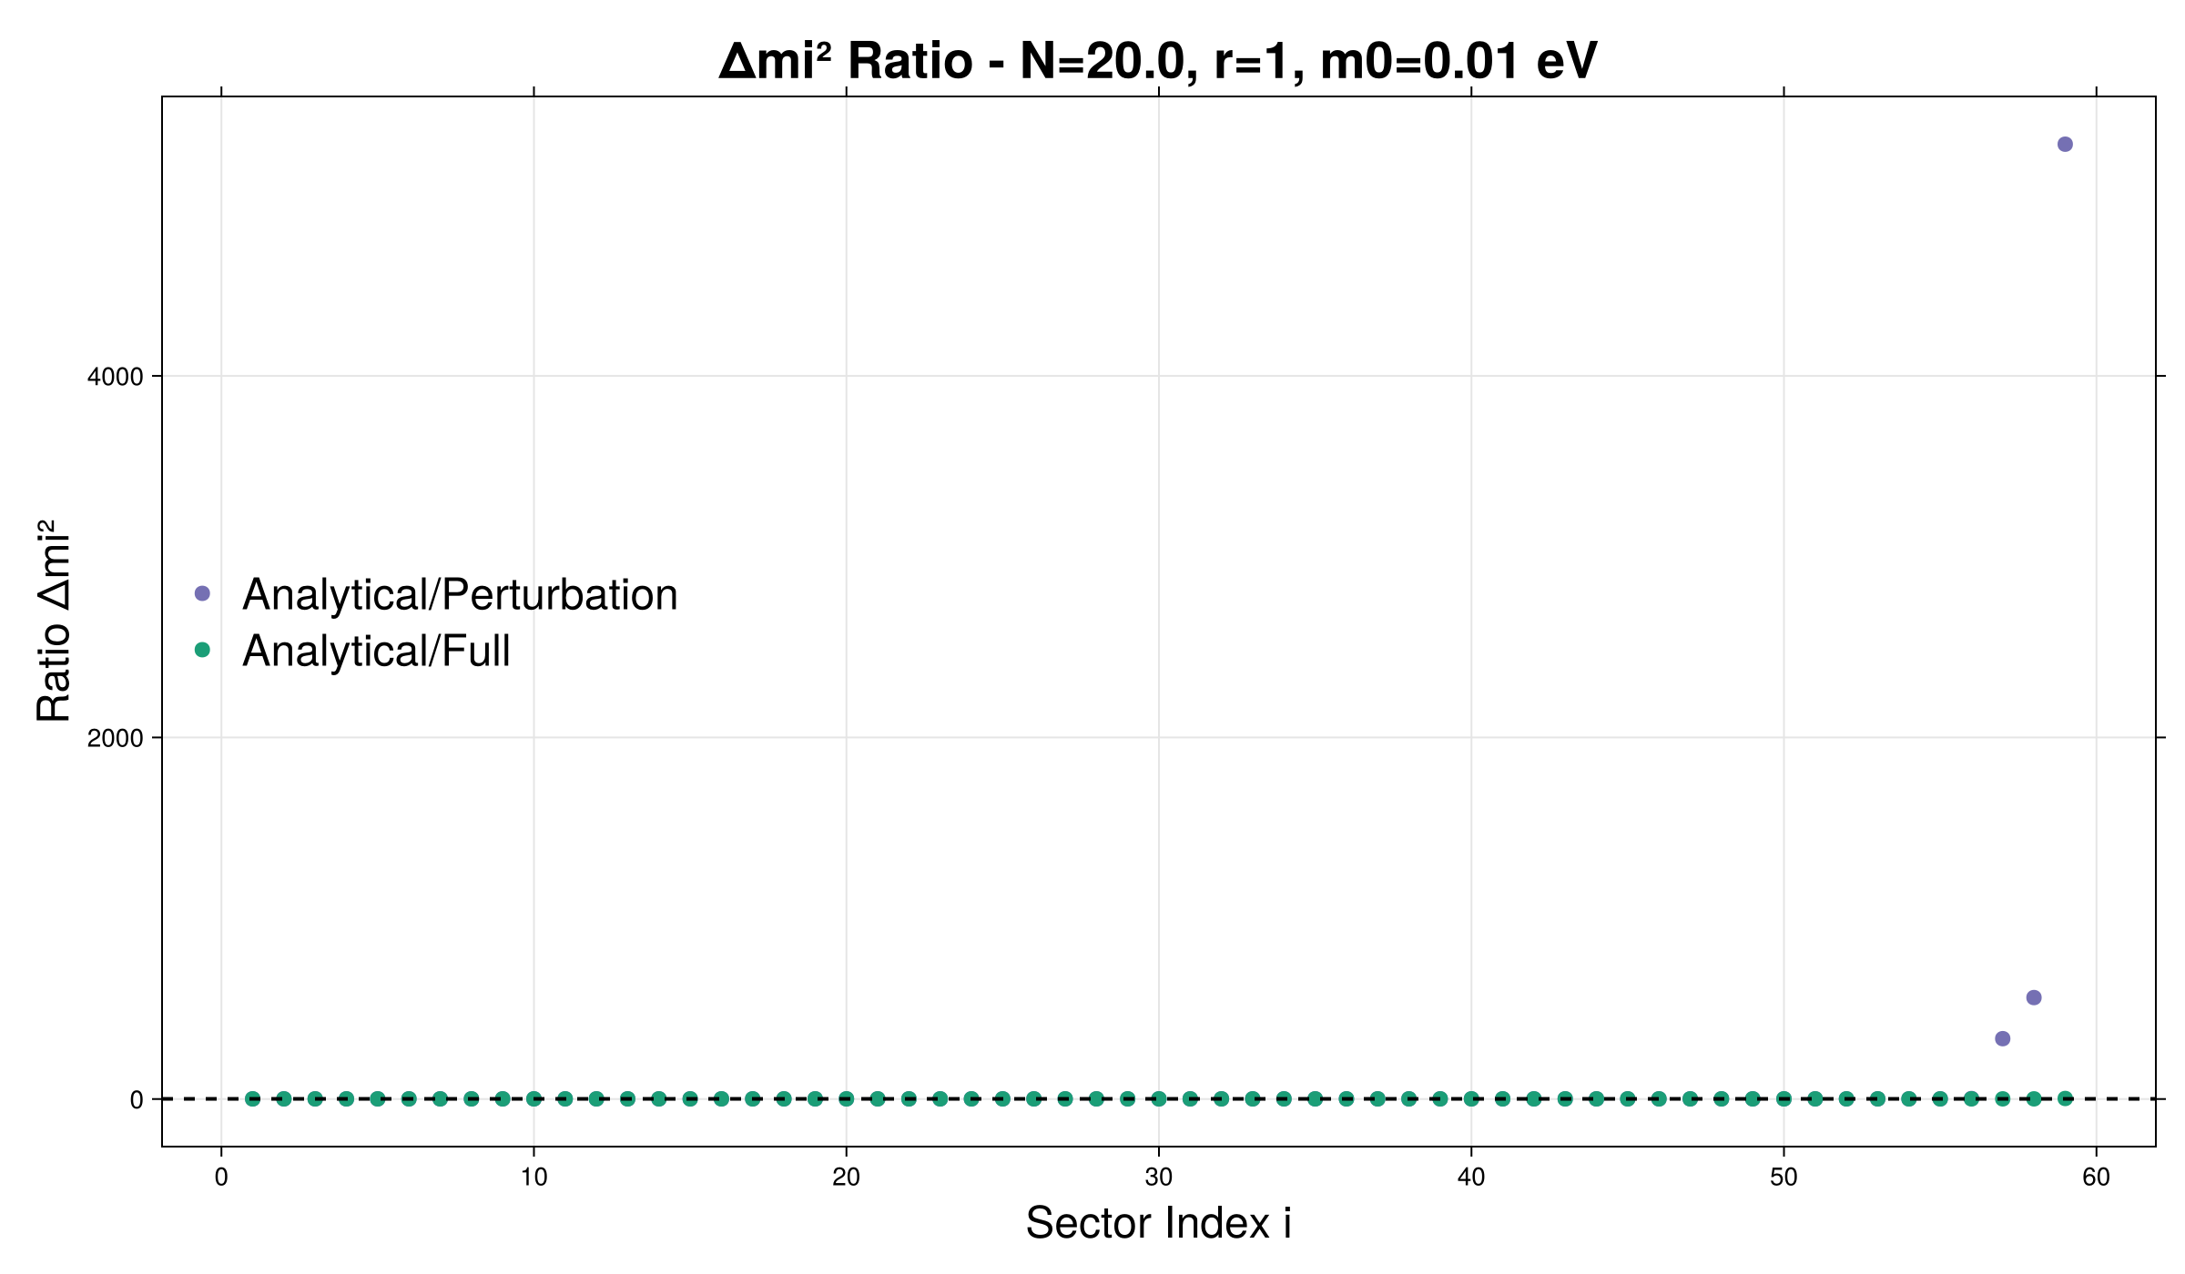
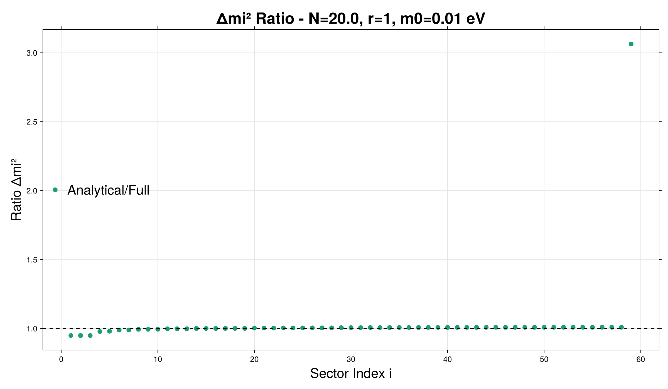
Comparison perturbation - full matrix

Slide 41
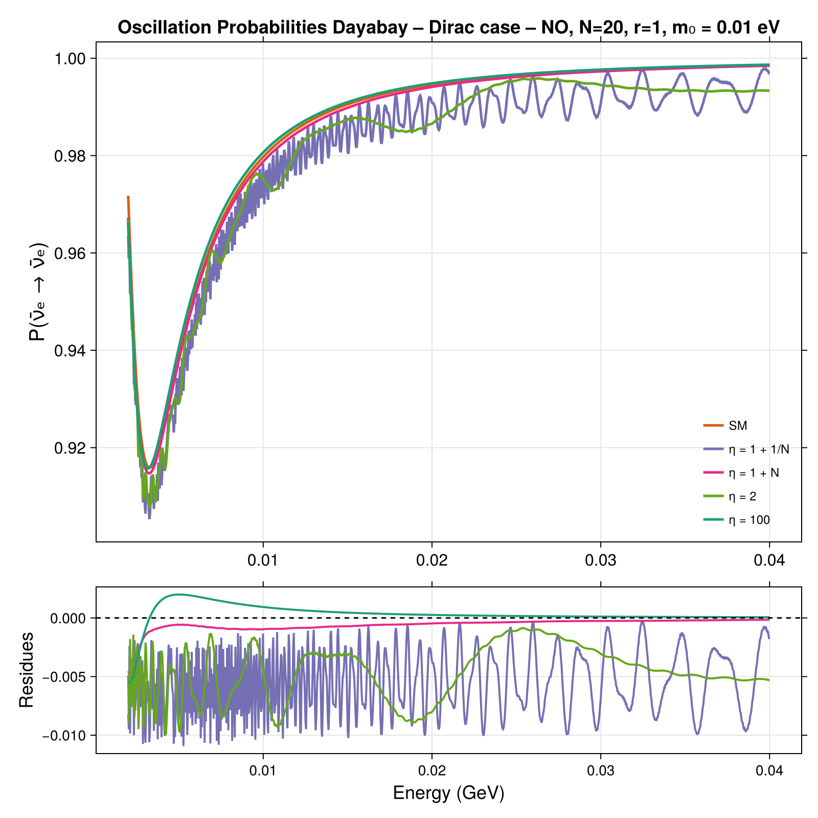
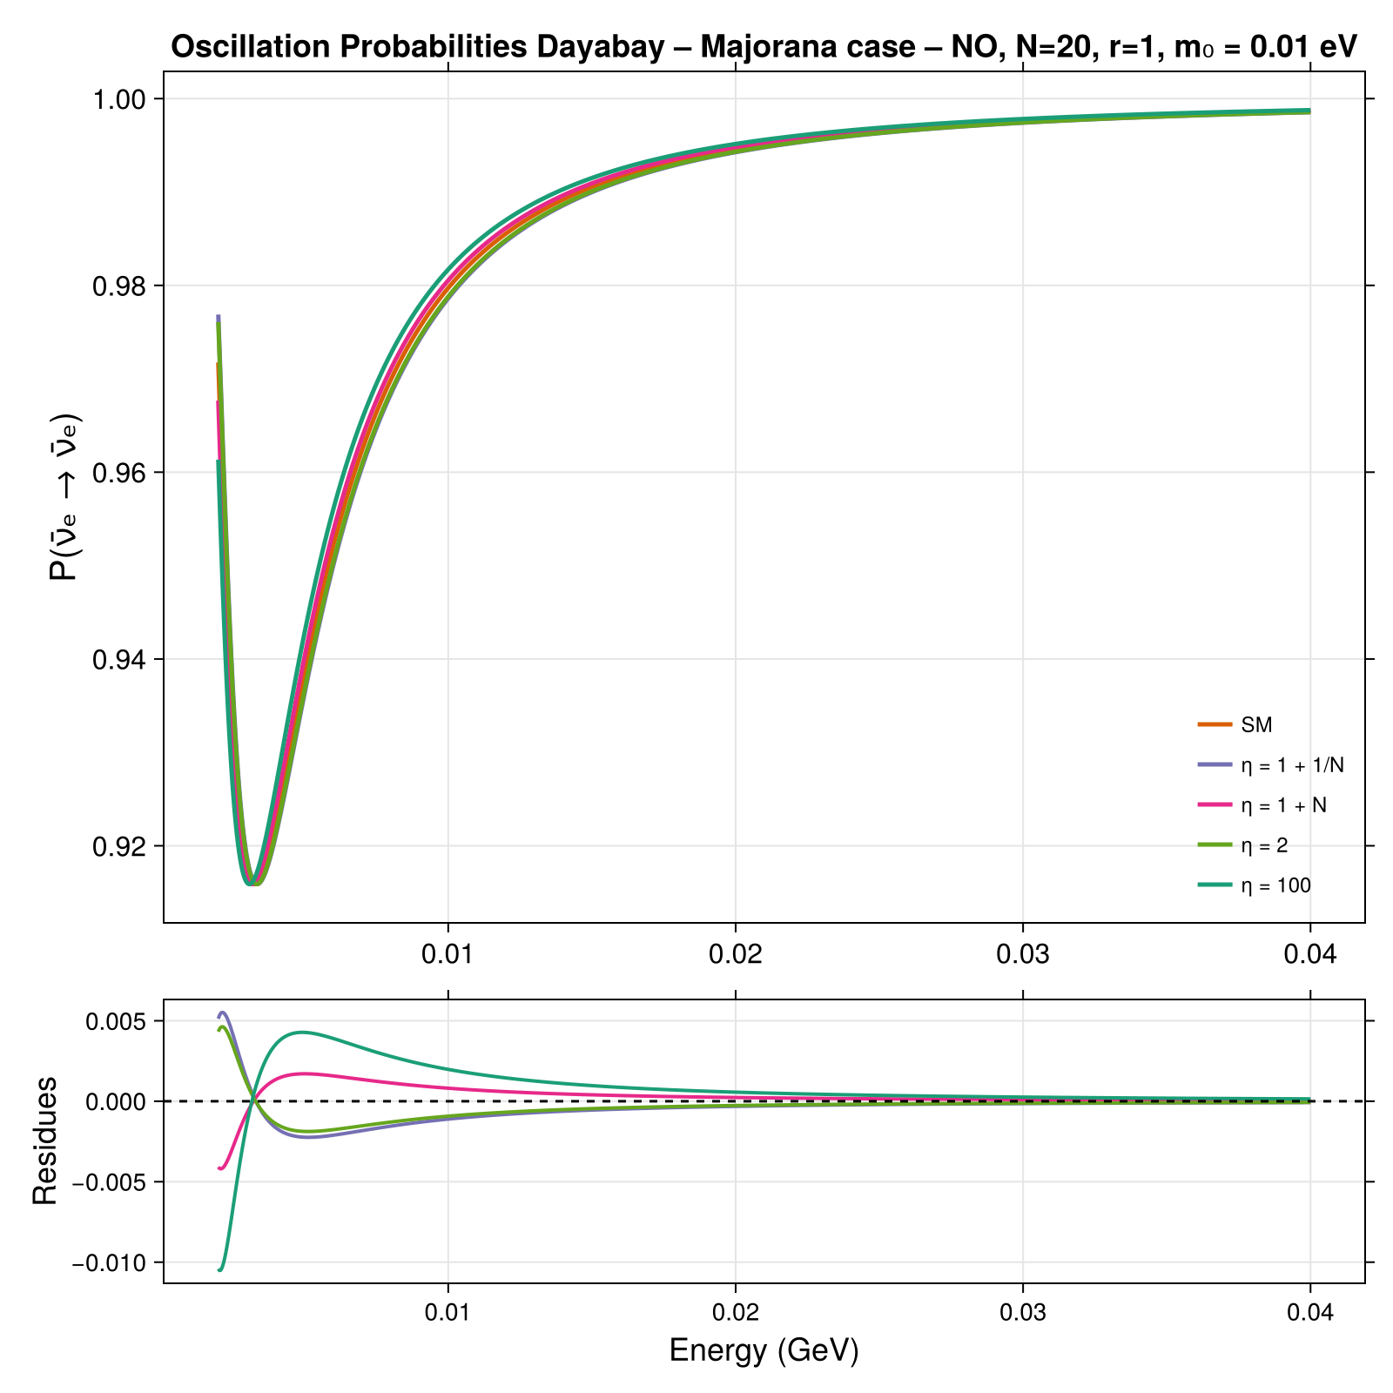
OSCILLATIONS - η EFFECT

Slide 42
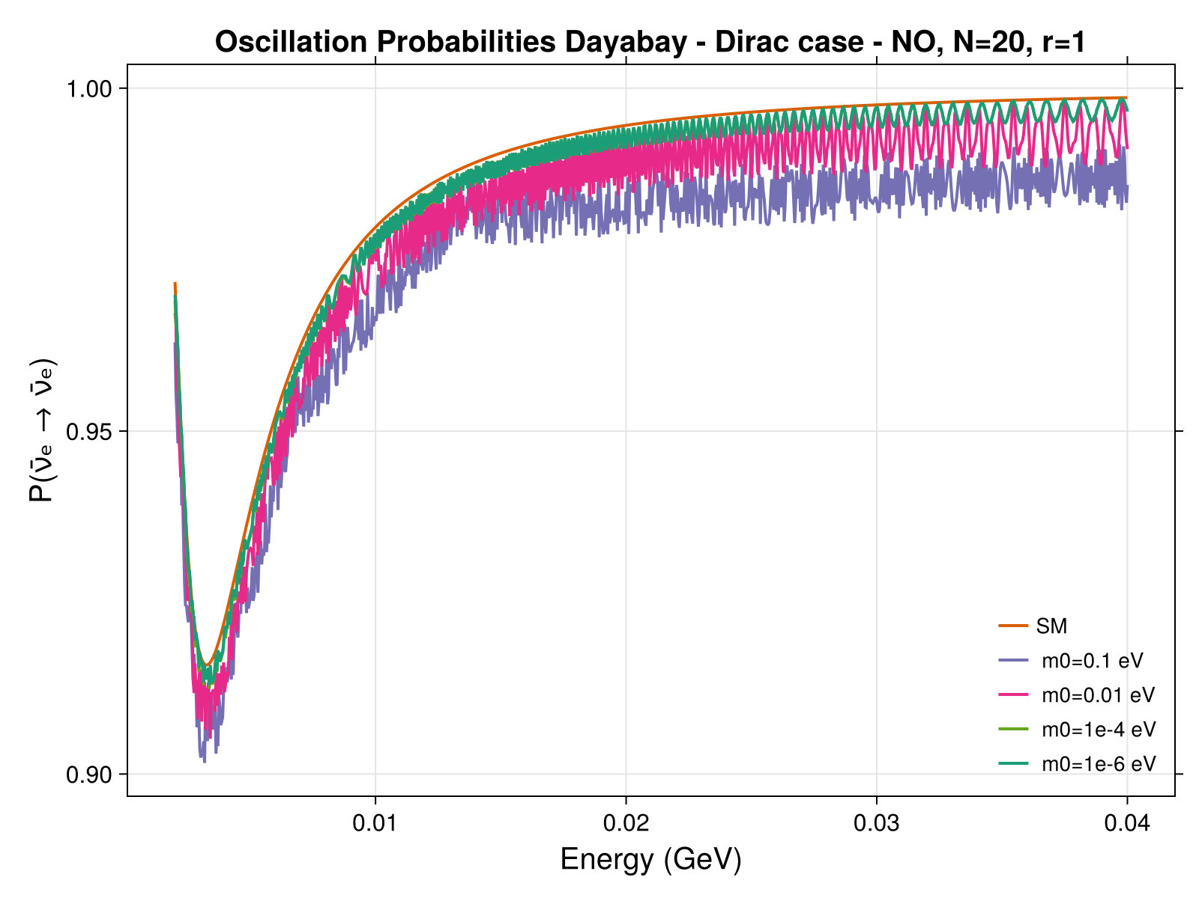

OSCILLATIONS – m0 EFFECT

Slide 43


Dependence on neutrino absolute mass

Slide 44

Likelihood analysis
Compute the likelihood L at each point of the parameter space
If more experiments together:
L_{tot}= L_{DAYABAY} x L_{JUNO} x ...
Likelihood ratio test
Confidence levels with Wilk‘s theorem

Slide 45


Effective Majorana mass

Slide 46

Daya Bay η effect

Slide 47

GERDA
Different matrix elements

Slide 48

Cutoff choice
Once we fix m0, r, N and we fix the cutoff scale and b as a whole
One can fix b (or the cutoff) to see what is the value of the other parameter that satisfy the relation with m0
This also gives limits on the regions of parameter space that can explain neutrino mass and hierarchy problem

Slide 49


Cutoff choice – Regions with cutoff > 10 TeV

Slide 50


Scaling of matrix elements for mßß
There are three possibilities:
Cutting heavy modes ~MeV (detector energy) even though the neutrinos are virtual
Not applying any cut: all the modes are treated the same way
Apply a correction to the contribution of heavy modes, which takes into account a different nuclear matrix

Slide 51

Scaling of the standard mass splitting

Slide 52


N dependence of the mass splittings

Slide 53


R dependence of the mass splittings

Slide 54


T2K implementation

Slide 55


NOvA implementation

Slide 56

Neutrino oscillations
probability that one flavour oscillates in one of the others
the probability depends on energy and on distance + matter effects
3 flavours eigenstates do not correspond to 3 mass eigenstates

Slide 57


Oscillations parameters
PMNS matrix with 3 angles and a phase
3 unconstrained parameters:
△m²₃₁ , Θ₂₃ , δ_{CP}

Slide 58

Current constraints on oscillation parameters
Δm²₂₁: ~2-3% precision
|Δm²₃₂|: ~2-3% precision
sin²θ₁₃: ~3-4% precision
sin²θ₁₂: ~4-6% precision
sin²θ₂₃: ~5-10% precision
δ_{CP}: Poor constraint (＞10% precision)

