Slide 1


Probing Features of a Strong First-Order Electroweak
Phase Transition in correlation to the Alignment Limit in the
Two-Higgs-Doublet Model of Type-I
Debankana Nath
DESY, Hamburg and Universität Hamburg
In Collaboration with:
Francisco Arco, Georg Weiglein, Kateryna Radchenko, Maria Olalla Olea Romacho, Sven Heinemeyer
Herbstschule HEP 2026

Slide 2
Probing Features of a Strong First-Order Electroweak
Phase Transition in correlation to the Alignment Limit in the
Two-Higgs-Doublet Model of Type-I
Debankana Nath
DESY, Hamburg and Universität Hamburg
In Collaboration with:
Francisco Arco, Georg Weiglein, Kateryna Radchenko, Maria Olalla Olea Romacho, Sven Heinemeyer
Herbstschule HEP 2026

Slide 3
Outline
The Two-higgs-doublet model (2HDM)
Finite-temperature effective potential
Results and discussion:
studying the 2hdm parameter space of type-I
Conclusions
Future prospects
references
Herbstschule HEP 2026

Slide 4
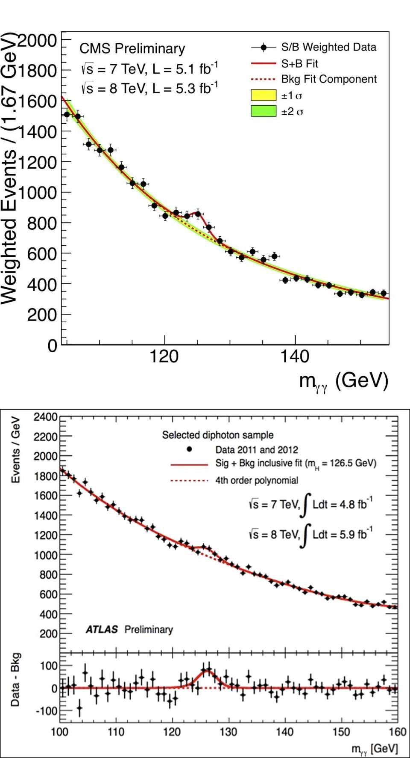
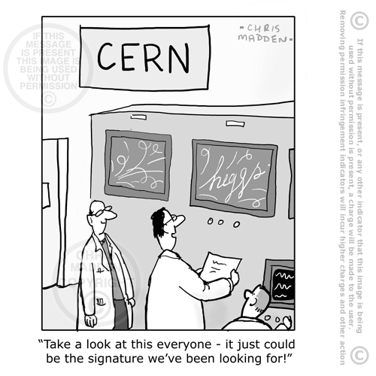

2012
Herbstschule HEP 2026

Slide 5



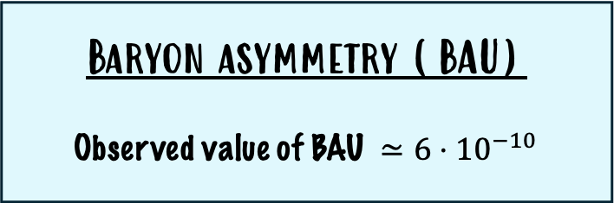

The Premise of interest
Baryon asymmetry (BAU)
Observed value of BAU $≃6⋅{10}^{−10}$
insufficient !
The STANDARD MODEL ?
Smooth-crossover phase transition
V_{eff}$\left(Φ\right)$
$↓ T$ decreases
EW BAryogenesis
Beyond the SM !
A strong first-order phase transition
$$Φ$$
Figure 1.1: SM prediction of electroweak symmetry breaking as a smooth-crossover phase transition
Herbstschule HEP 2026

Slide 6
2
The Two-higgs-doublet model (2HDM)
Herbstschule HEP 2026

Slide 7
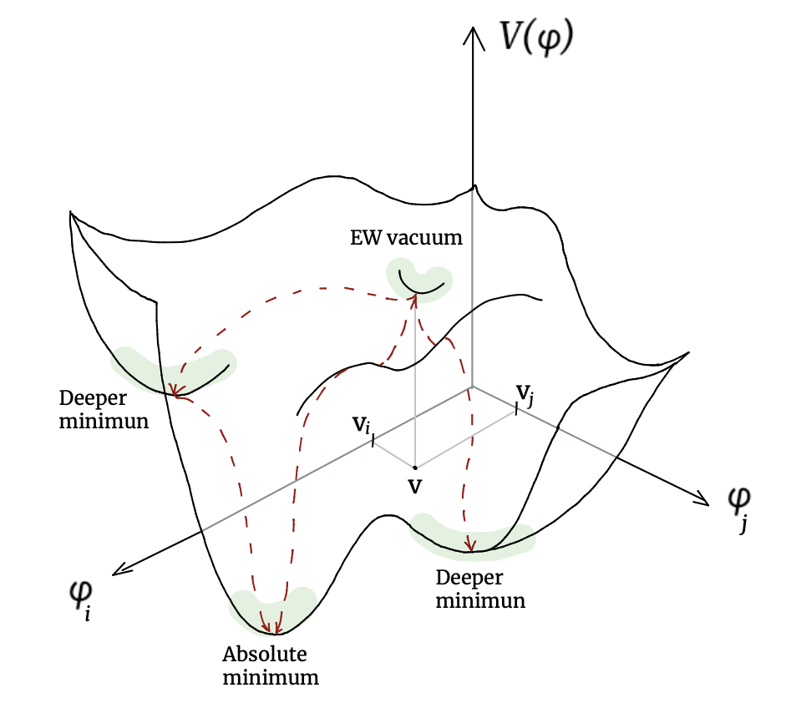
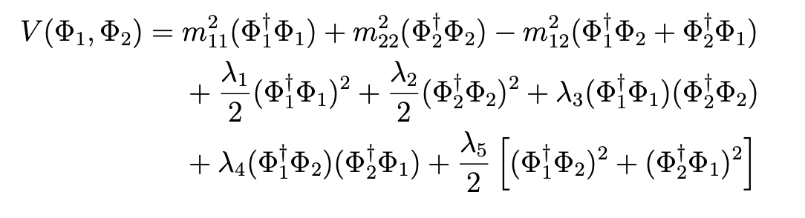
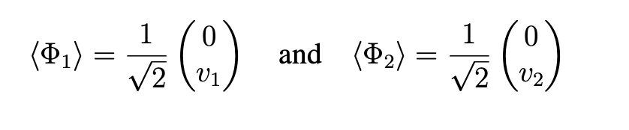





2HDM
Richer potential structure!
Scalar sector
SM extension with a scalar doublet
$Φ_{1}$and $Φ_{2}$
Z₂ symmetry
$$Φ_{1 }→Φ_{1}$$
$$Φ_{2}→−Φ_{2}$$
5 physical scalar fields (h, H, A, $H^{±}$)
Figure 2.1:
Illustration* of the minima structure of the Higgs potential in the field space of the 2HDM.
*Art credit: Kateryna Radchenko
Figure 2.2:
Illustration* of the physical scalars in the 2HDM.
Herbstschule HEP 2026

Slide 8
free parameters
tan β, cos (β - α), ${v, m}_{h}$ ${, m}_{H}$, $m_{H±}$, $m_{A},$ ${ m}_{12}^{2}$
Vev and vacuum direction
Physical scalar spectrum
Soft Z₂ breaking scale
Theoretical constraints:
experimental constraints:
  Vacuum stability and boundedness-from-below
  Perturbative unitarity
  Electroweak precision observables
  limits from BSM Higgs bosons searches
  Measurements of the properties of h₁₂₅
  Flavour Constraints
Herbstschule HEP 2026

Slide 9
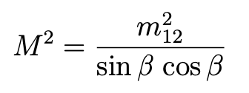
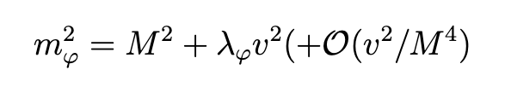
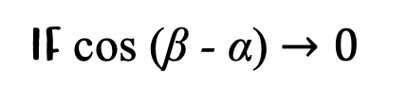
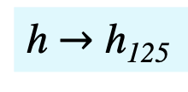
In which direction ews breaking occurs?
Do heavier scalars decouple?
$$h_{SM}=h \sin\left(α−β\right)−H \cos\left(α−β\right)$$
if cos (β - α) $→0$
The alignment limit
EW vacuum aligns with the lighter state,h
Enter loop corrections
h $→$ h₁₂₅
Sm-like couplings at tree-level
Herbstschule HEP 2026

Slide 10
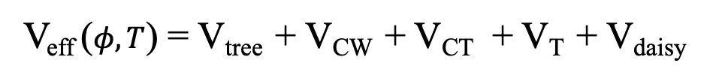
Thermal Evolution of vacuum
high temperatures
today: T=0
V_{eff} ($φ,T$) = V_{tree} + V_{CW} + V_{CT} + V_{T} + V_{daisy}
the effective potential
from effective action
Zero temperature
scalar potential
Finite temperature
effects
Herbstschule HEP 2026

Slide 11
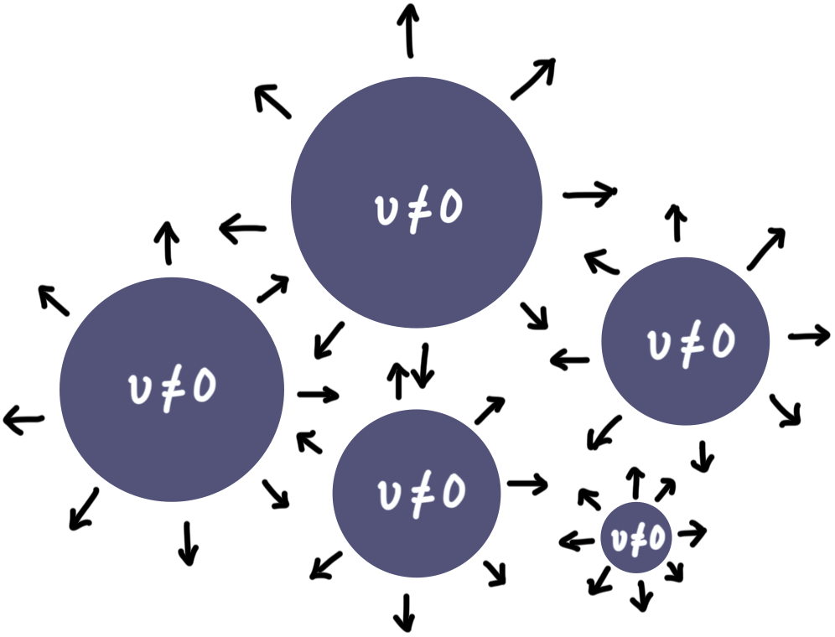
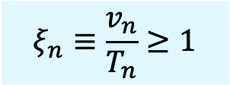
First-order Phase Transition
Ew symmetry
Degenerate vacua
Figure 3.2:
Nucleation of broken bubbles as a result of SFOEWPT in the background space of unbroken phase.
Ews breaking
is the foewpt strong?
$$ξ_{n}≡\frac{v_{n}}{T_{n}}≥1$$
Figure 3.1:
Thermal evolution of the 2HDM potential leading to a strong first-order phase transition from the false vacuum to the true vacuum.
Herbstschule HEP 2026

Slide 12

First-order Phase Transition
Source of GWs!
Ew symmetry
Degenerate vacua
Figure 3.2:
Nucleation of broken bubbles as a result of SFOEWPT in the background space of unbroken phase.
Ews breaking
is the foewpt strong?
$$ξ_{n}≡\frac{v_{n}}{T_{n}}≥1$$
Figure 3.1:
Thermal evolution of the 2HDM potential leading to a strong first-order phase transition from the false vacuum to the true vacuum.
Herbstschule HEP 2026

Slide 13
4
results
How do the scalar masses influence sfoewpt?
In relation to the alignment limit
Herbstschule HEP 2026

Slide 14
SFOEWPT in (m_{H} , cos(β-α) ) plane
For high masses: m_{H} ≳ 400 GeV :
SFOEWPT occurs very close to the alignment limit
EW symmetry breaking is preferred in the direction of the lighter state h, identified with the SM-like Higgs boson.
For low masses: m_{H} ≲ 400 GeV :
SFOEWPT occurs for larger deviations from the alignment limit
EWPT driven by both H and h, broken vacuum preferred in non-SM-like Higgs direction.
Figure 4.1:
Parameter points featuring an SFOEWPT in the plane of (m_{H}, cos(β − α)) that are allowed by the recent constraints within 2HDM of Type-I.
Herbstschule HEP 2026

Slide 15
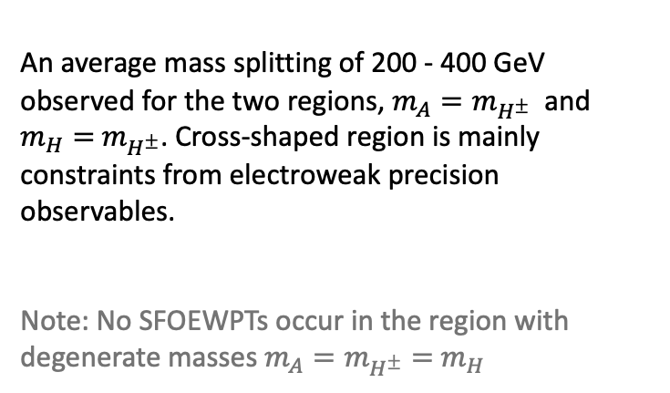
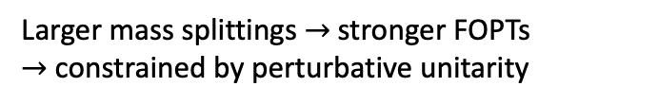
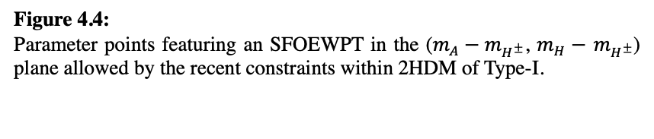

$$E_{φ}∝m_{φ}^{3}$$
Cubic contribution
mass splittings
Mass splittings (driven by λ_{φ}) are correlated to an SFOEWPT occurence
Larger mass splittings $→$stronger FOPTs
$→$ constrained by perturbative unitarity
An average mass splitting of 200 - 400 GeV observed for the two regions, $m_{A}=m_{H^{±}}$ and $m_{H}=$ $m_{H^{±}}$. Cross-shaped region is mainly constraints from electroweak precision observables.
Note: No SFOEWPTs occur in the region with degenerate masses $m_{A}=m_{H^{±}}=$ $m_{H}$
Figure 4.4:
Parameter points featuring an SFOEWPT in the ($m_{A}−m_{H^{±}}$, $m_{H}−$ $m_{H^{±}}$) plane allowed by the recent constraints within 2HDM of Type-I.
Herbstschule HEP 2026
Notes:
Scalar masses enter as cubic terms in the high-temperature expansion of the thermal potential.

Slide 16


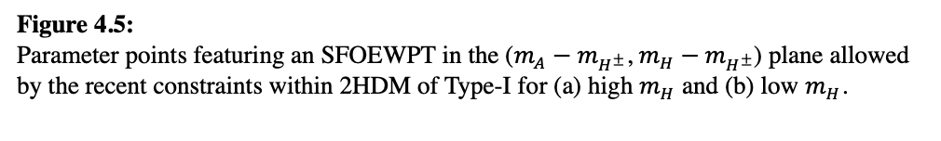


mass splittings planes for m_{H}
$$m_{A}=m_{H^{±}}:$$
$Δm$ ≲ 300 GeV
$$m_{H}= m_{H^{±}}:$$
$Δm$ ≲ 400 GeV
Figure 4.5:
Parameter points featuring an SFOEWPT in the ($m_{A}−m_{H^{±}}$, $m_{H}−$ $m_{H^{±}}$) plane allowed by the recent constraints within 2HDM of Type-I for (a) high $m_{H}$ and (b) low $m_{H}$.
Herbstschule HEP 2026

Slide 17
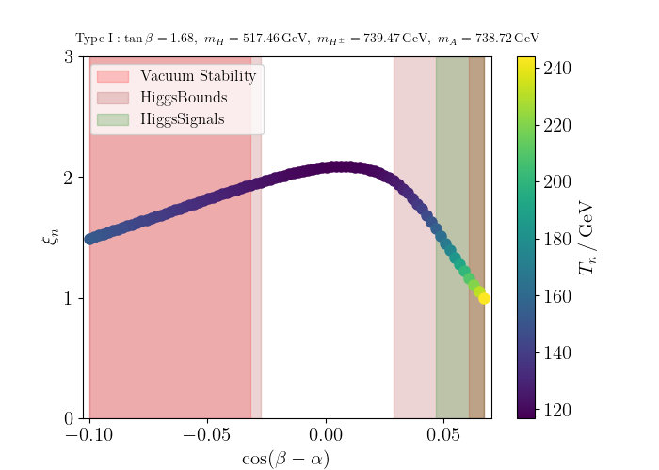
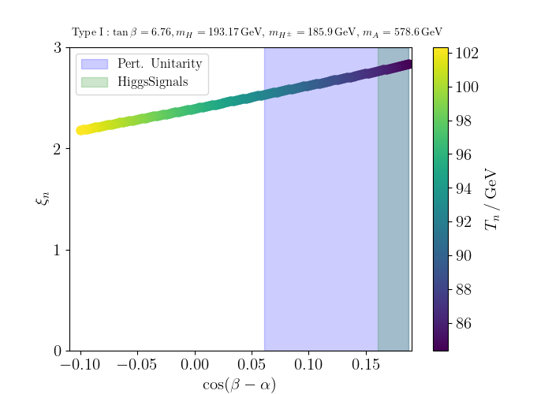
behaviour of ξ_{n} with cos(β-α)
High m_{H}
Low m_{H}
Figure 4.2.: Variation of the strength of the transition, ξ_{n} with cos(β-α) for (a) high CP-even Higgs mass and (b) for low CP-even Higgs masses.
Herbstschule HEP 2026

Slide 18
thermal evolution of vacuum
High m_{H}
Low m_{H}
Figure 4.3: Thermal evolution of the vacuum from high T to low T, indicating a discontinuous phase transition from the false vacuum to the true vacuum for (a) high CP-even Higgs mass and (b) for low CP-even Higgs mass.
Herbstschule HEP 2026

Slide 19
conclusions
Extended Higgs sectors can feature a SFOEWPT, necessary for EW baryogenesis, can potentially lead to detectable GW signals.
Heavier scalars enter loop corrections and enhance the barrier for a strongly first-order EWPT.
Thermal effects play a crucial role in generating the barrier, featuring SFOEWPTs within the model.
Higher the mass splitting between scalars, stronger the transitions induced.
For higher m_{H}, SFOEWPTs occur close to the alignment limit. But, for lower m_{H}, it occurs away from this limit and in non-SM-like direction.
Herbstschule HEP 2026

Slide 20
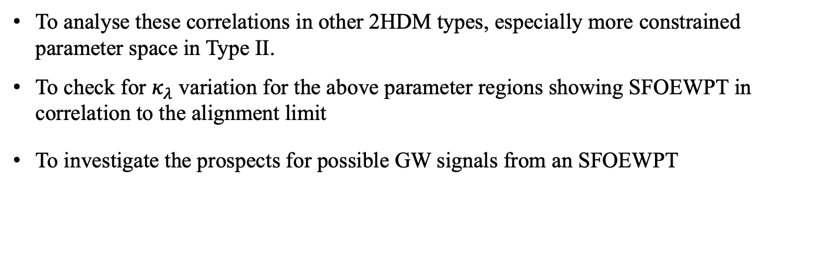
future prospects
To analyse these correlations in other 2HDM types, especially more constrained parameter space in Type II.
To check for $κ_{λ}$ variation for the above parameter regions showing SFOEWPT in correlation to the alignment limit
To investigate the prospects for possible GW signals from an SFOEWPT
Herbstschule HEP 2026

Slide 21
references
Biekötter, T., Heinemeyer, S., No, J.M., Radchenko, K., Olea Romacho, M.O. and Weiglein, G., 2024. First shot of the smoking gun: probing the electroweak phase transition in the 2HDM with novel searches for A→ ZH in $${\ell}^{+}{\ell}^{-} t\overline {t} $$ and $$\nu\nu b\overline {b} $$ final states. Journal of high energy physics, 2024(1), pp.1-44.
Coleman, S. and Weinberg, E., 1973. Radiative corrections as the origin of spontaneous symmetry breaking. Physical Review D, 7(6), p.1888.
Arnold, P. and Espinosa, O., 1993. Effective potential and first-order phase transitions: Beyond leading order. Physical Review D, 47(8), p.3546.
GWs studies: Athron, P., Balázs, C., Fowlie, A., Morris, L. and Wu, L., 2024. Cosmological phase transitions: From perturbative particle physics to gravitational waves. Progress in Particle and Nuclear Physics, 135, p.104094.
Biekötter, T., Heinemeyer, S., No, J.M., Olea, M.O. and Weiglein, G., 2021. Fate of electroweak symmetry in the early Universe: Non-restoration and trapped vacua in the N2HDM. Journal of Cosmology and Astroparticle Physics, 2021(06), p.018.
Cline, J.M. and Lemieux, P.A., 1997. Electroweak phase transition in two Higgs doublet models. Physical Review D, 55(6), p.3873.
Fromme, L., Huber, S.J. and Seniuch, M., 2006. Baryogenesis in the two-Higgs doublet model. Journal of High Energy Physics, 2006(11), p.038.
Dorsch, G.C., Huber, S.J., Konstandin, T. and No, J.M., 2017. A second Higgs doublet in the early universe: baryogenesis and gravitational waves. Journal of Cosmology and Astroparticle Physics, 2017(05), p.052.
Dorsch, G.C., Huber, S., Mimasu, K. and No, J.M., 2014. Echoes of the Electroweak Phase Transition: Discovering a second Higgs doublet through $ A_0\rightarrow H_0 Z$. arXiv preprint arXiv:1405.5537.
Dorsch, G.C., Huber, S.J., Mimasu, K. and No, J.M., 2017. The Higgs vacuum uplifted: revisiting the electroweak phase transition with a second Higgs doublet. Journal of high energy physics, 2017(12), pp.1-32.
Su, Wei, Anthony G. Williams, and Mengchao Zhang. "Strong first order electroweak phase transition in 2HDM confronting future Z & Higgs factories." Journal of High Energy Physics 2021, no. 4 (2021): 219.
Herbstschule HEP 2026

Slide 22
Thank you
Herbstschule HEP 2026

Slide 23
Backup slides

Slide 24
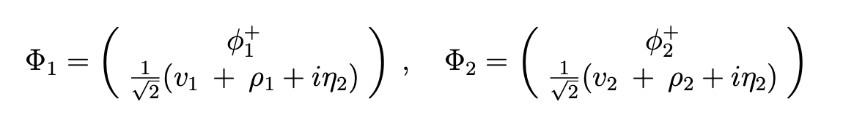
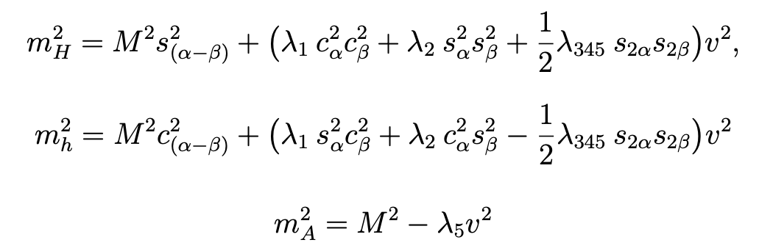
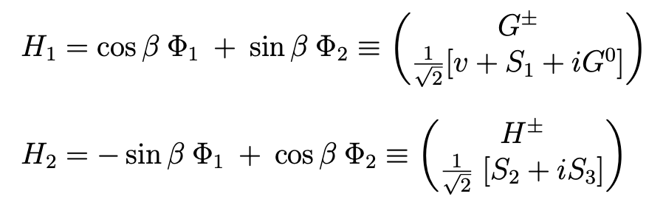
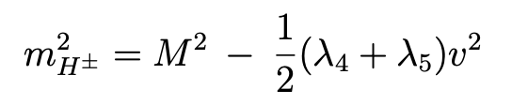
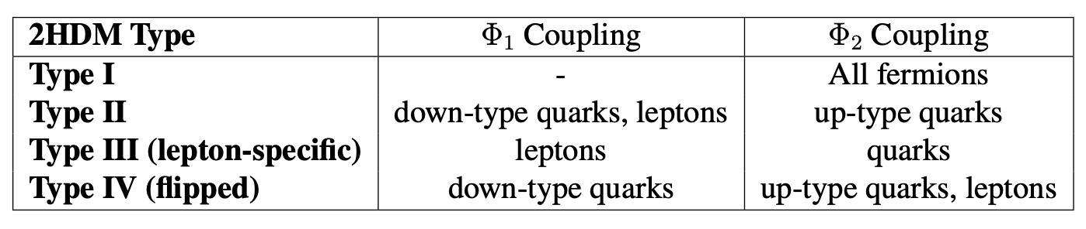
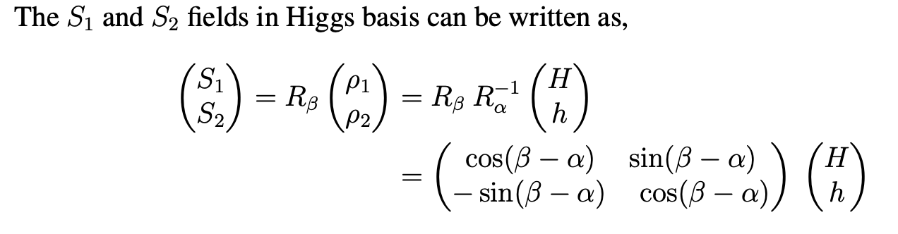
2HDM
Higgs basis

Slide 25
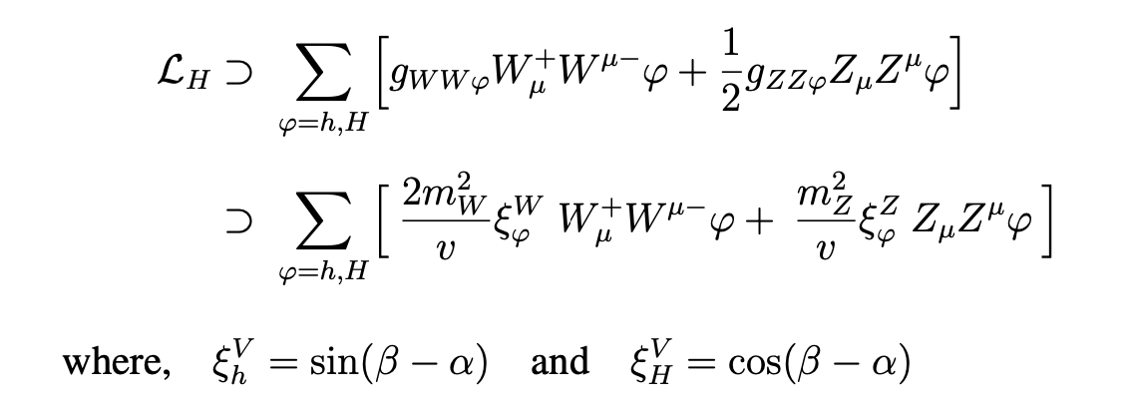
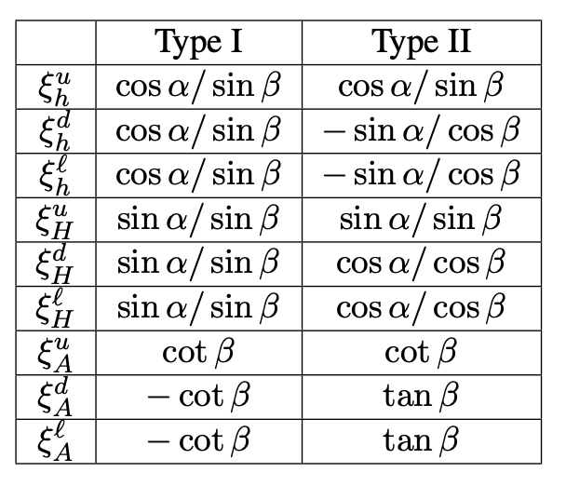
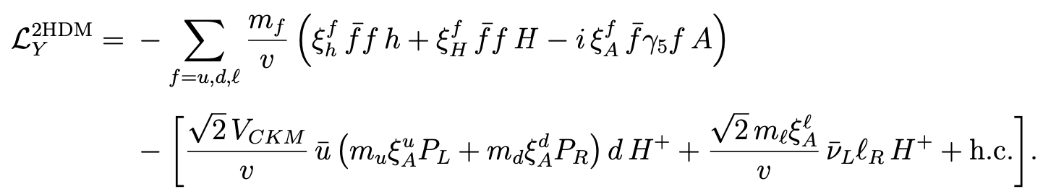
Gauge sector
Yukawa sector

Slide 26
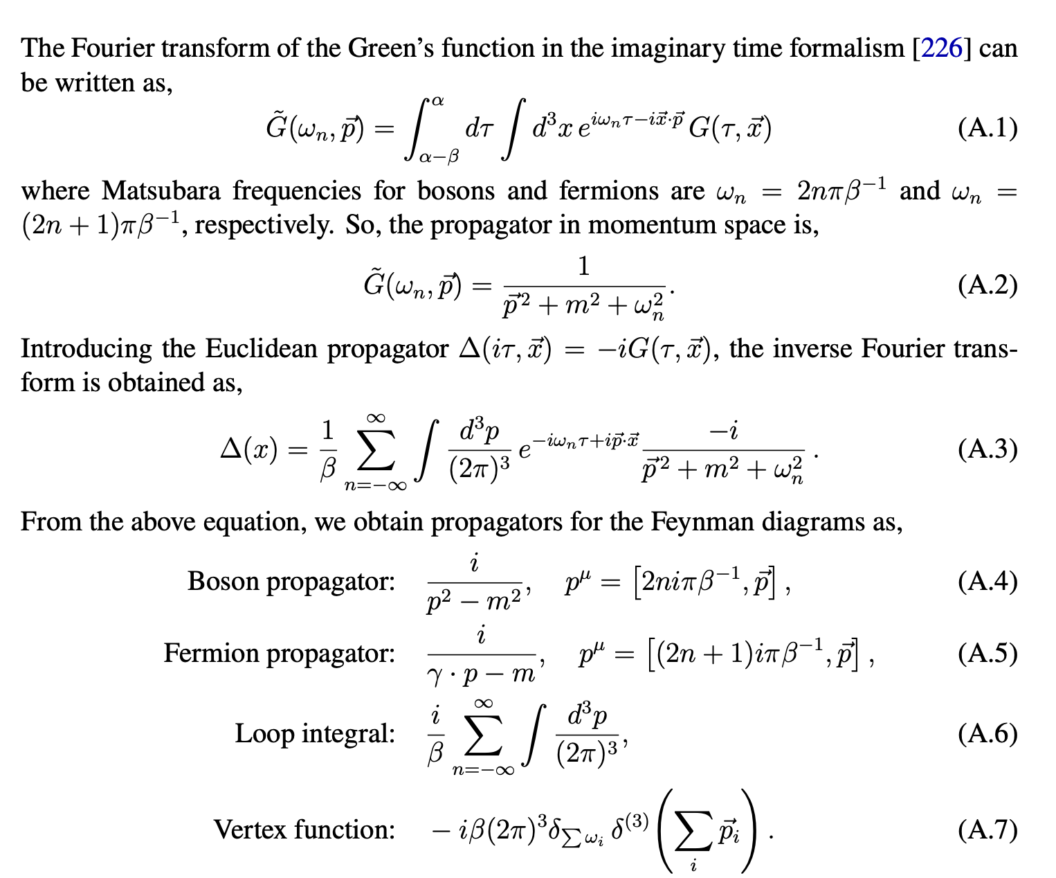
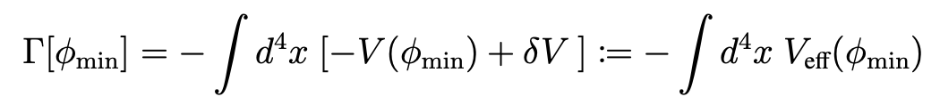
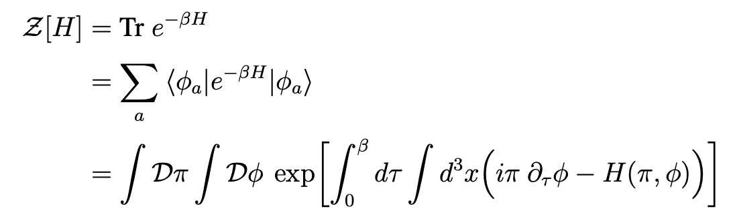
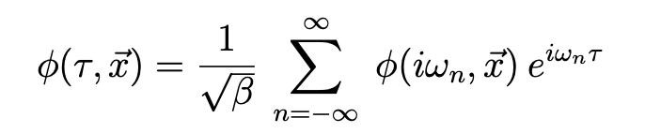
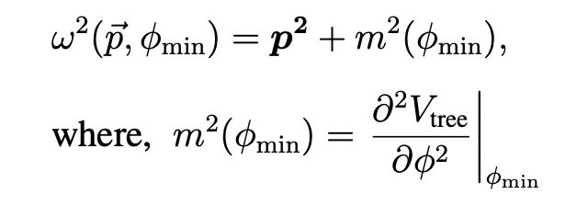
Thermal field formalism

Slide 27
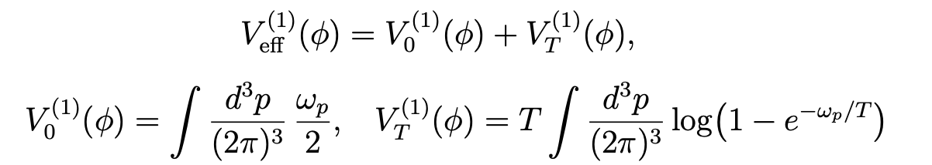
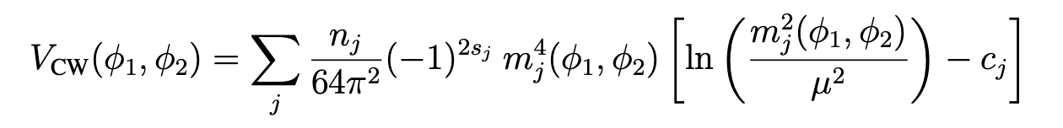
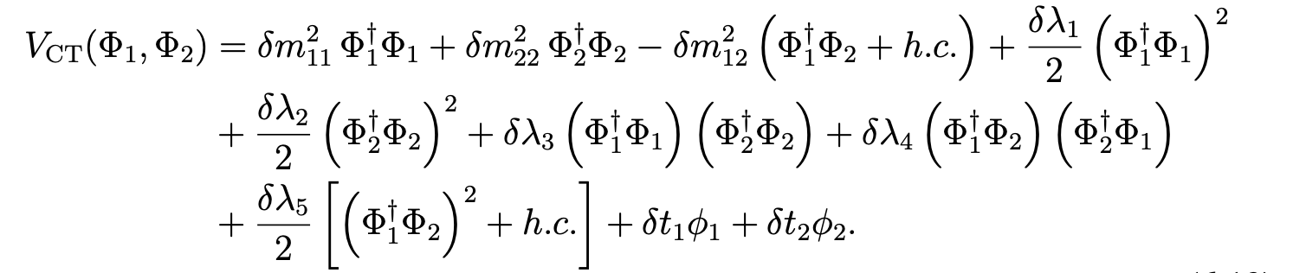
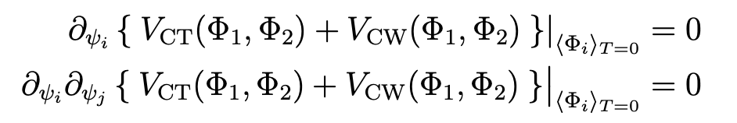
1-loop coleman-weineberg potential
UV-finite counter terms to the zero-temperature one-loop scalar potential:
os-renormlisation conditions:

Slide 28
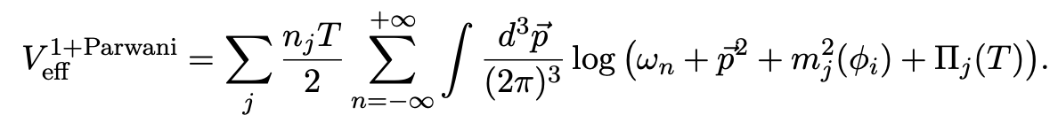
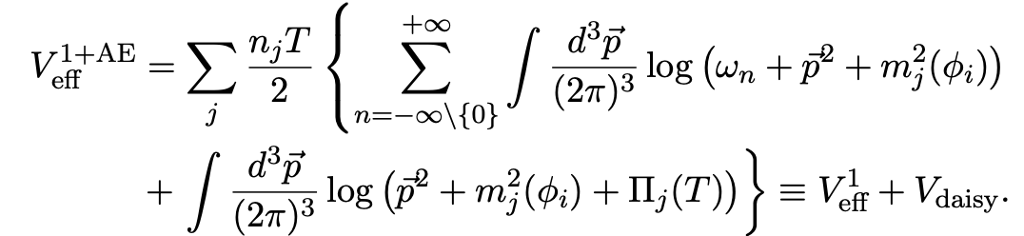
Daisy ring resummations
Infrared (IR) breakdown of the perturbation theory by soft bosonic modes
Image from Ref. Delaunay, Cedric, Christophe Grojean, and James D. Wells. "Dynamics of non-renormalizable electroweak symmetry breaking." Journal of High Energy Physics 2008, no. 04 (2008): 029-029.

Slide 29
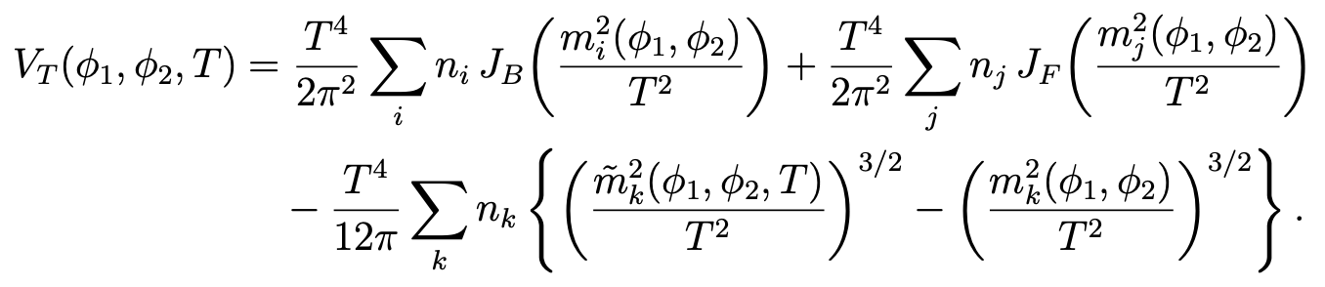
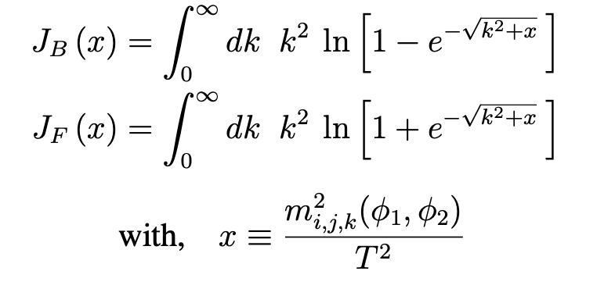
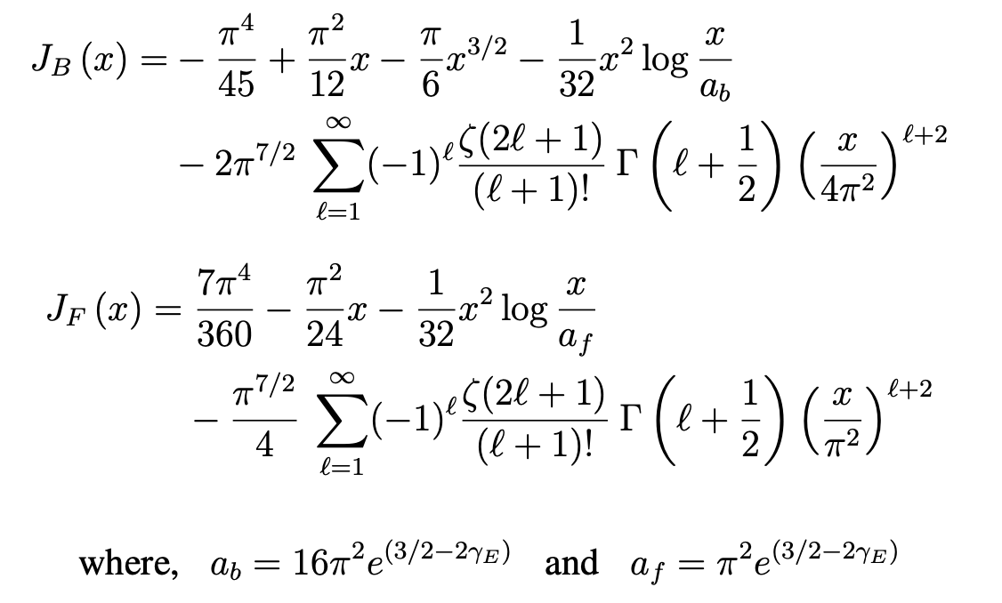
1-loop thermal potential
Thermal loop integrals:
High T expansion

Slide 30



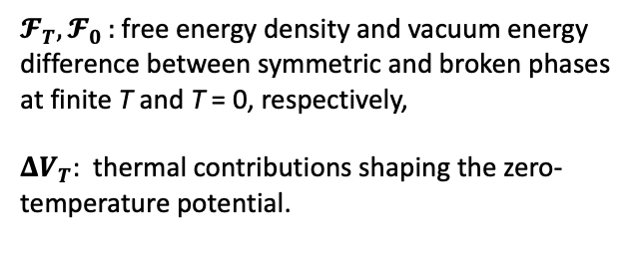

higgs vacuum upliftment
How uplifted is the Higgs vacuum relative to the SM?
$$ℱ_{T}=ℱ_{0 }+ΔV_{T}$$
where,
$𝓕_{T},𝓕_{0 }:$ free energy density and vacuum energy difference between symmetric and broken phases at finite T and T = 0, respectively,
$ΔV_{T}$: thermal contributions shaping the zero-temperature potential.
[
]
shallower scalar potential
easier barrier formation
stronger fopts
Herbstschule HEP 2026
Notes:
If thermal corrections must do too much just to make the phases comparable, the resulting broken minimum may be less favorable for a large v/Tv/Tv/T. But if the zero-temperature vacuum is already relatively shallow, the thermal corrections can more efficiently produce the needed barrier while preserving a sizable broken-phase vev. It means the finite-temperature terms are in a better position to produce the combination that matters physically: comparable phases, a barrier and a large enough broken minimum.

Slide 31
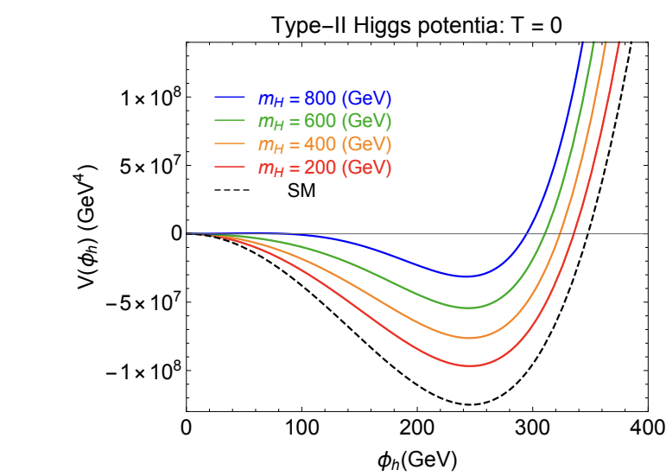

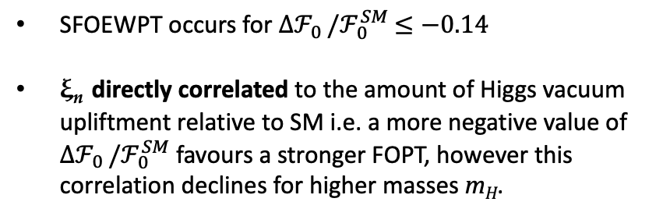
correlating ξ_{n} with ${Δℱ}_{0 }/ℱ_{0}^{SM}$
SFOEWPT occurs for ${Δℱ}_{0 }/ℱ_{0}^{SM}$ $≤−0.14$
ξ_{n} directly correlated to the amount of Higgs vacuum upliftment relative to SM i.e. a more negative value of ${Δℱ}_{0 }/ℱ_{0}^{SM}$ favours a stronger FOPT, however this correlation declines for higher masses m_{H}.
Figure 4.6:
The strength of the transition in the 2HDM of Type I in relation to the vacuum uplifting variable ∆F₀/F_{SM}. The colour coding indicates the value of the mass m_{H} .
Figure: The zero-temperature Higgs potential with different $m_{H}.$
Ref: [11] arXiv:2011.04540v1
Herbstschule HEP 2026
Notes:
The study of the amount of upliftment of the 2HDM Higgs vacuum with respect to the SM vacuum energy is beneficial in correlating the strength of a phase transition with parameter regions within 2HDM that can induce a first-order electroweak phase transition.
Note mH < 400 GeV region, 400 < mH < 800 GeV (alignment favoured), above 800 GeV (too much uplifted) weaker transitions.

Slide 32
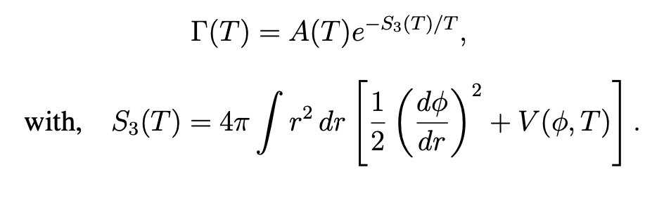
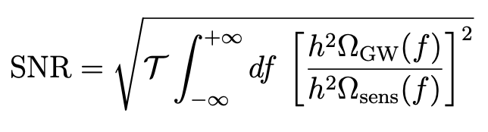
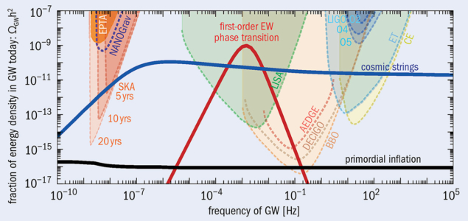
Λcdm and ew baryogenesis
gw density and snr
CERN Courier, Vol. 62, No. 4, July/August 2022

Slide 33
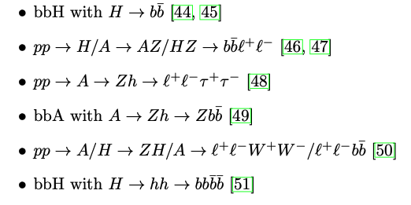
Direct searches

