Slide 1
Architectures for
Event Camera Tracking
TrackOpt Meeting
March 2026

Slide 2
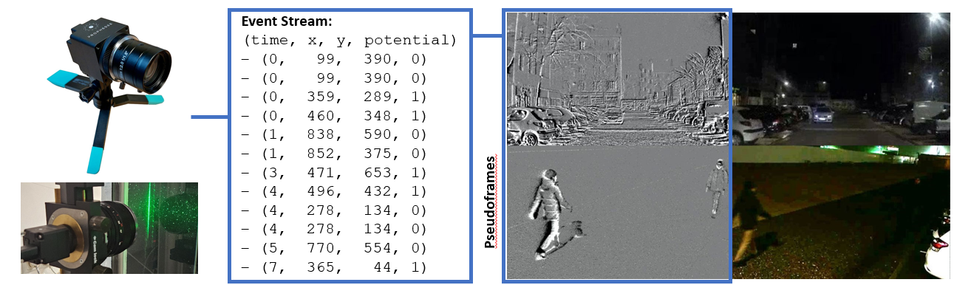
Event Cameras

Slide 3
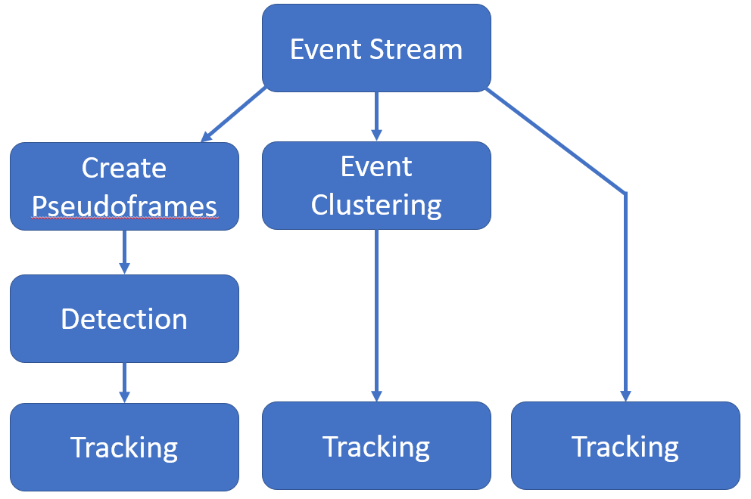
Tracking Scenarios
[1,2]

Slide 4
Models
[1] MvHeatDET: https://github.com/Event-AHU/OpenEvDET
  Transformer-based detection model based on Mixture-of-Experts
  Pseudoframes
[2] RVT: https://github.com/uzh-rpg/RVT
  Recurrent Vision Transformer (combines transformer-based backbone with recurrent neural network)
  Event-Tensors
SMAC3 for HPO: https://github.com/automl/SMAC3
  Random forest performance predictor
  Sampling via expected improvement

Slide 5
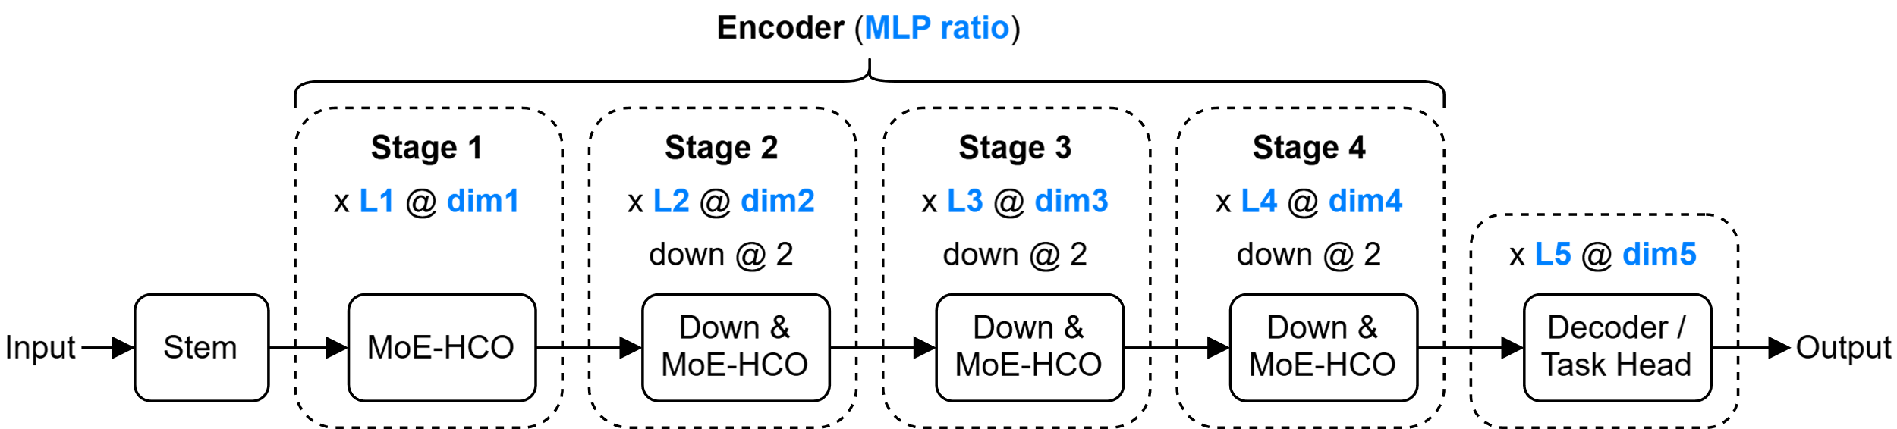
[1] MvHeatDET – HPO

Slide 6
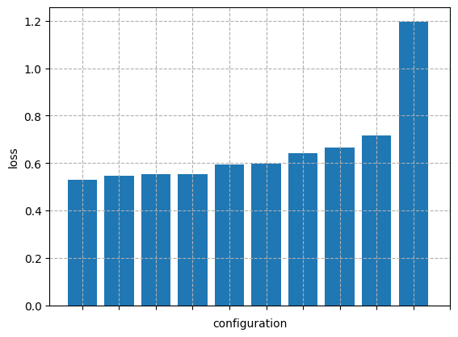
[1] MvHeatDET – HPO
Hyperparameters
'MvHeat_DET_depths_0': (1, 18),
'MvHeat_DET_depths_1': (1, 18),
'MvHeat_DET_depths_2': (1, 18),
'MvHeat_DET_depths_3': (1, 18),
'MvHeat_DET_dims_0’: [16, 32, …, 768],
'MvHeat_DET_dims_1': [16, 32, …, 768],
'MvHeat_DET_dims_2': [16, 32, …, 768],
'MvHeat_DET_dims_3': [16, 32, …, 768],
'MvHeat_DET_mlp_ratio': (1, 4),
'RTDETRTransformer_num_decoder_layers': (1, 6),
'RTDETRTransformer_hidden_dim’: [16, 32, …, 256]

Slide 7
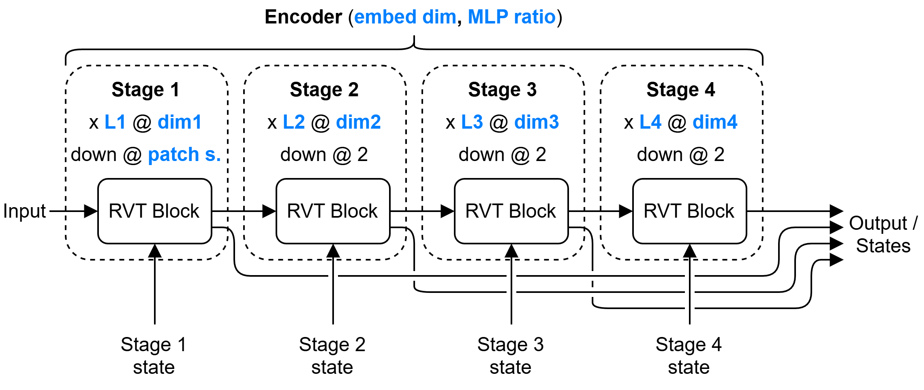
[2] RVT – HPO

Slide 8
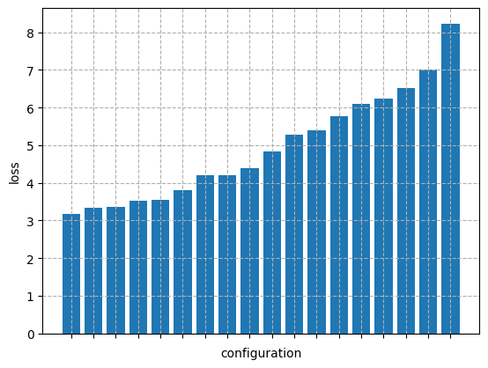
[2] RVT – HPO
Hyperparameters (~4M configs)
'dim_multiplier_1': (1, 4),
'dim_multiplier_2': (1, 4),
'dim_multiplier_3': (1, 4),
'dim_multiplier_4': (1, 4),
'embed_dim': [4, 8, 16, 32, 64],
'num_blocks_1': (1, 4),
'num_blocks_2': (1, 4),
'num_blocks_3': (1, 4),
'num_blocks_4': (1, 4),
'mlp_ratio': (1, 4),
'patch_size': [2, 4, 8]

Slide 9
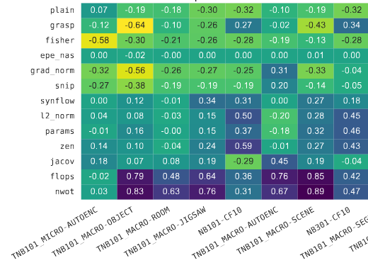
Next steps
Main limitation is cost of training these networks
Zero Cost Proxies (ZCPs):
  Modify ZCPs for detection / tracking
  Identify ZCPs via HPO results
  Optimize architectures via
  these ZCPs

