Slide 1
trackopt – 11-March-26
Jannis Maron
Universität Siegen

Slide 2
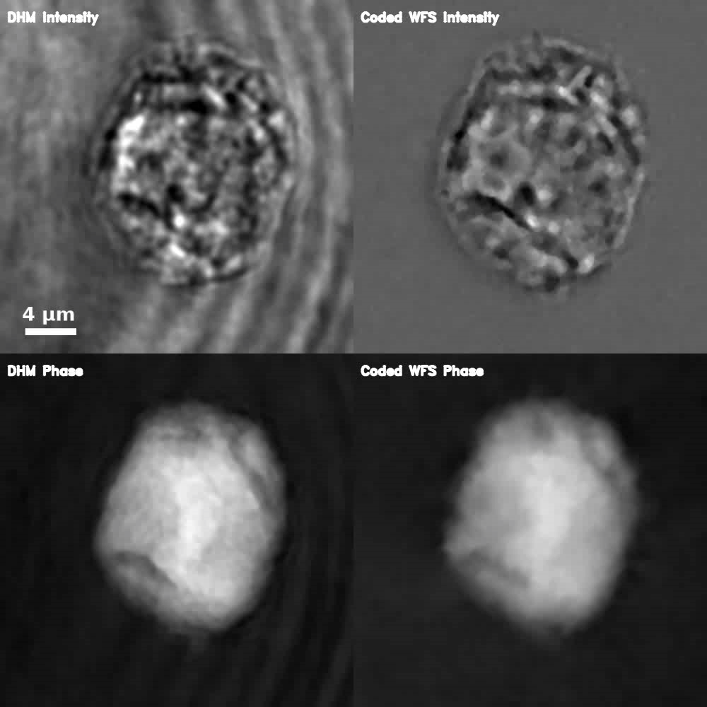
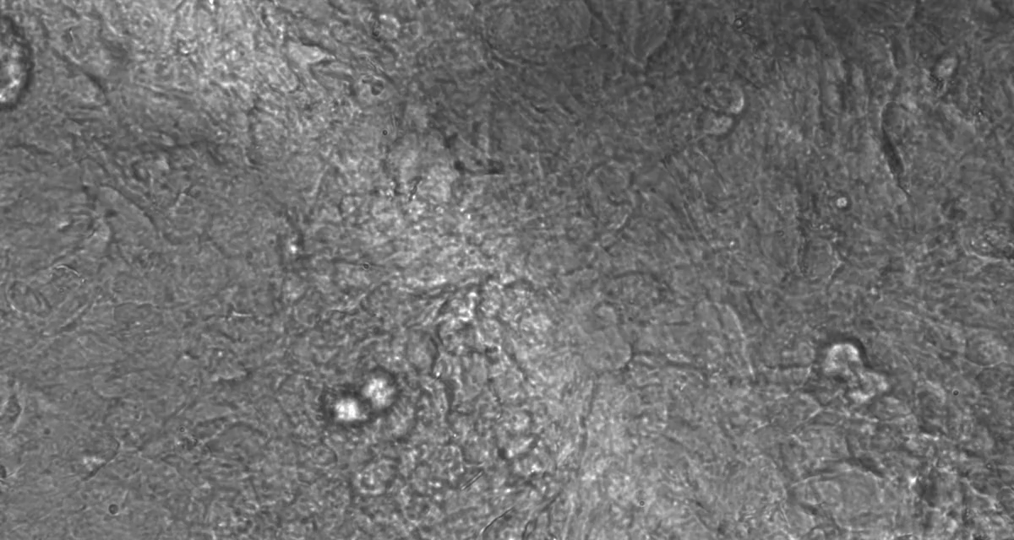
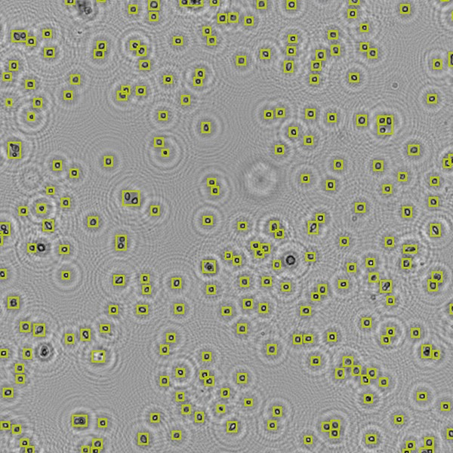
Applications
Rigid Body Motion
Elastic Deformation
Holographic Particles
Source: Prof. Jari Hyttinen, Tampere University
Source: anvajo - fludlab-r300

Slide 3
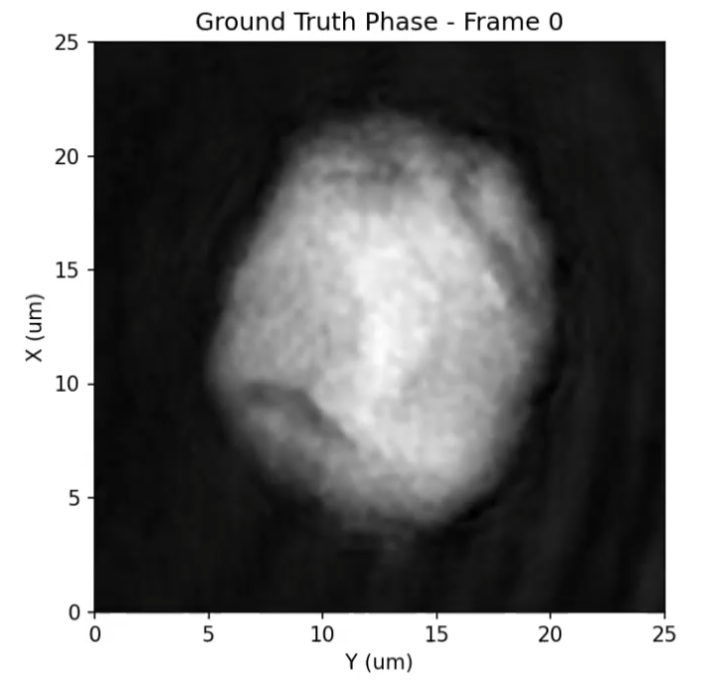
Rigid Body Motion
We Observed:
Phase-Video of a rotating transparent HEK Cell.
The Goal:
Reconstruct the Refractive Index (RI) distribution of the cell as a 3D Volume.
⇒ RI-Tomography
Problem:
We don’t know:
Geometry of the cell.
Pose for any given frame.
  Translation
  Rotation
What to do?
Work with some initial assumptions.
Simulate the scattering of the wavefield.
Then optimize geometry/poses to fit the video sequence.
Observed Phase of a rotating HEK Cell

Slide 4
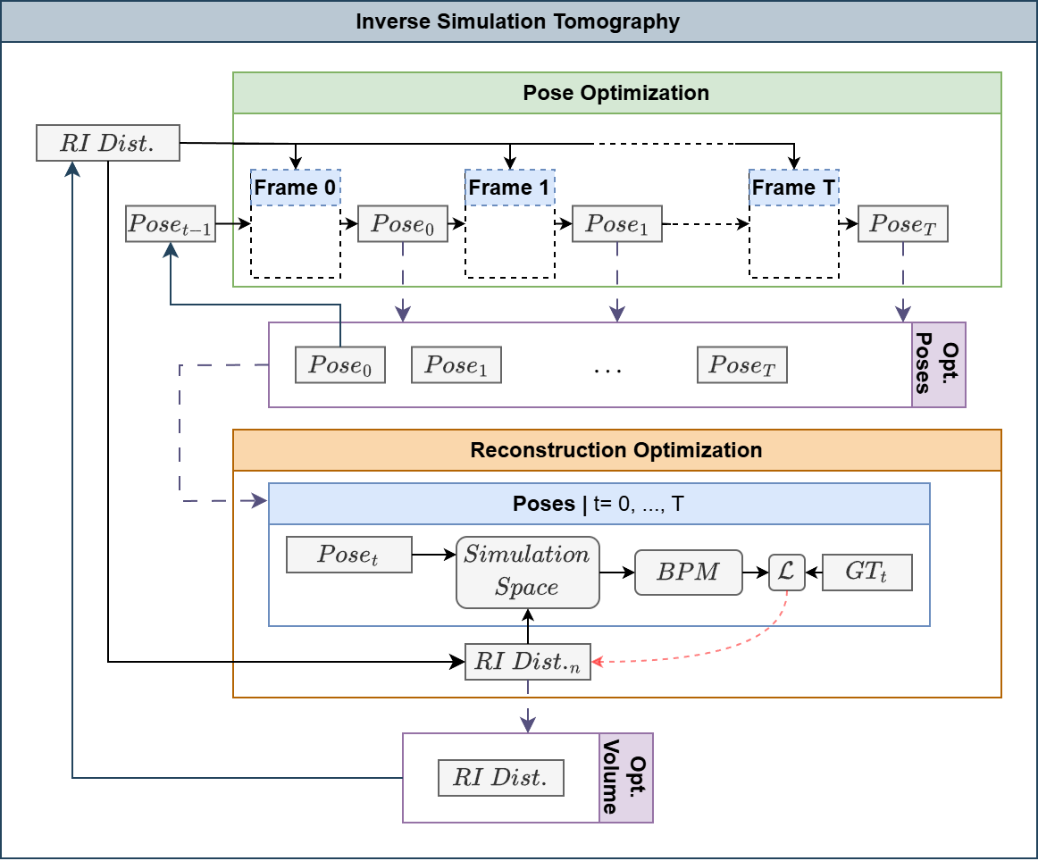
Recap: Frame-by-Frame Simulation
⇒ End-to-End Optimization
Initialization:
Estimated RI Distribution
Guessed Pose for first frame
Separated Optimization:
Perform Pose Optimization to get updated poses.
Update Volume with the Reconstruction Optimization using the updated poses.
Repeat with updated RI. Distribution and pose of the first frame.

Slide 5
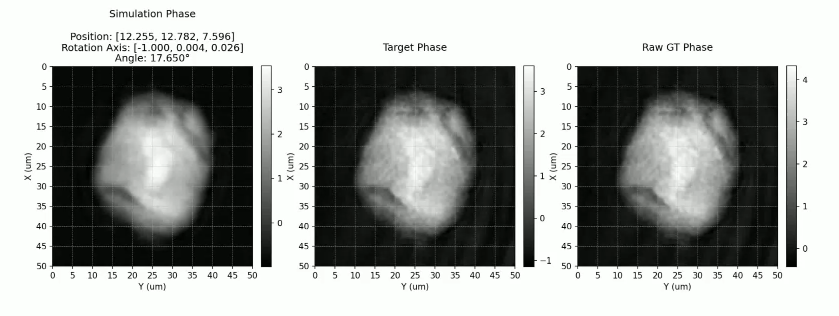
Recap: Frame-by-Frame Simulation

Slide 6
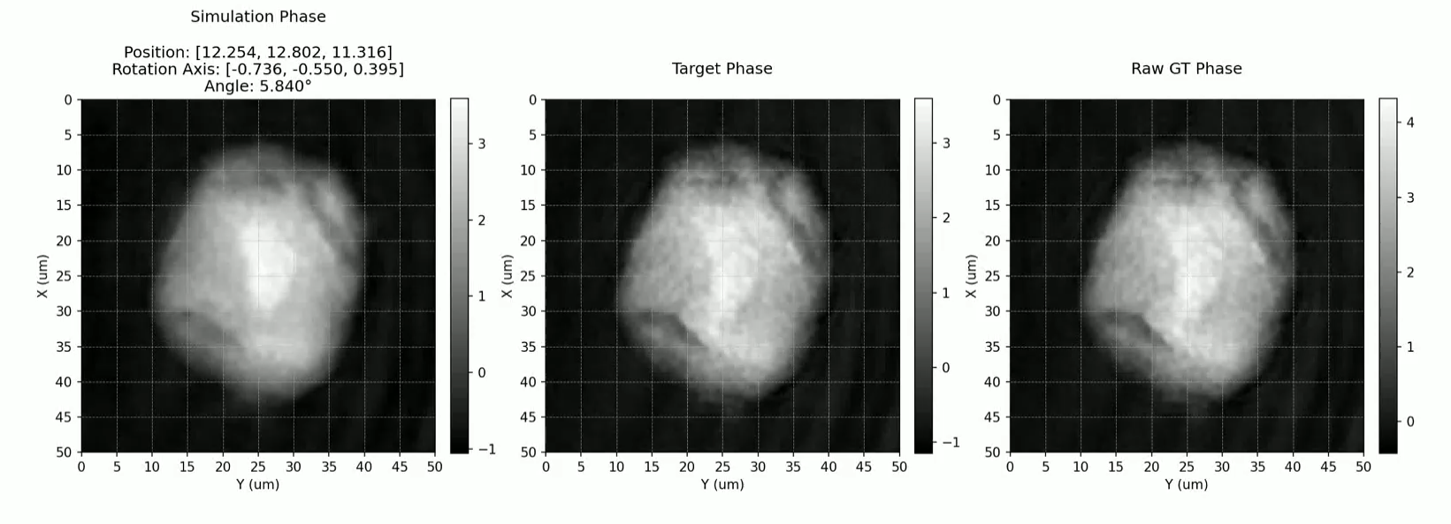
Recap: The Problem
We aren’t the first to do this!
Moser et al.: Optical tomography reconstructing 3D motion and structure of multi-scattering samples under rotational actuation
Problem:
Our reproduction optimizes towards piecewise constant angles, rather than smooth rotations.

Slide 7
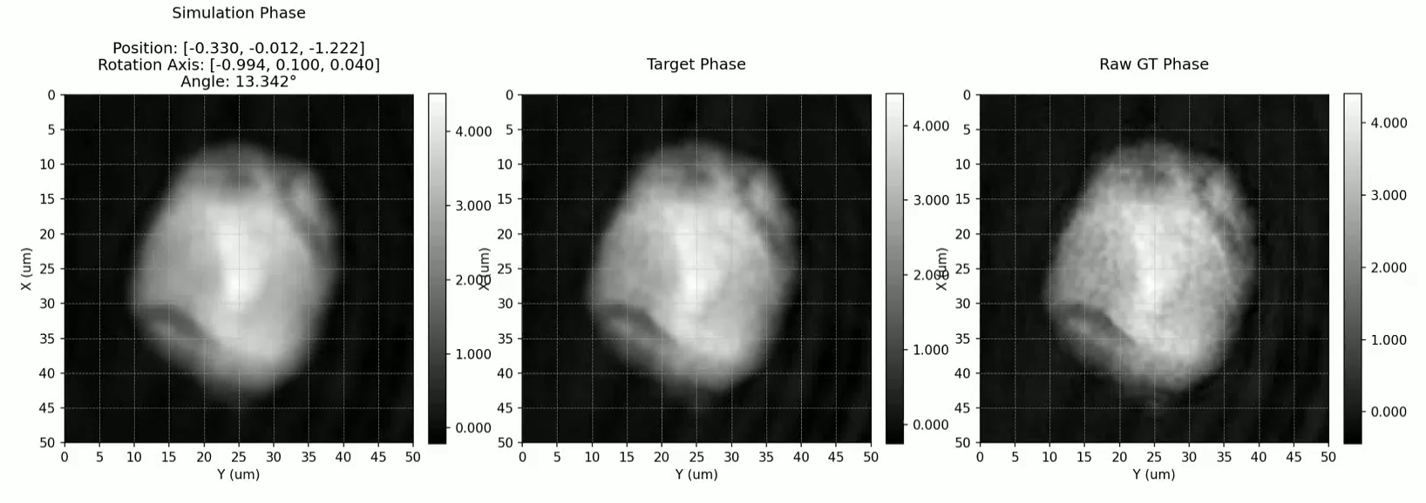
We Did it?
The Fix?:
Problem:
Increase the rotation smoothness regularizer until it works.
Add circular constraints for pose regularization.
Are these the actual poses?
They look at least to be correct.

Slide 8
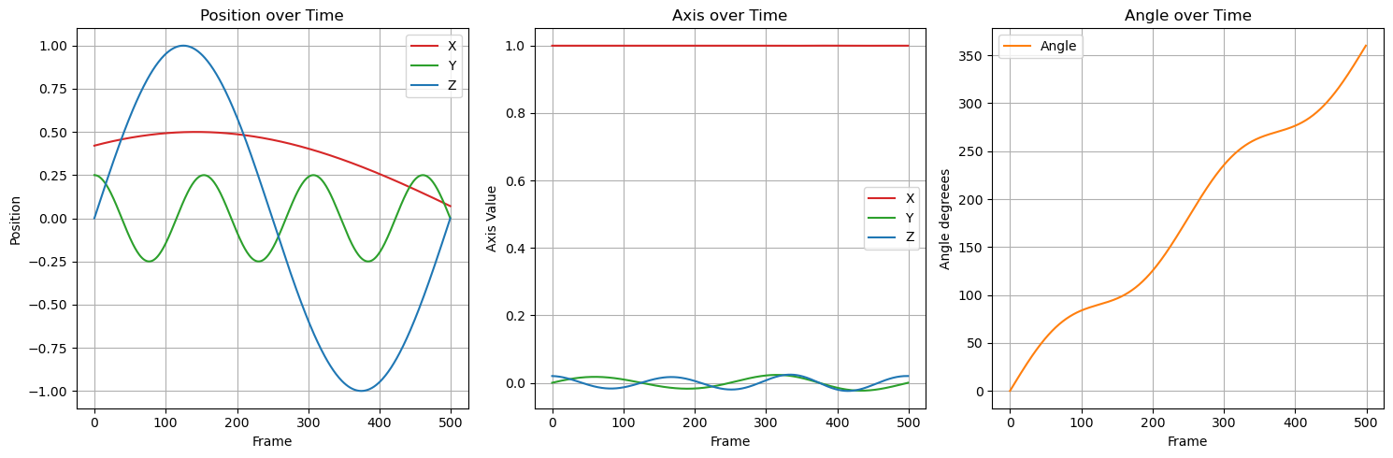
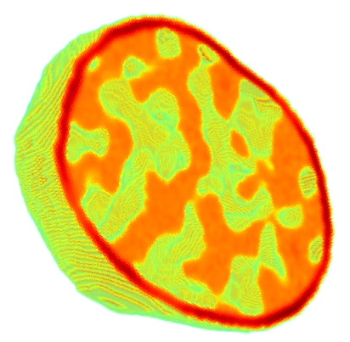
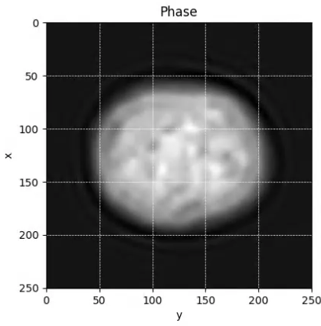
Synthetic Data - CytoPacq
Requirement:
If we want to compare with Moser et al., we need data with known ground truth.
Ground Truth Data
Handcrafted Poses Trajectories
Cell Structure: CytoPacq
Phase Images via our Forward Simulation
From There:
Create Initial Object
Run Optimization
CytoPacq: https://cbia.fi.muni.cz/simulator

Slide 9
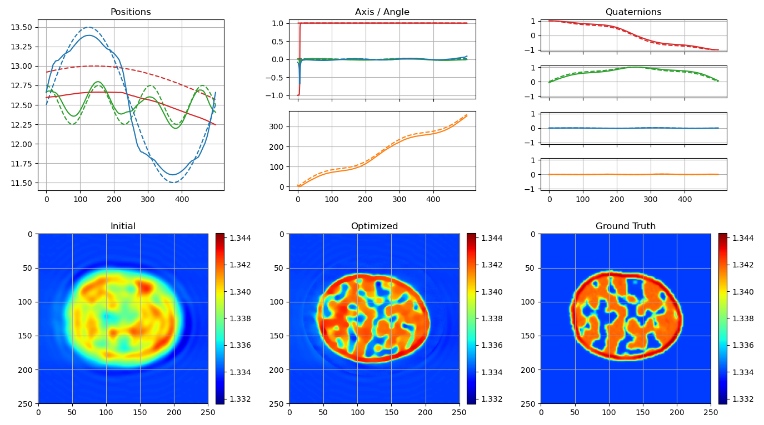
Synthetic: Frame-by-Frame

Slide 10
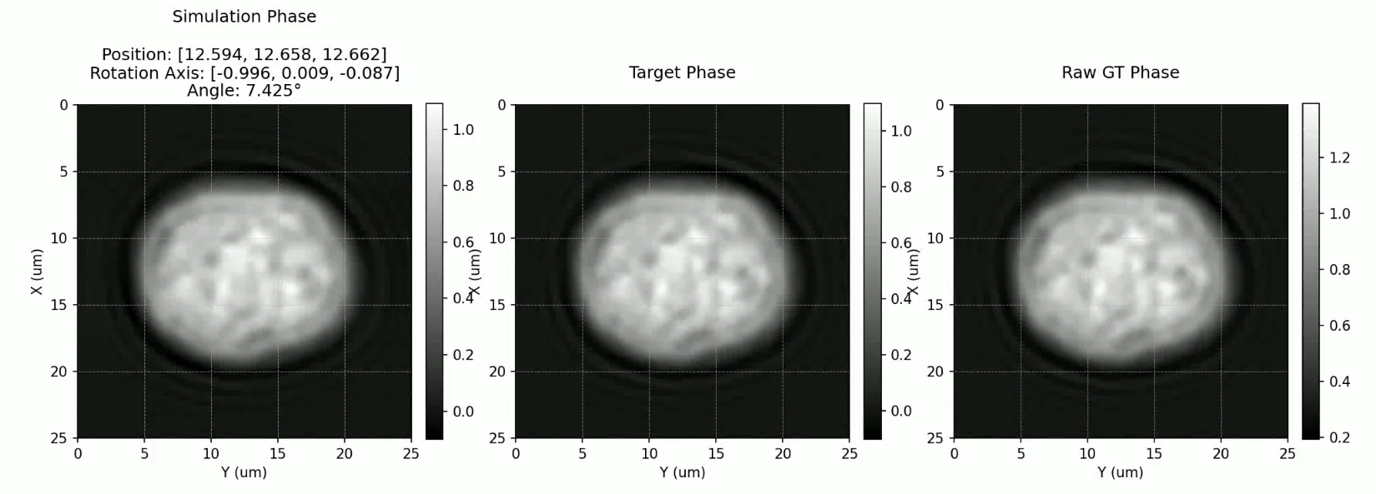
Synthetic: Frame-by-Frame

Slide 11
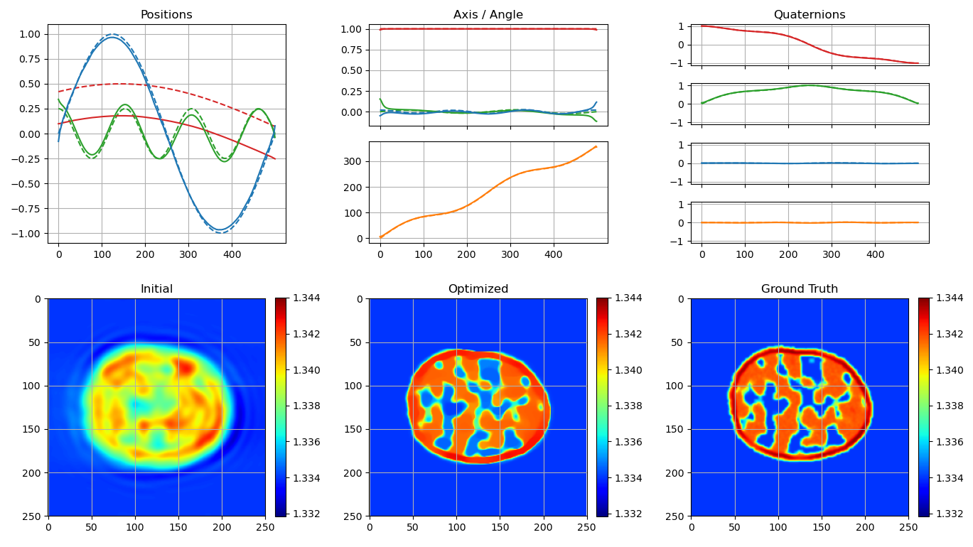
Synthetic: Moser et al.

Slide 12
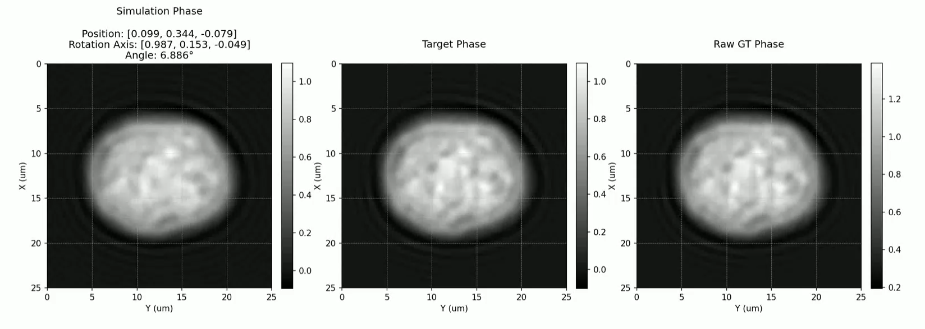
Synthetic: Moser et al.

Slide 13
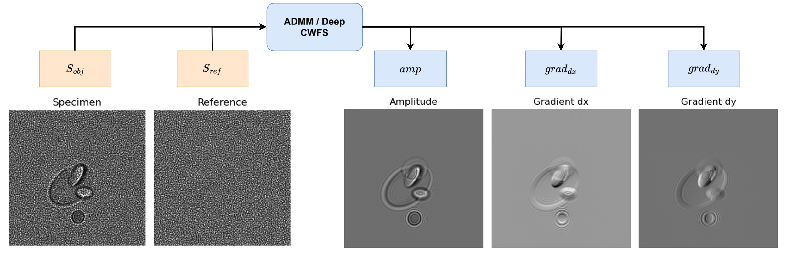
Coded Wavefront Sensing
How to capture phase images:
Digital Holographic Microscopy (DHM)
Coded Wavefront Sensing (CWFS)
CWFS:

Slide 14
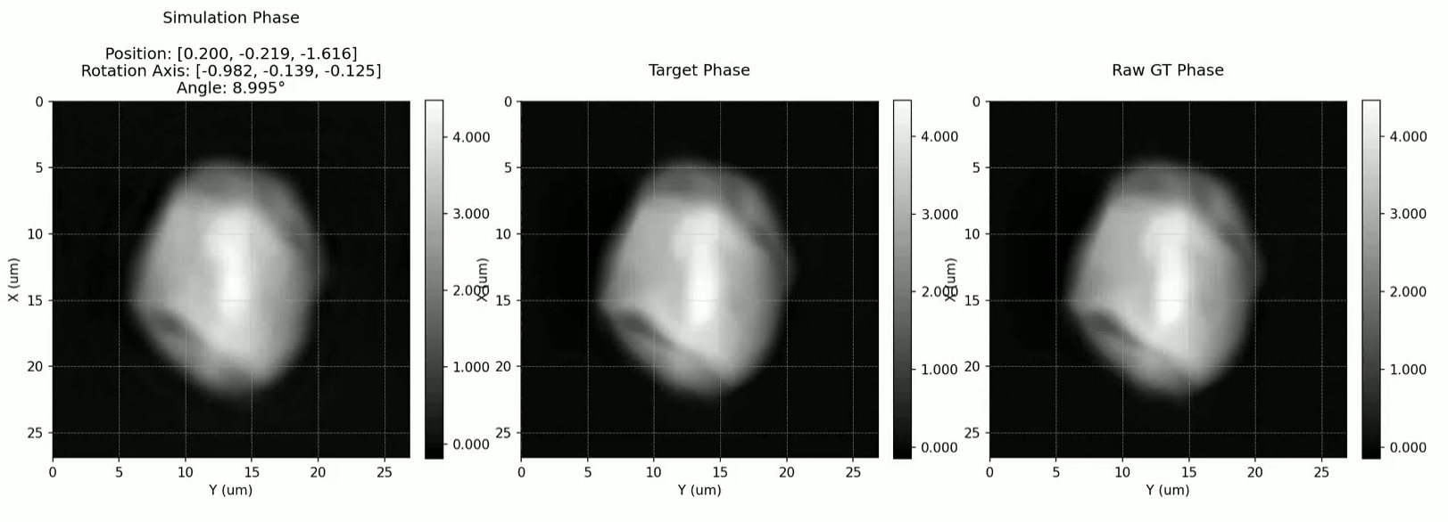
Deep CWFS Optimization

Slide 15
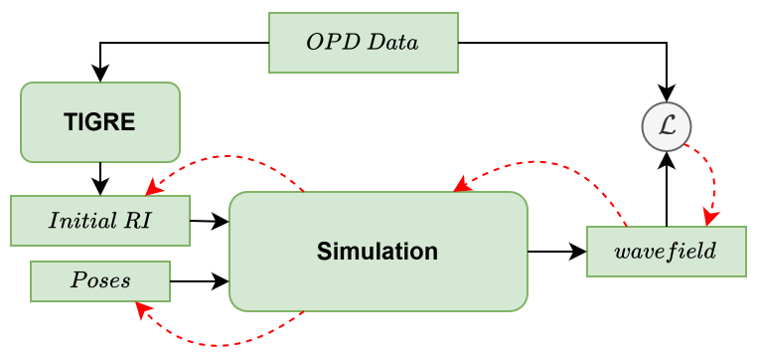
Simplified Simulation
Basic Simulation:
Create Initial Volume based on Optical Path Difference (OPD) data.
Optimize parameters by comparing OPD data.

Slide 16
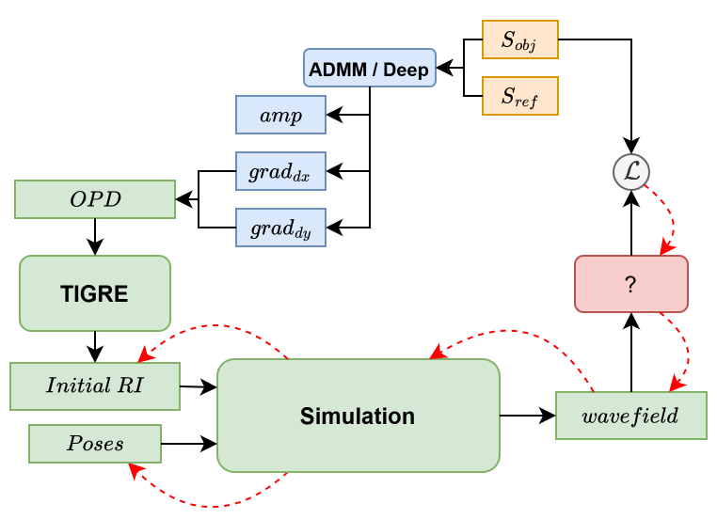
Optimize on Speckle Patterns Directly
Compare to Sensor Data directly?
Requires some way to go from complex wavefield to speckle data.

Slide 17
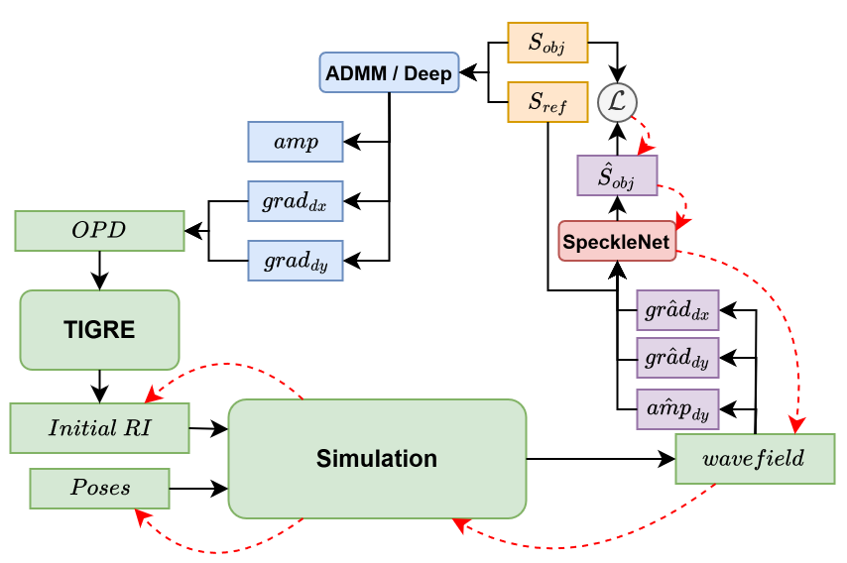
SpeckleNet
Add a small Network:
Predict Speckle pattern, based on complex wavefield and recorded reference.

Slide 18
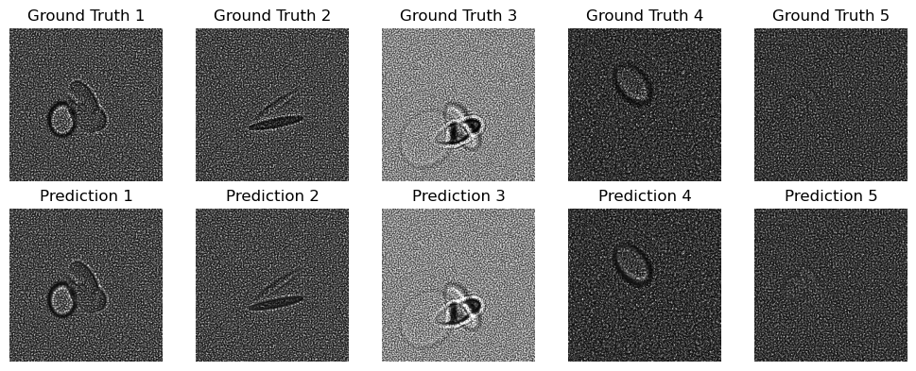
Pre-training Specklenet
So far:
Train SpeckleNet on synthetic ellipsoid data.
Hope that it generalizes to the real data / outputs of our simulation.

Slide 19
Thank you!

