Slide 1
trackopt - Update
Jannis Maron
Universität Siegen

Slide 2
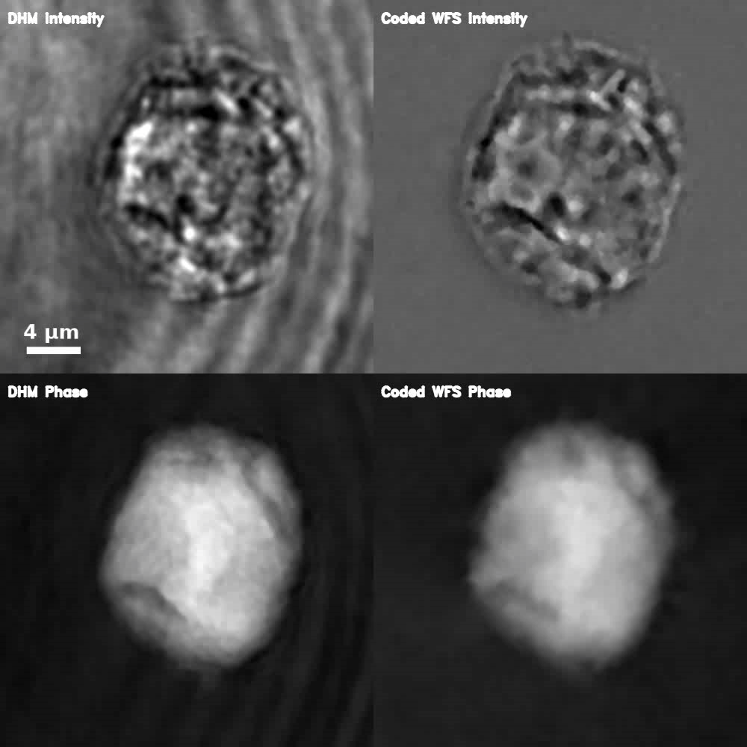
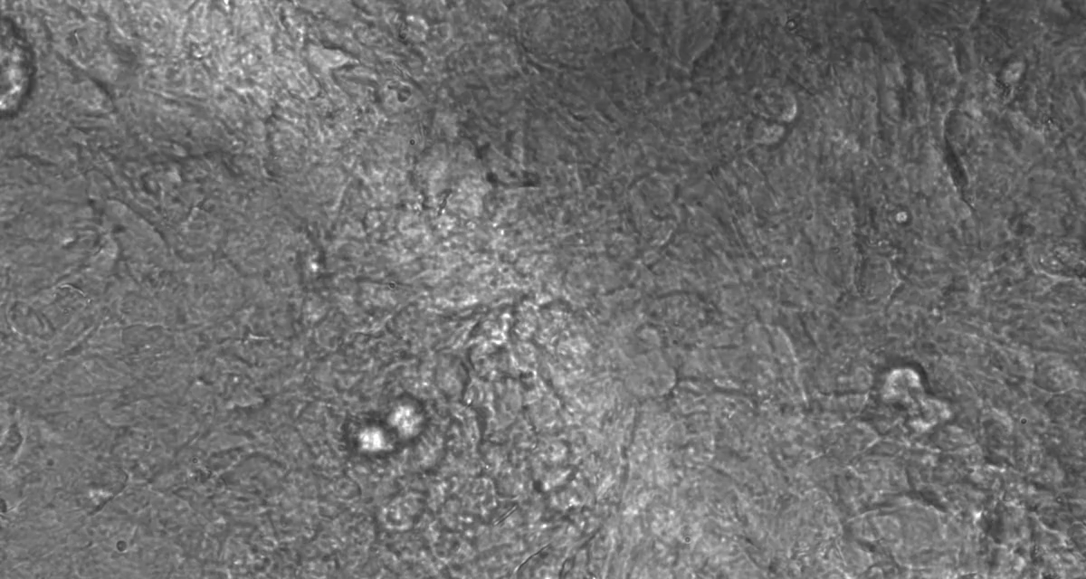
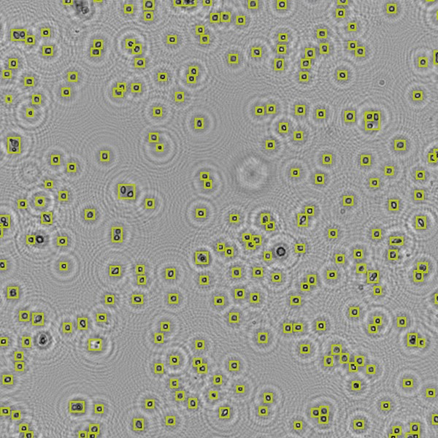
Applications
Rigid Body Motion
Elastic Deformation
Holographic Particles
Source: Prof. Jari Hyttinen, Tampere University
Source: anvajo - fludlab-r300

Slide 3
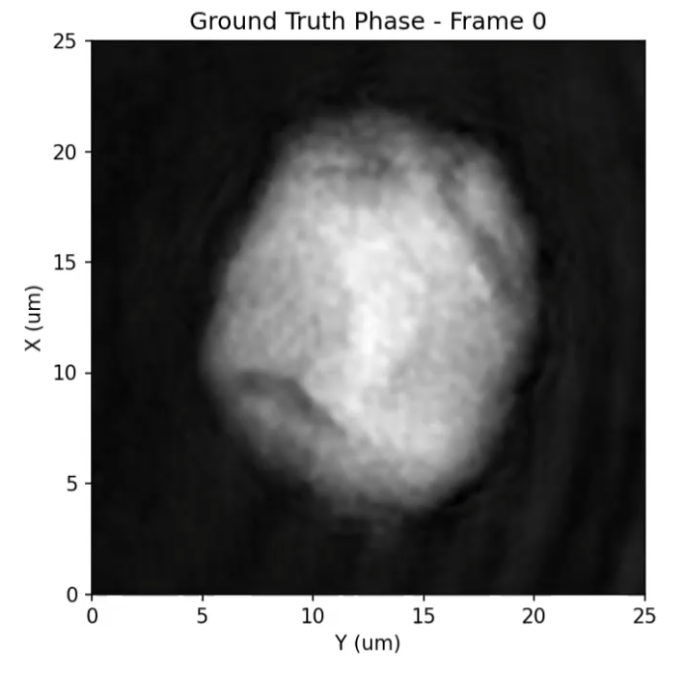
Rigid Body Motion
We Observed:
Phase-Video of a rotating transparent HEK Cell.
The Goal:
Reconstruct the Refractive Index (RI) distribution of the cell as a 3D Volume.
⇒ RI-Tomography
Problem:
We don’t know:
Geometry of the cell.
Pose for any given frame.
  Translation
  Rotation
What to do?
Work with some initial assumptions.
Simulate the scattering of the wavefield.
Then optimize geometry/poses to fit the video sequence.
Observed Phase of a rotating HEK Cell

Slide 4
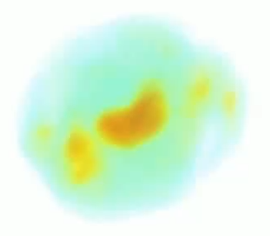
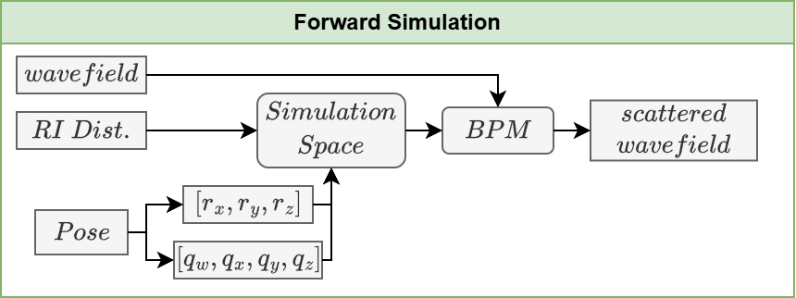
Recap: Last time
Estimated Initial RI Distribution:
Based on a non-scattering tomography with sensible poses.
Fixed position/rotation axis
Constant angular velocity
Wavefield Simulation:
Simulate scattering of a wavefield through an RI Distribution, where we are in control of:
Geometry
Position
Rotation

Slide 5
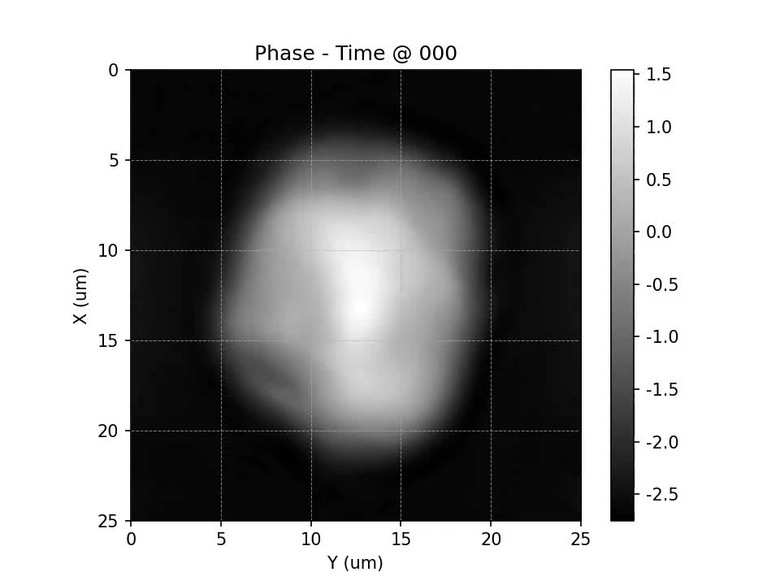
Recap: Forward Simulation
Next:
Optimize the pose to obtain a better guess for the RI Distribution.
Notes:
TODO:
- Redo Video with Clean GT DHM Data

Slide 6
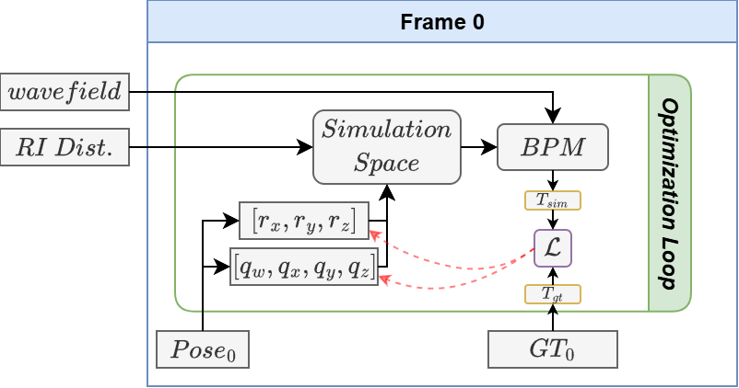
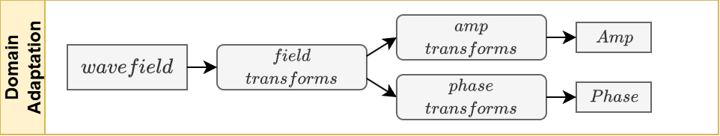
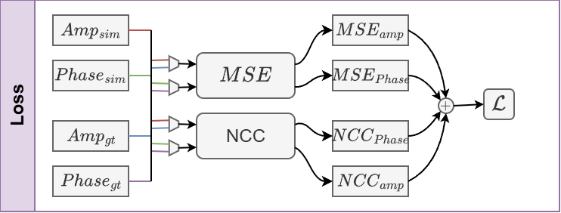
Single Frame Optimization
Optimization
Update pose parameters using gradient descent, comparing the simulated wavefield to the real wavefield.
Domain Adaptations:
Increase similarities between the ground truth and the simulated wavefield using different transforms:
Upscaling/Cropping
Gaussian Blur
Normalization
Objective/Loss Function
Compute Loss by comparing the Mean Squared Error and Normalized Cross-Entropy of simulated amplitude and phase to their ground truth counterparts.
Notes:
Create Animation

Slide 7
Single Frame Optimization
Optimization
Update pose parameters using gradient descent, comparing the simulated wavefield to the real wavefield.
Domain Adaptations:
Increase similarities between the ground truth and the simulated wavefield using different transforms:
Upscaling/Cropping
Gaussian Blur
Normalization
Objective/Loss Function
Compute Loss by comparing the Mean Squared Error and Normalized Cross-Entropy of simulated amplitude and phase to their ground truth counterparts.
Notes:
Create Animation

Slide 8
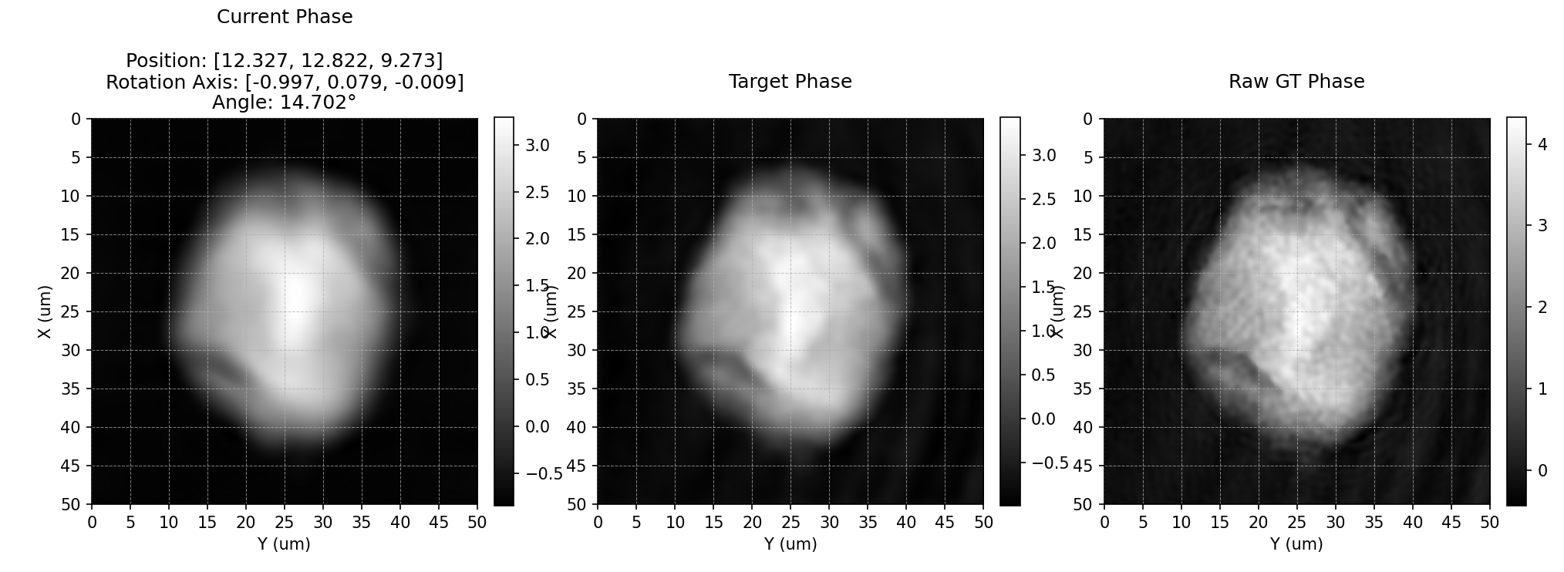
Single Frame Optimization
Success!
We can find a pose such that our simulated wavefield resembles the real wavefield.
What now?
Optimize the whole video sequence!

Slide 9
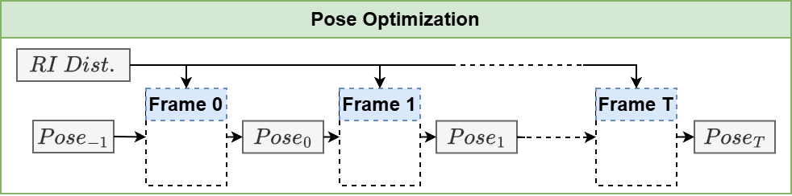
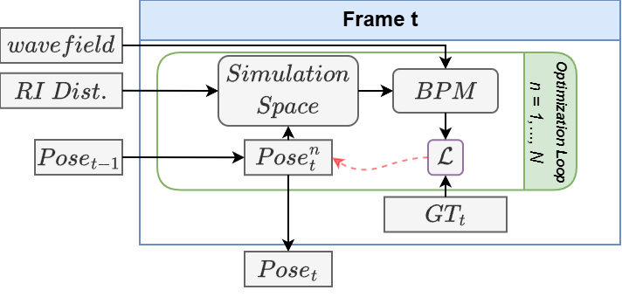
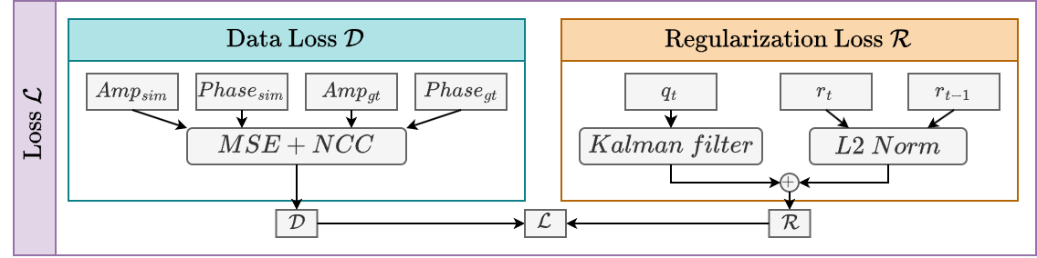
Frame-by-Frame Pose Optimization
Next Frame:
Initialize the next frame with the best pose of the previous frame.
Regularization:
Add an additional Regularization Loss to our previous Data Loss to encourage a smooth pose trajectory.
L2 Distance between subsequent Positions
Kalman Filter predictions for subsequent Rotations
Notes:
Create Animation

Slide 10
Frame-by-Frame Pose Optimization
Next Frame:
Initialize the next frame with the best pose of the previous frame.
Regularization:
Add an additional Regularization Loss to our previous Data Loss to encourage a smooth pose trajectory.
L2 Distance between subsequent Positions
Kalman Filter predictions for subsequent Rotations
Notes:
Create Animation

Slide 11
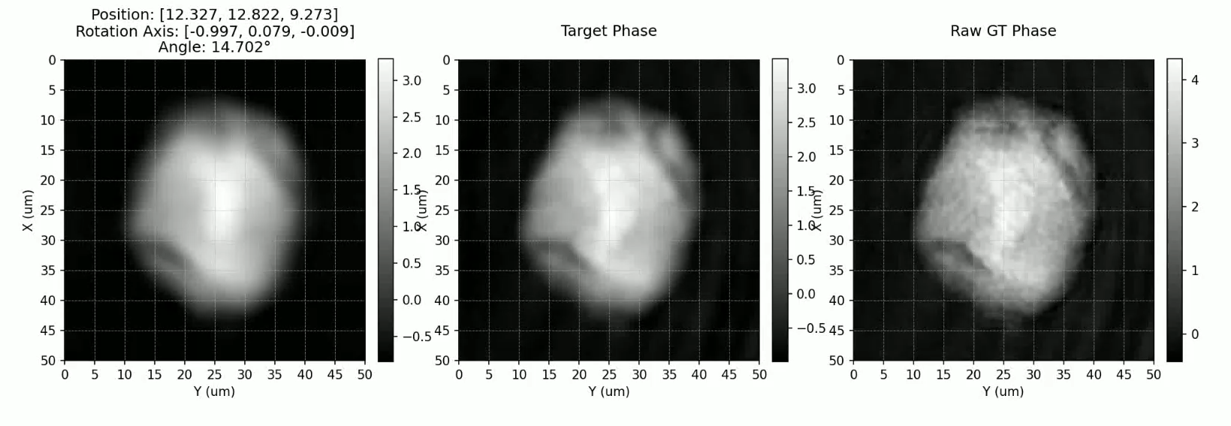
Frame-by-Frame Pose Optimization

Slide 12
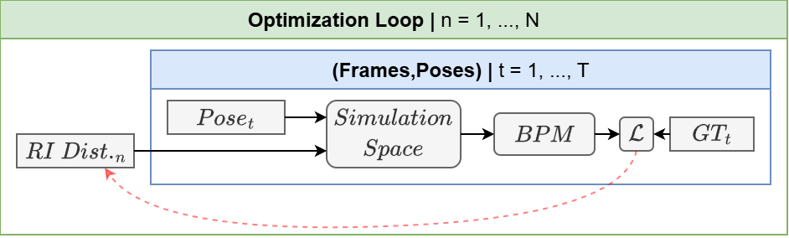
Reconstruction Optimization
Problem:
We were unable to utilize the improved pose estimates to apply non-scattering RI-Tomography and obtain a better RI Distribution.
Solution:
⇒ Use our Simulation!
Rather than updating the poses, update the 3D volume.
Reconstruction Optimization:
Run the simulation for every optimized pose/frame and accumulate gradients. Update the 3D Volume once we have passed every pose.
Reconstruction Regularization:
Use a TV Regularization to encourage a smooth 3D volume.

Slide 13
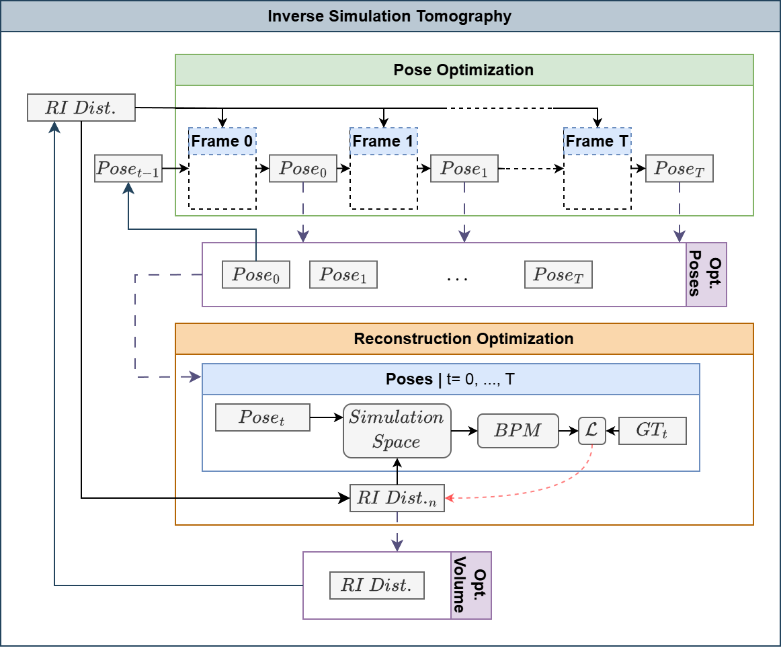
Inverse Simulation Tomography
⇒ End-to-End Optimization
Initialization:
Estimated RI Distribution
Guessed Pose for first frame
Combined Optimization:
Perform Pose Optimization to get updated poses.
Update Volume with the Reconstruction Optimization using the updated poses.
Repeat with updated RI. Distribution and pose of the first frame.
Update Domain Adaptations:
Reduce Gaussian blur every full loop.

Slide 14
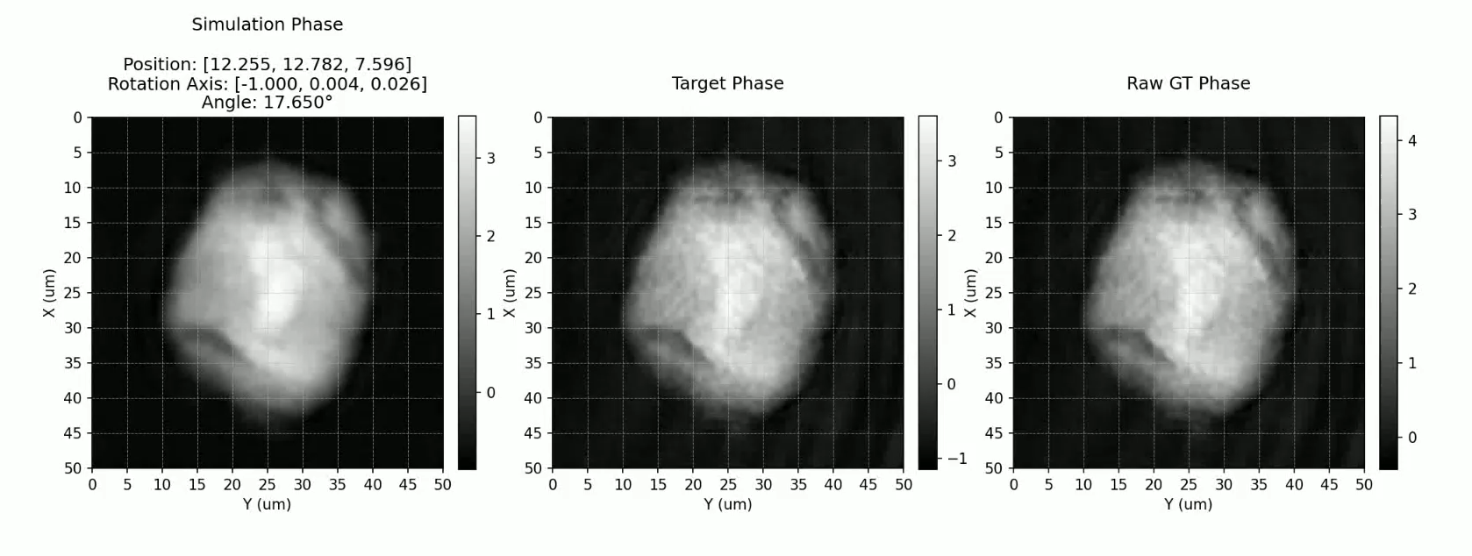
Inverse Simulation Tomography

Slide 15
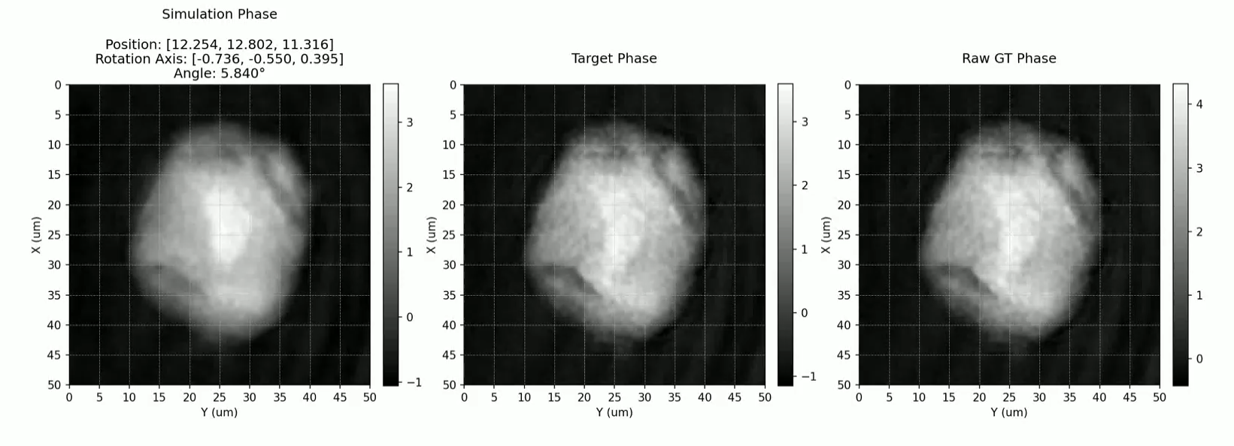
Current State of things
We aren’t the first to do this!
Moser et al.: Optical tomography reconstructing 3D motion and structure of multi-scattering samples under rotational actuation
Problem:
So far, we haven’t been able to reproduce their method successfully.

Slide 16
The Future
Soon:
Novelty to Moser et al. and publish results.
Extend to new data (Coded WFS)
Technical ablation (What does work, what doesn’t)
Incremental improvements
And then?
New Tasks, new challenges.
Elastic Deformation
Holographic Particles

Slide 17
Thank you!
Jannis.Maron@uni-siegen.de

