Slide 1
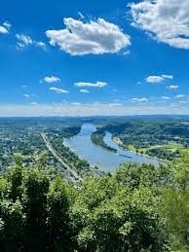



Physics Beyond the SM
Under The Higgs Lamppost
Tao Han
Pitt PACC, Univ. of Pittsburgh
Herbstschule of High Energy Physics 2025
Bad Honnef, Sept. 8 – 11, 2025

Slide 2
Physics Beyond the SM
Under The Higgs Lamppost
  The Quest for the SM & Beyond
  A Strongly-coupled EW Sector
  A Weakly-coupled Extension
  Flavors of Matter Fields & EFT

Slide 3
Why the weak scale M_{W} is so much smaller than M_{Pl}?
Dynamical generation: dimensional transmutation
Controlled by symmetry:
Shift symmetry (Nambu-Goldstone boson)
Super-symmetry (elementary particles)
Discrete symmetries

Slide 4
Supersymmetry: an elegant formalism
Julius Wess & Bruno Zumino (in 1974)
Generalized extension of Poincare group of spacetime symmetry
Critical ingredients for string theory:
World sheet/Spacetime SUSY
Low energy effective field theory from compactification
Eliminate the cosmological constant upto
symmetry breaking
Stabilizes weak scale at all orders
Potential Grand Unification of EW & QCD
Natural WIMP dark matter candidate

Slide 5

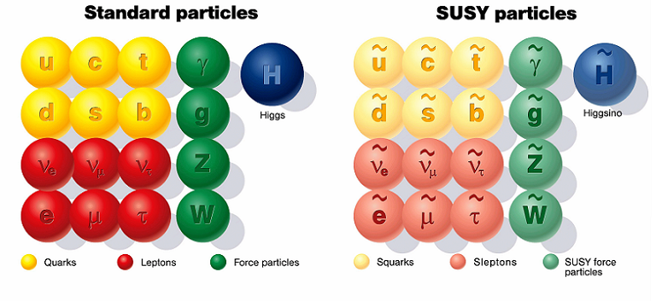
Supersymmetry: fermion <-> boson
Under SUSY, the two partners must
Have the same mass, the same coupling
Spin different by ½
Since we have not seen a partner of same mass,
SUSY must be broken, at a higher scale.

Slide 6
Minimal Supersymmetric Standard-Model (MSSM)
→ “Weak scale” supersymmetry!

Slide 8
General parameter selection:
Phenomenological MSSM (pMSSM)

Slide 9


Slide 10
“Natural SUSY”: Radiative EWSB
Assume higher scales correlated ,
only insist on light Higgsinos:
Cohen, Kaplan, Nelson, 1996
Hall, Pinner, Ruderman, 2012
Baer, Barger, Huang, Tata, 2012

Slide 11
Higgs mass corrections & Heavy Higgs bosons
m_{H}² ≈ M_{Z}² cos²2β + Δm²_{SUSY}
Tree-level <(80 GeV)² + loop-level: >(45 GeV)²
Need large tanβ;
m_{stop} & mixing X_{t} >> m_{t}
sensitive to 𝛍, the Higgsino parameter
(more parameter space here!)
“Little hierarchy problem”

Slide 12
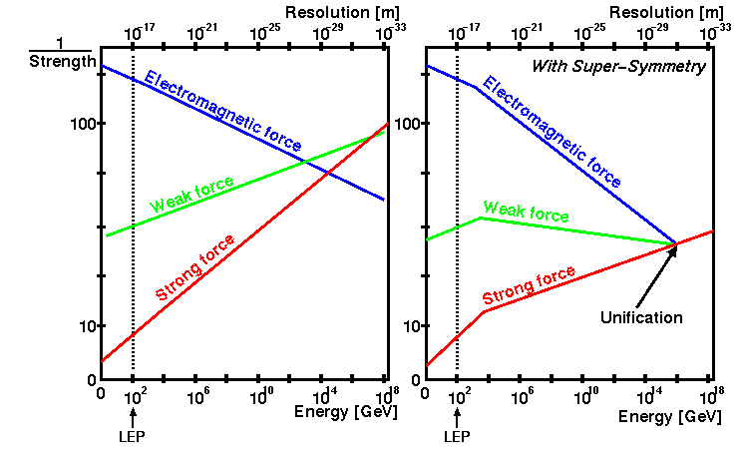
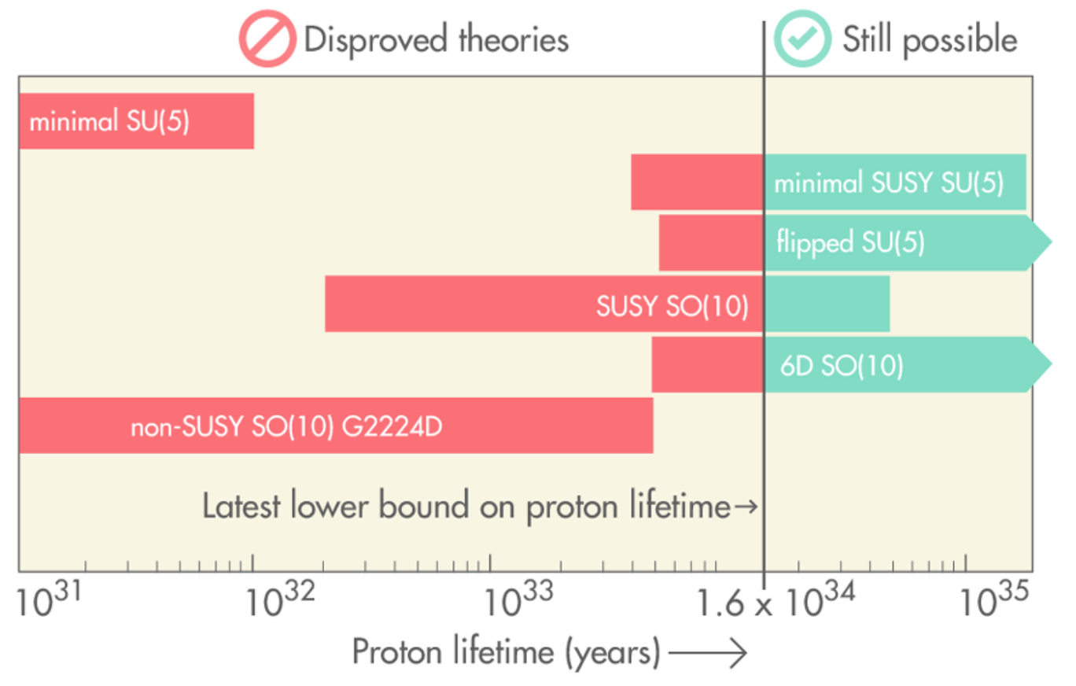
SUSY Grand Unification
Proton decay bounds
--- SUSY helps!

Slide 13
However,
Currently, 𝜟_{BG}(mSUGRA) > 1000

Slide 15
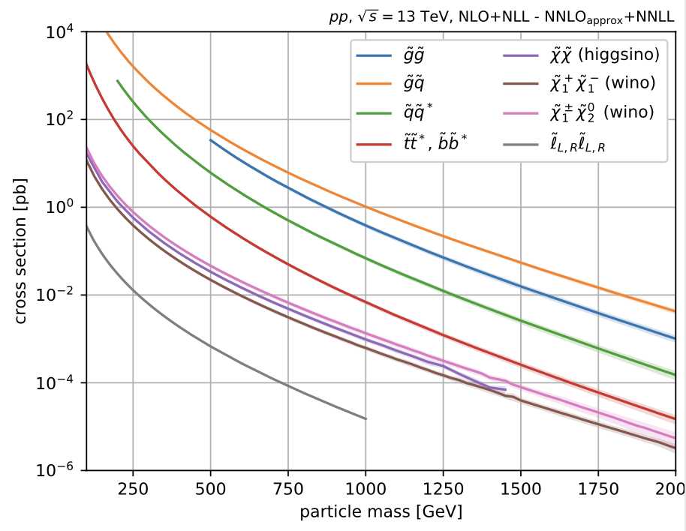
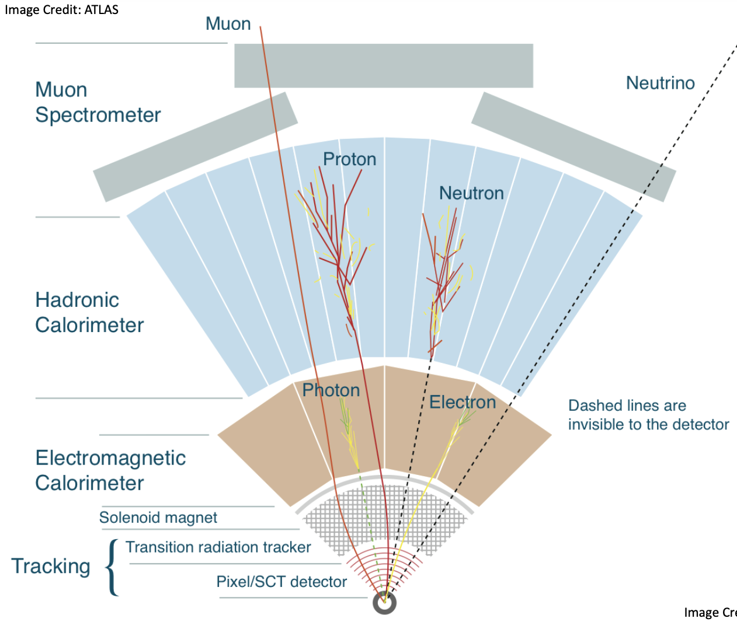

Slide 16
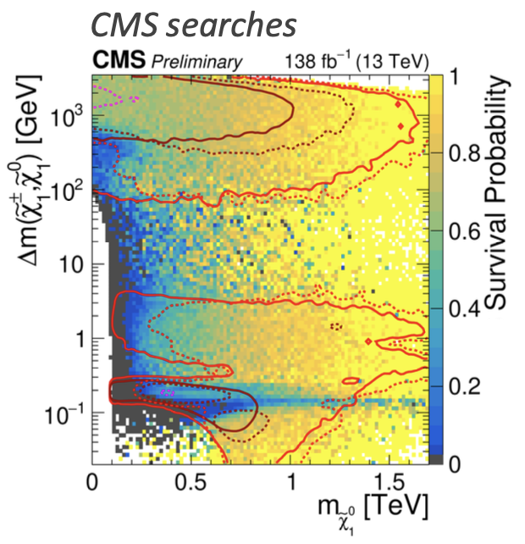
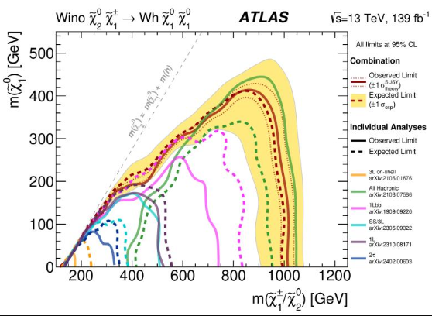
Smoking gun signal for SUSY ---
Large missing transverse momentum:

Slide 17
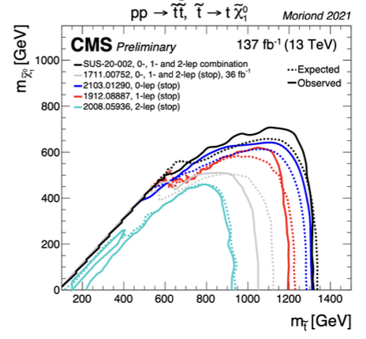
Top-partner is the most likely suspect
SUSY on Trial:

Slide 18
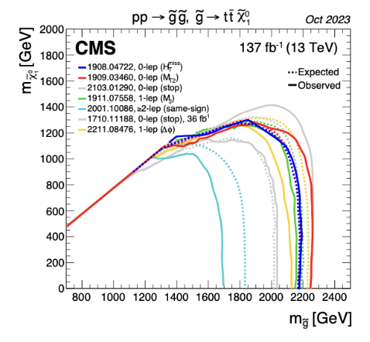
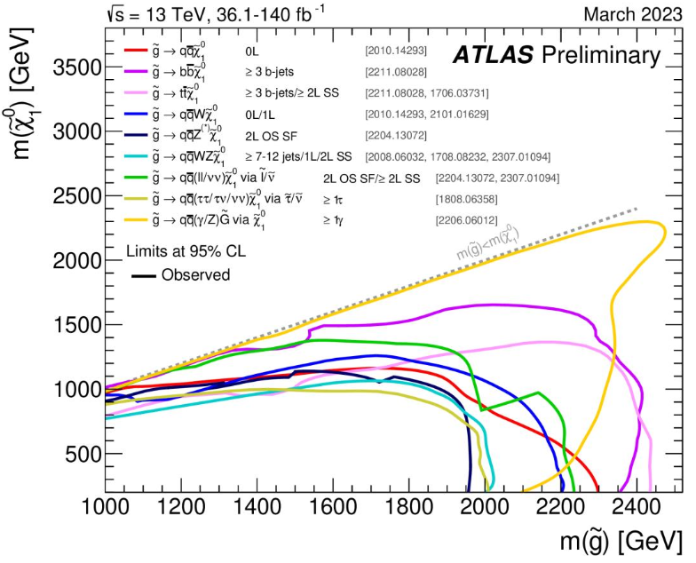
Gluinos are the next candidate!

Slide 19
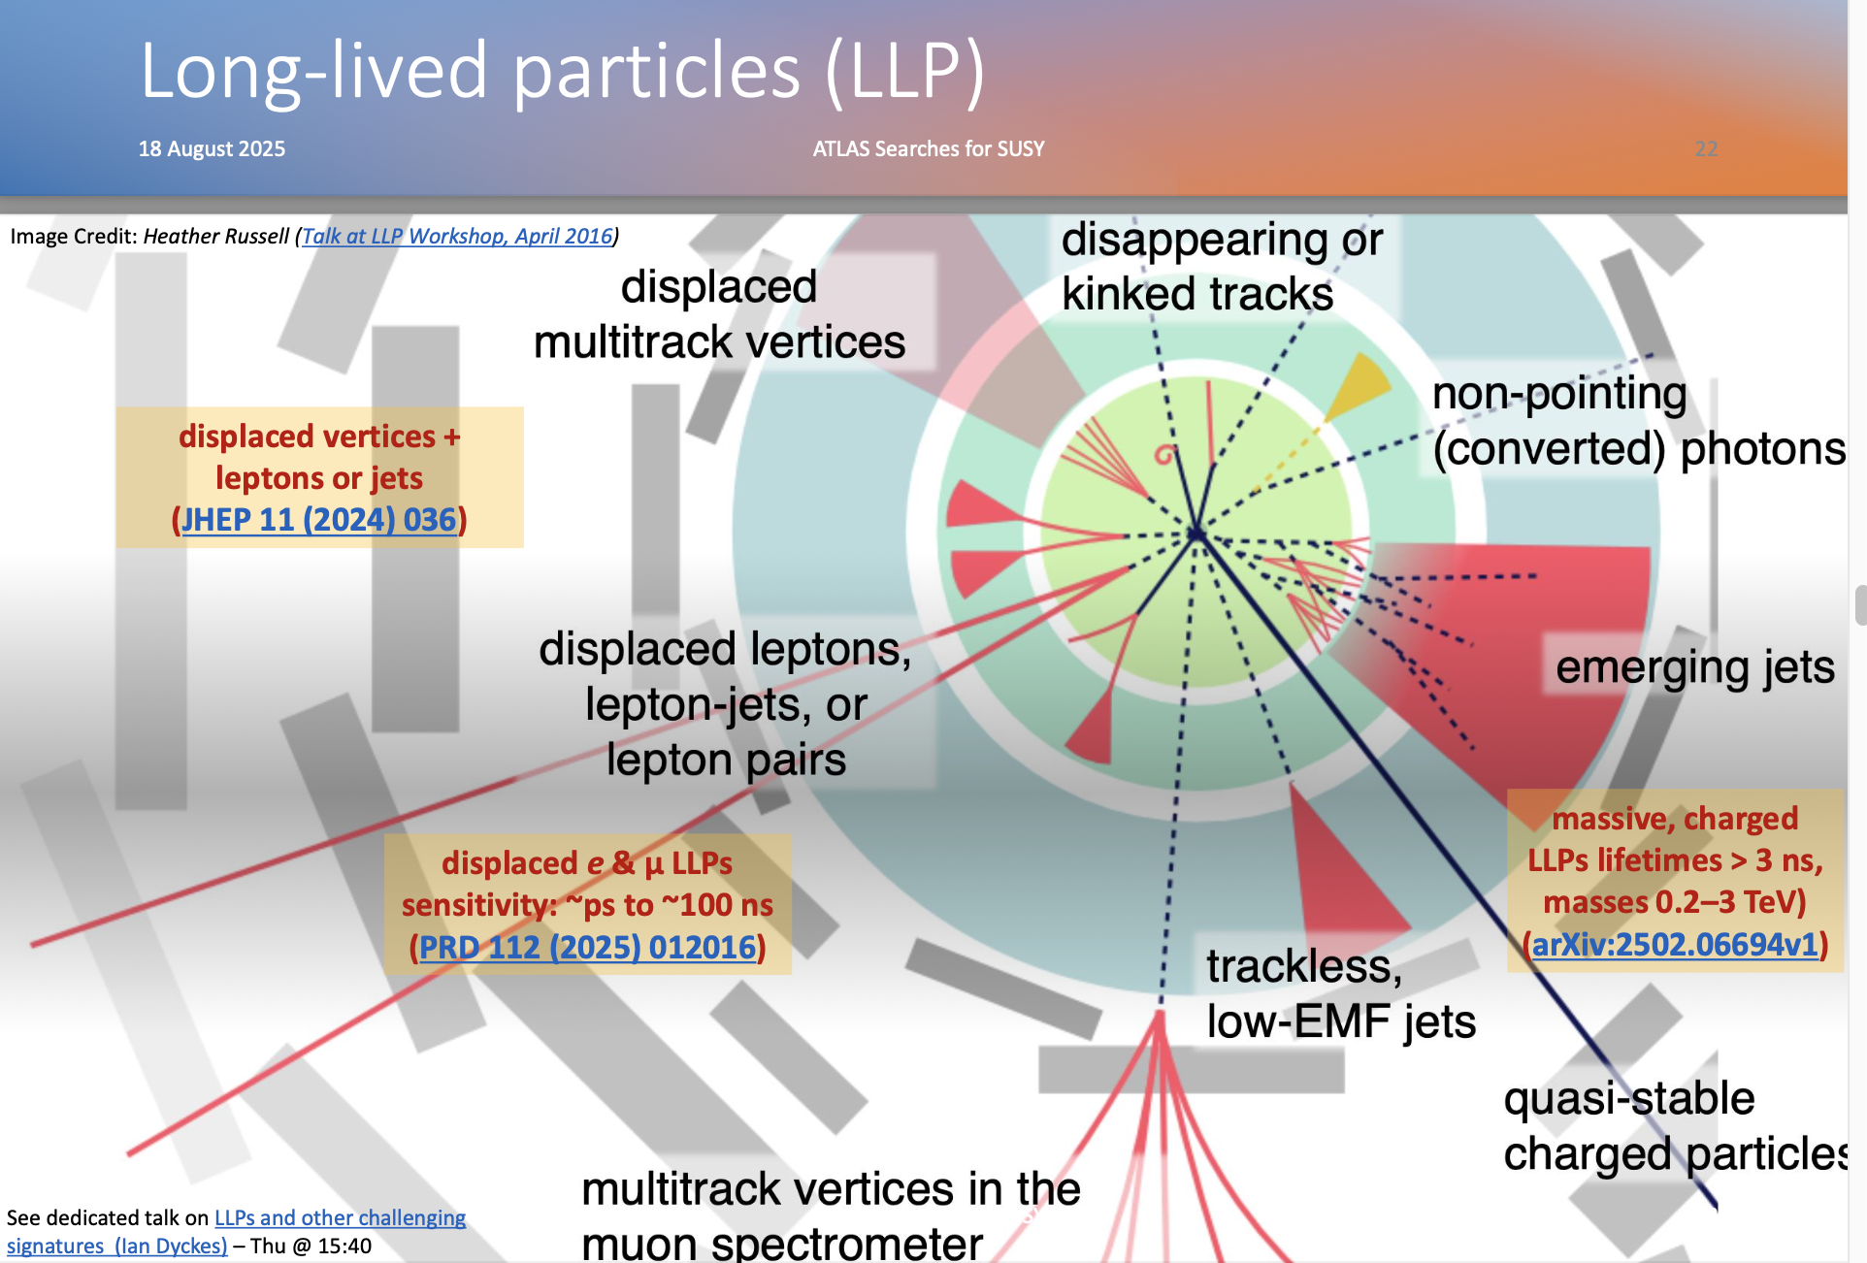

Slide 20

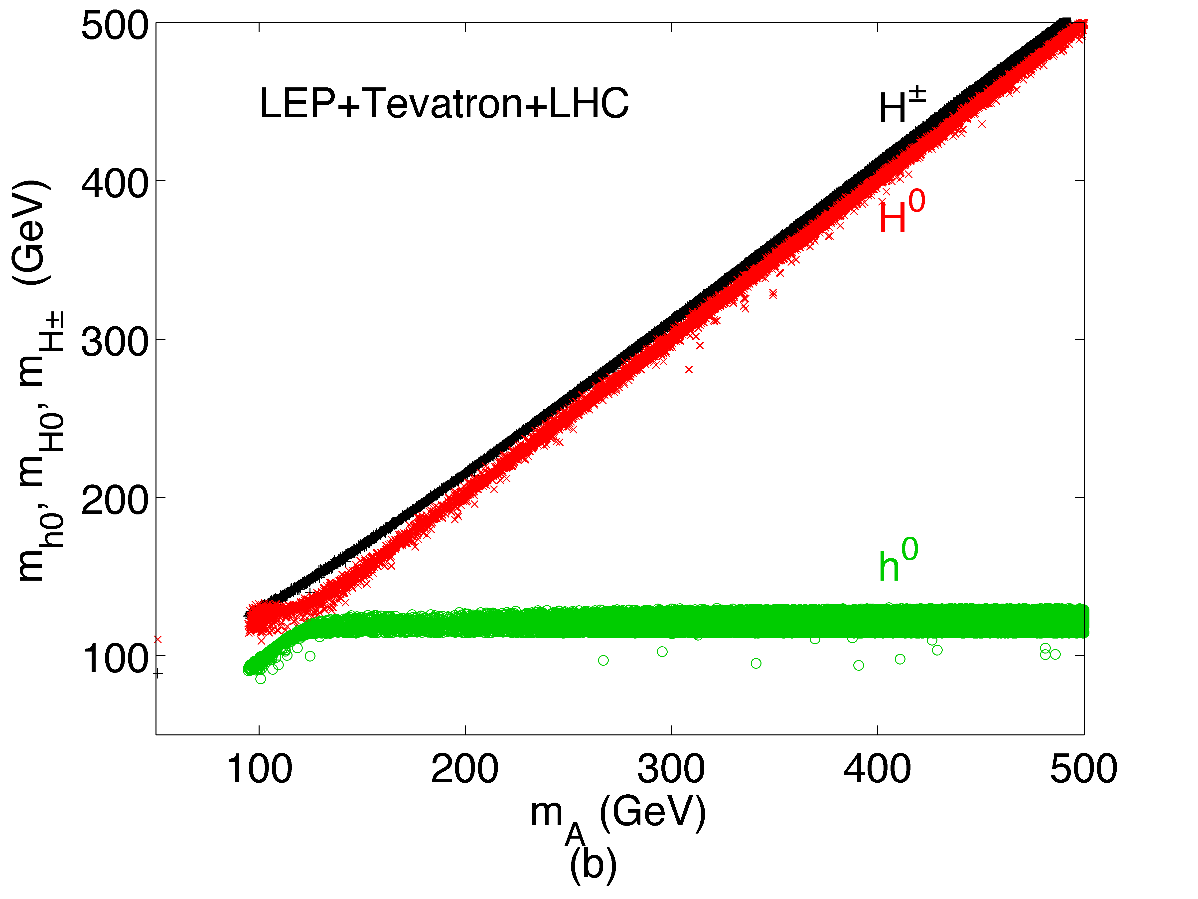

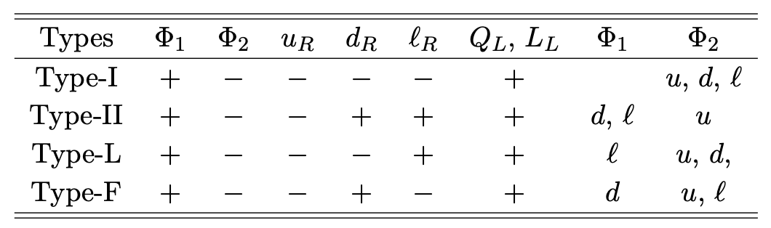
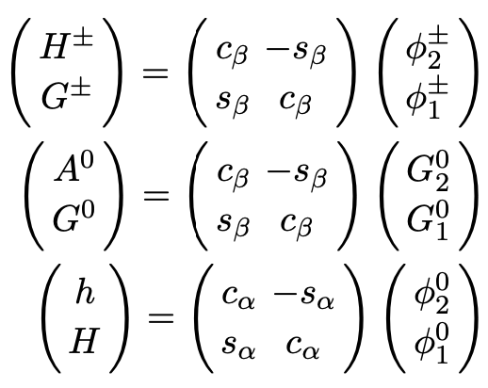
Missing siblings:
Two Higgs-Doublet Model
5 Higgs bosons:
Collider constraints:
Tree-level mass given by:
General 2HDM with Z₂ symm
125

Slide 21
“Naturally speaking”:
H⁰ should not be a lonely particle; has an “interactive friend circle”:
and partners …
“Little hierarchy problem”
The Jury is still out (again) …

Slide 22
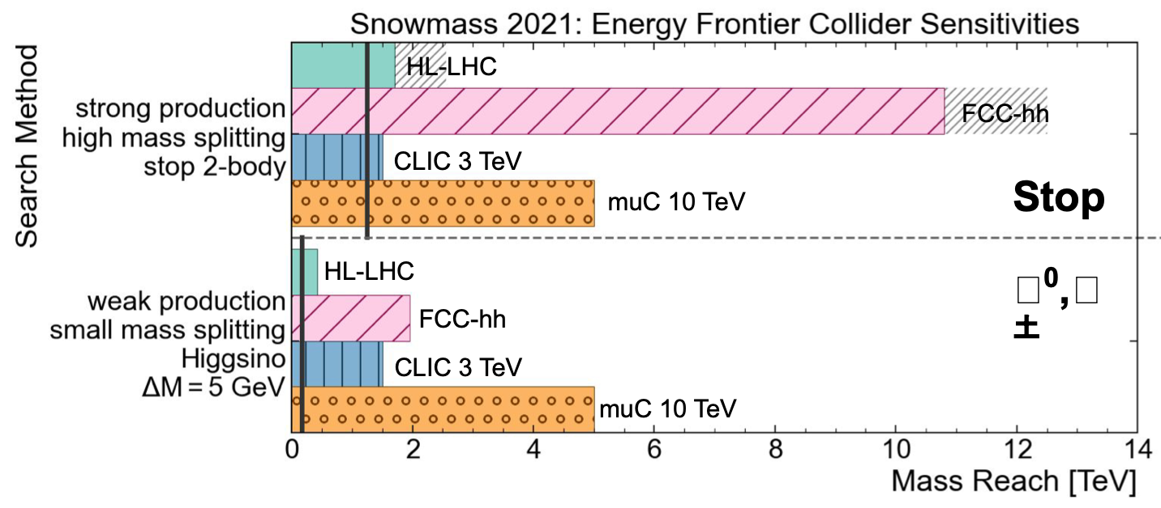
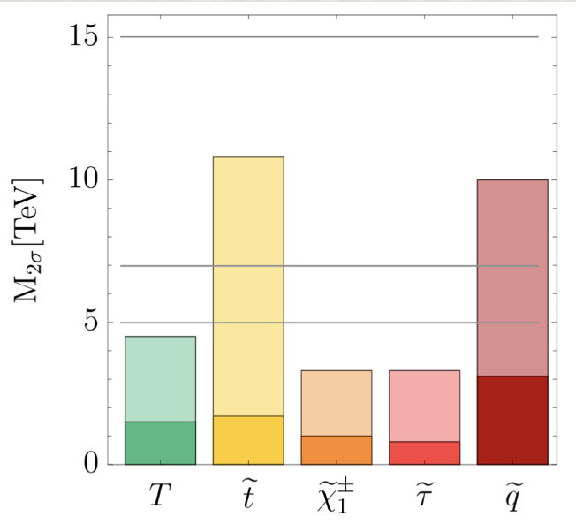
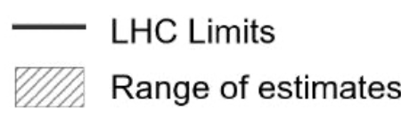

Future prospects:
pushing the “Naturalness” limit
The searches for top quark partners & gluinos, gauginos …
E=30
14
10 TeV
gauginos
→ Higgs mass fine-tune: δm_{H}/m_{H} ~ 1% (1 TeV/Λ)²
Thus, m_{stop} > 8 TeV → 10⁻⁴ fine-tune!

Slide 23


SUSY WIMP DM
The lightest neutralino could be a natural WIMP dark matter candidate!
GeV low mass:
DD difficult;
Collider complementary
100 GeV or higher mass:
DD + ID + HE Collider

Slide 24

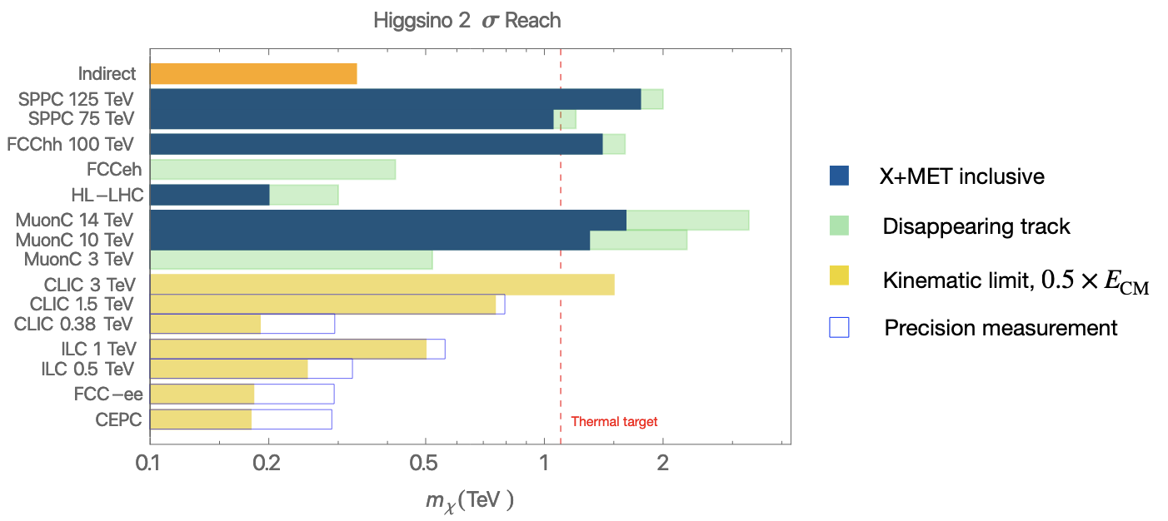
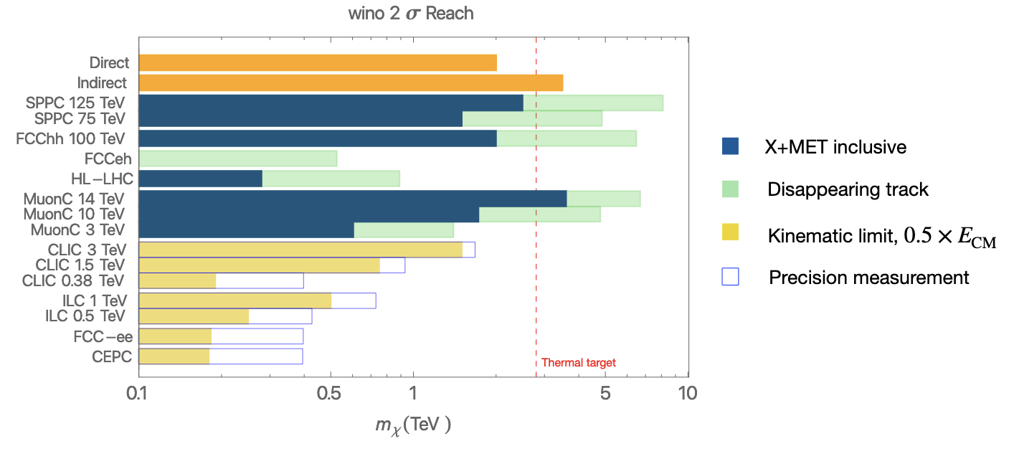
Utilizing the missing-mass technique for DM search,
covering the thermal target
~1.1 TeV
~2.8 TeV
TH, Z. Liu, L.T. Wang, X. Wang: arXiv:2009.11287; arXiv:2203.07351

Slide 25
Alternative to “Naturalness”: SUSY “splitted”?
Nima Arkani-Hamed,
Giudice, Delgado, …

Slide 26
Alternatives to “Naturalness”?
String theory predicts: there are at least 10^{272,000} vacau!
And we just so happen to live here …(Don’t ask why!)

Slide 27
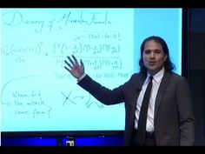
-- Nima Arkani-Hamed

