Slide 1

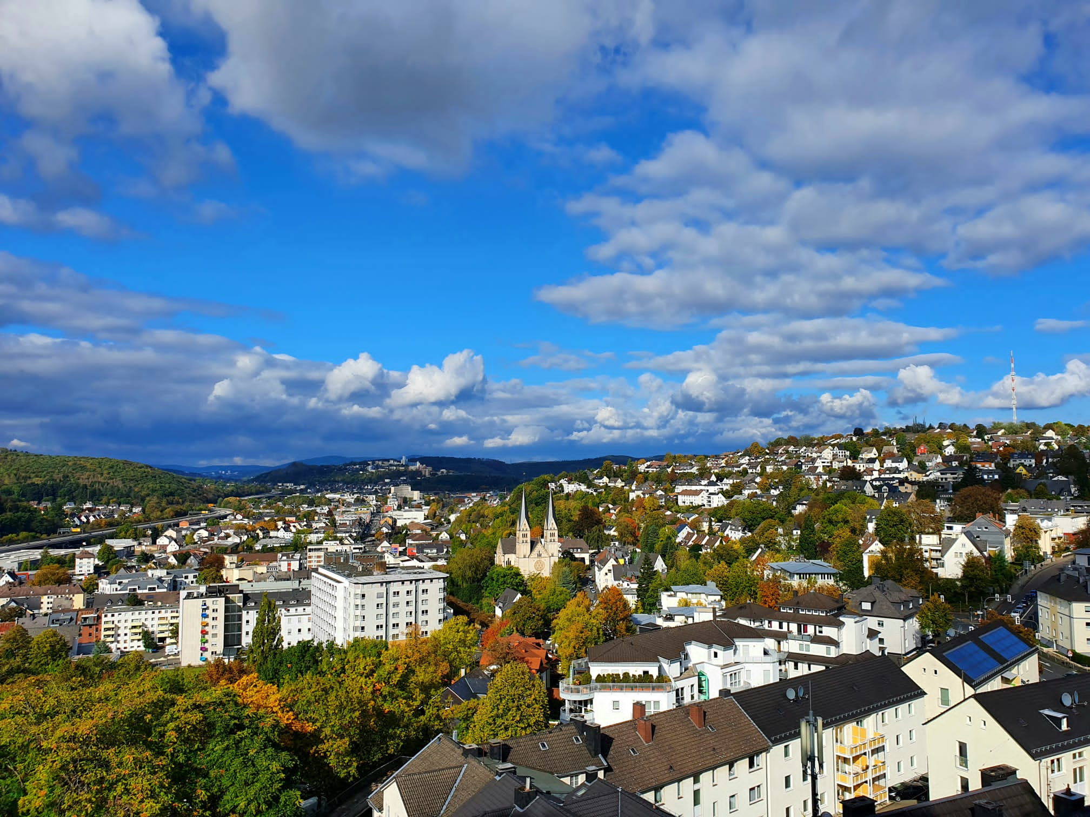
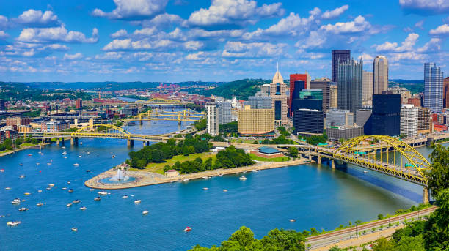
Quantum Tomography:
Spin states & Flavor Oscillations
Tao Han
Pitt PACC, University of Pittsburgh
Beyond Flavor Physics
University of Siegen, June 23, 2025
K. Cheng, TH, M. Low, A. Wu: arXiv: 2311.09166; 2407.01672; 2410.08303; 2507.xxxxx

Slide 2
Disclaimer:
In HEP experiments, we do not “test quantum mechanics” in the EPR (Einstein-Podolsky-Rosen) sense.
Our goals:
In the framework of QFT, in the HE regime at colliders,
We lay out the QM predictions / information:
Entanglement, Bell variables, Discord, Magic …
Hope to establish the quantum tomography.
Understand quantum nature
at this unprecedented regime & seek for BSM effects.

Slide 3
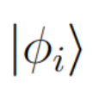
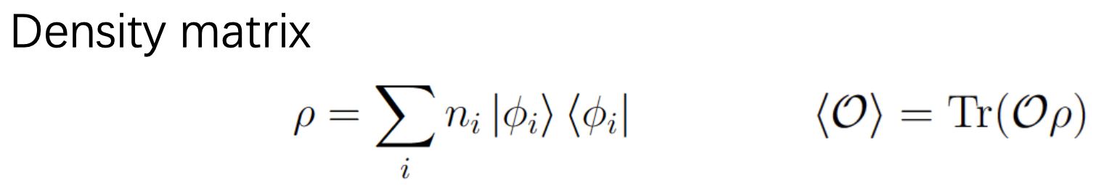
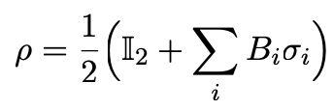
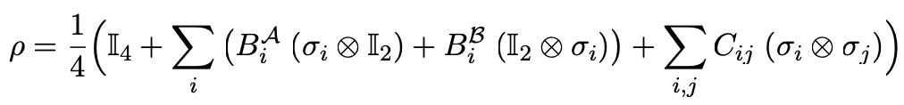
Quantum State & Quantum Tomography
For a state vector
a state an observable
For a pure state: n_{i} =1; for a mixed state: 𝝨_{i} n_{i} =1.
For a single qubit (i.e., a doublet of spin, iso-spin etc.):
For a bipartite system (i.e., ½⊗½)
B_{i}^{A,B} the polarizations, C_{ij} the spin-correlation matrix.
The 15 coefficients for the bipartite → Quantum Tomography,
which encodes the full QI.

Slide 4
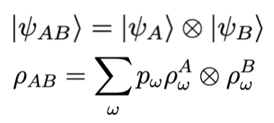

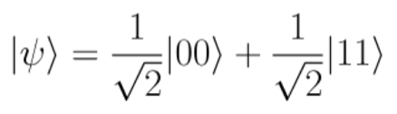
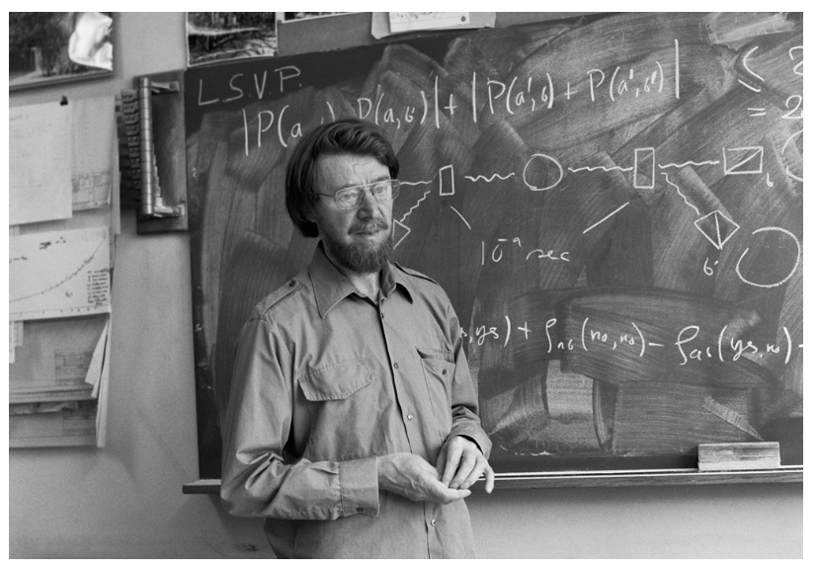
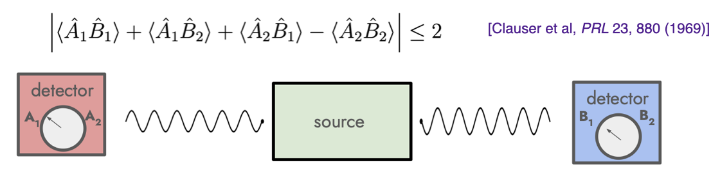
Quantum Information:
Entanglement & Bell Inequality
Entanglement is a genuine QM feature,
no classical correspondence!
If a state can be written as:
then it is “separable”
and thus not entangled.
i.e. separable, not entangled: Non-separable, entangled:
Bell inequality (1964) :
Alice
Bob

Slide 5
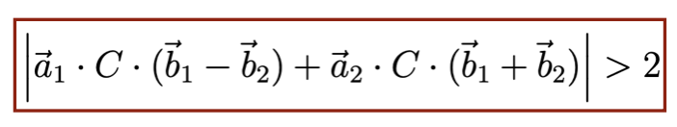
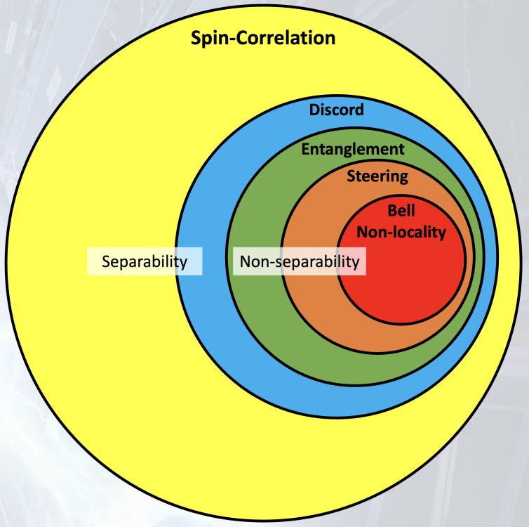
Quantum Information:
Bell Inequality violation & (many) observables
Bell inequality violation in QM:
With the quantum tomography C_{ij} :
→ much more quantum information:
C_{ij}
“Concurrence”: (entanglement CHSH):
0< C(𝛒) <1
“Discord”: the difference between the total mutual information and the classical mutual information
(Shannon entropy vs Von Neumann entropy)
0< D(𝛒_{A}) <1
(Yoav Afik)
“Magic”: something else beyond classical limit for quantum computers (non-stabiliziness; Renyi entropy) : M = -log₂[𝛇(𝛒)]
… …

Slide 6
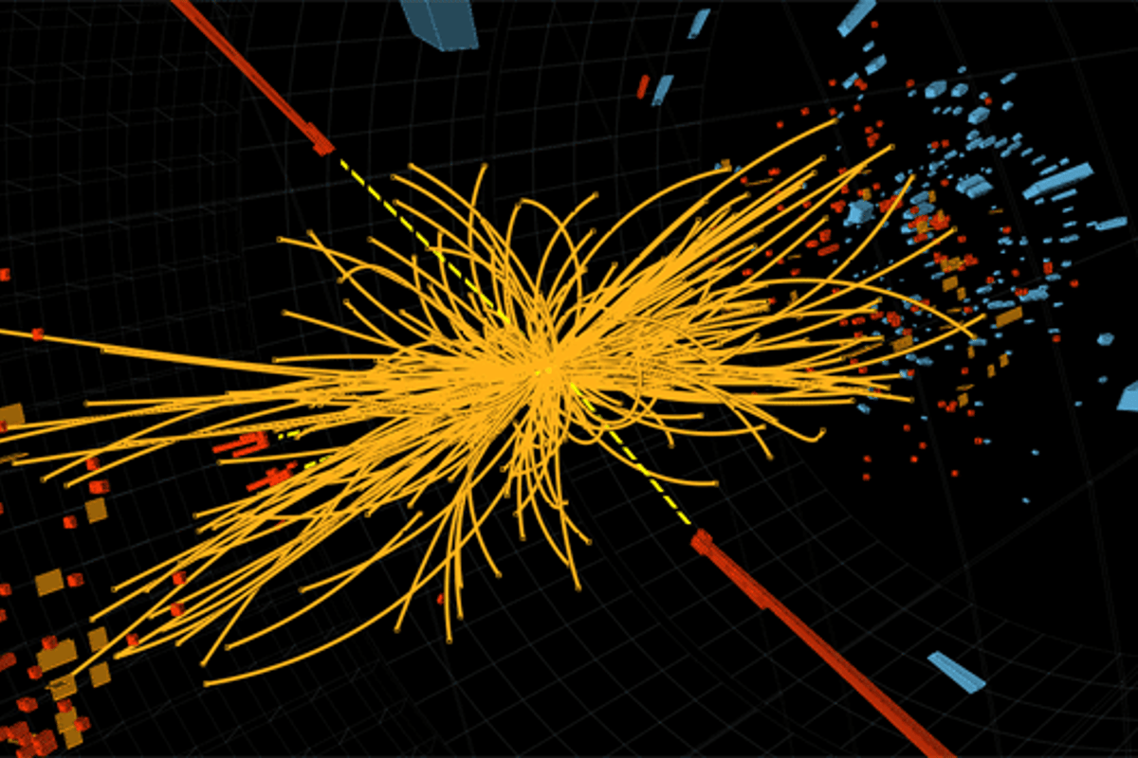
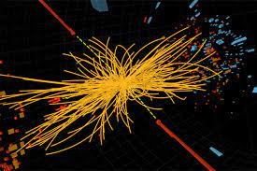
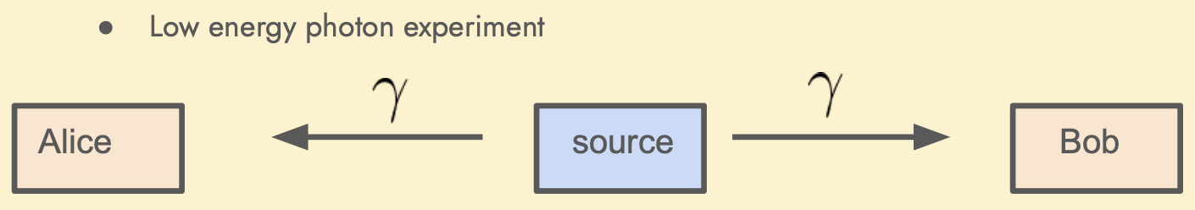
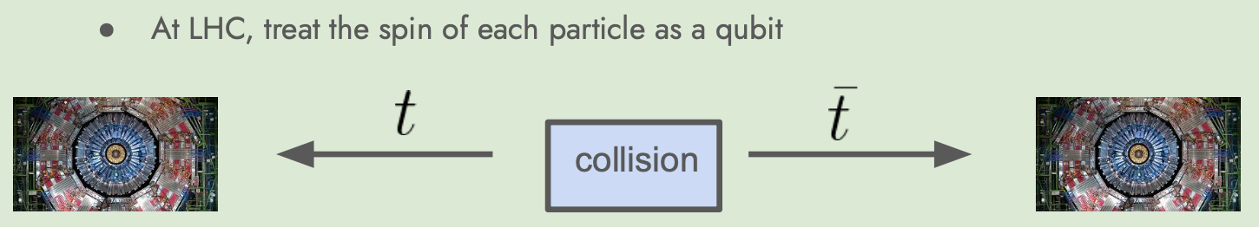
Quantum Tomography @ Colliders
a large number of states produced!

Slide 7
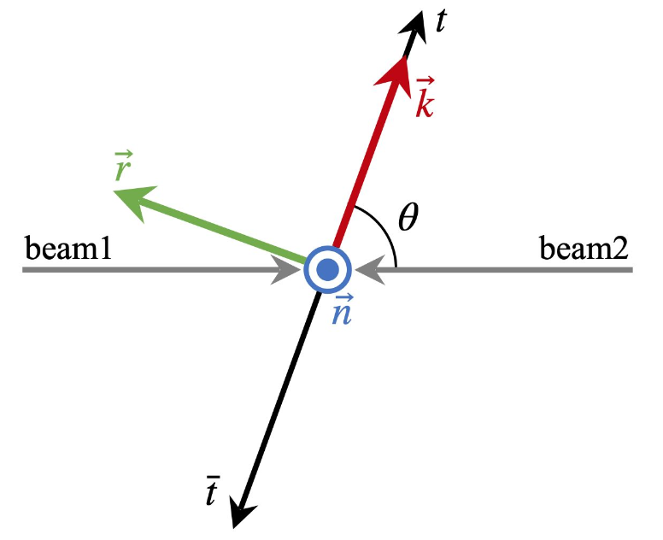
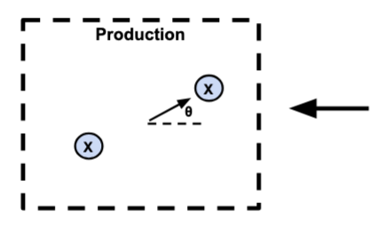
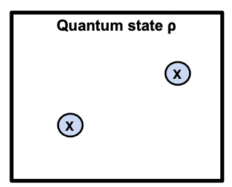
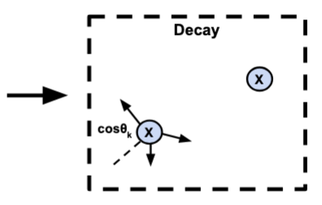
Quantum Tomography for spin states
All “classical observables”: energy, angles …
No direct spin measurement on event-by-event
→ inferred by angular distributions,
thus statistically: “fictitious states”!
Y. Afik, J. de Nova, arXiv:2003.02280; K. Cheng, TH, M. Low, arXiv:2407.01672.
Two paths to proceed to quantum tomography
Both the state before decay & the final state decay products inherit the SAME quantum information!

Slide 8
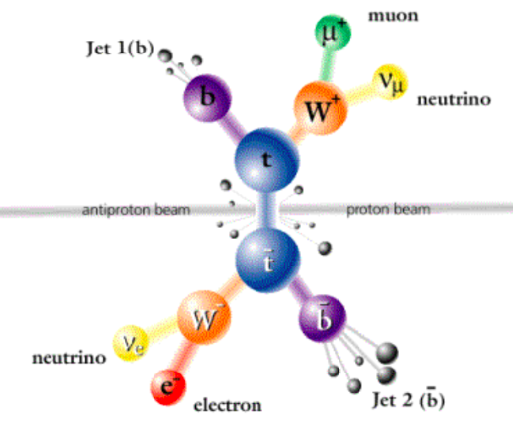
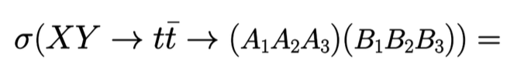
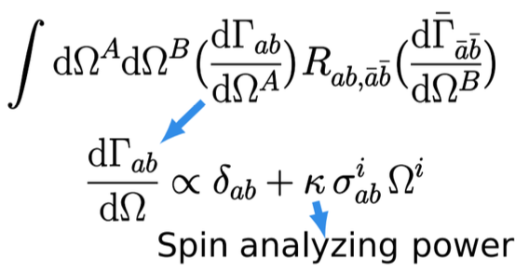
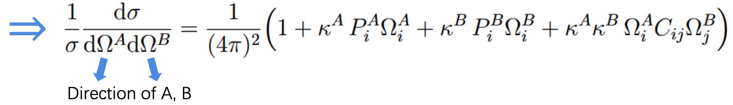
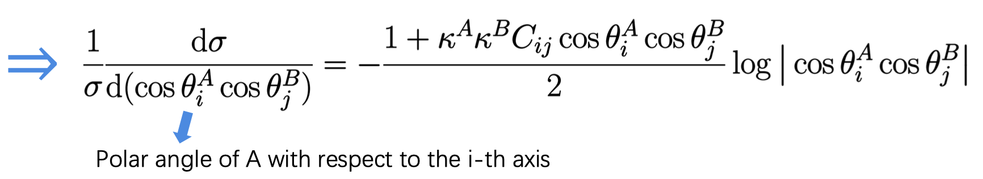
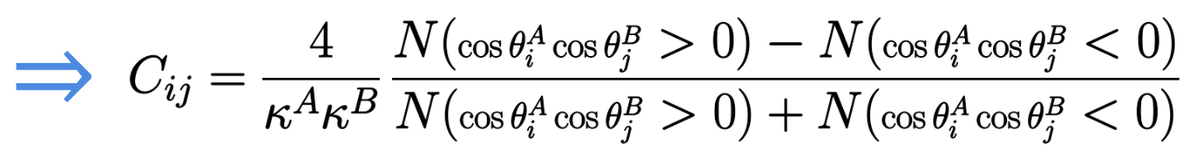
(1) Top decay & spin correlation
decaying to A_{1,2,3} , B_{1,2,3}

Slide 9
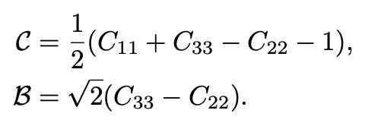
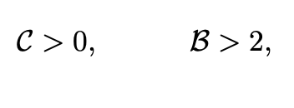
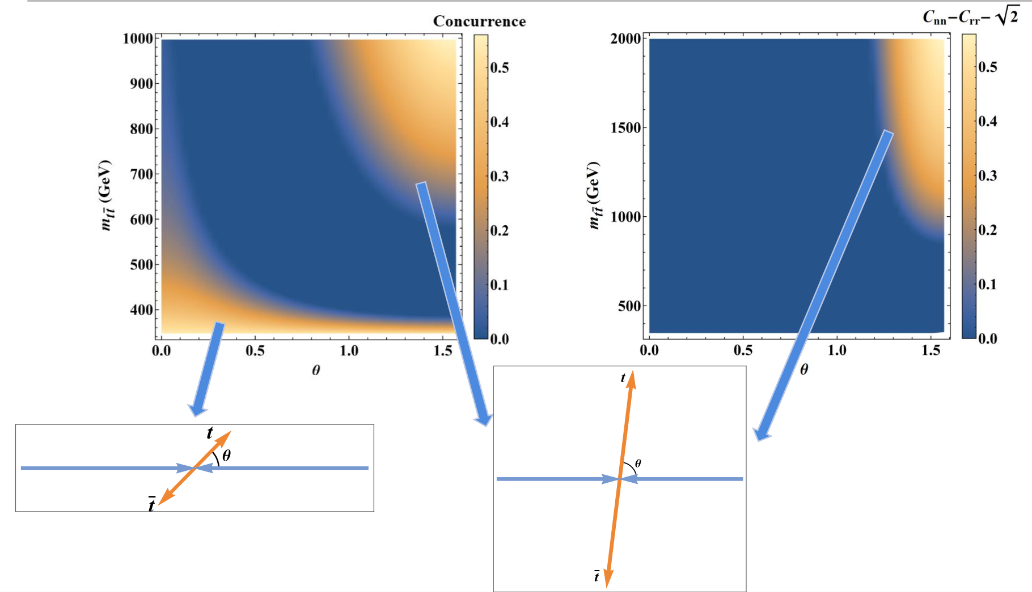
Theory & Observation:
(Many theory papers; ATLAS & CMS publications.)
for entanglement
Threshold:
singlet dominance
Boosted:
triplet dominance
Threshold:
high rate, low sensitivity
Highly boosted:
Low rate, high sensitivity

Slide 10
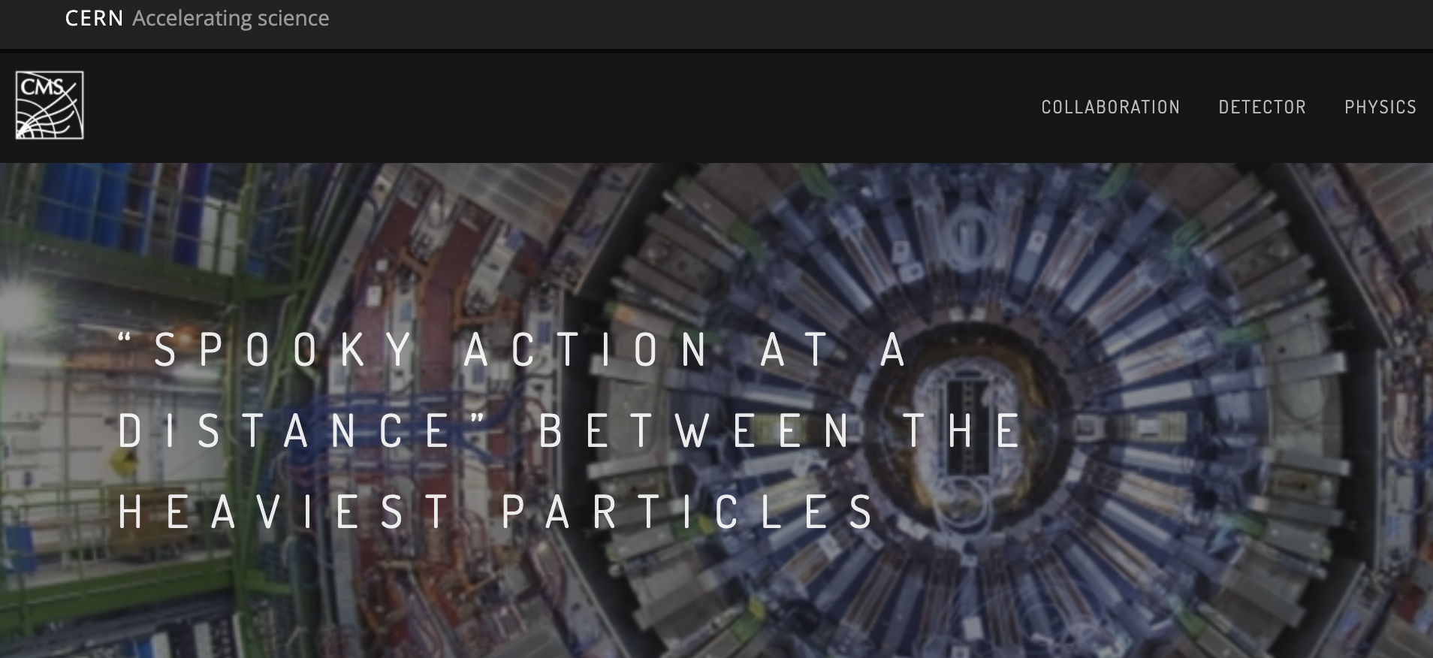
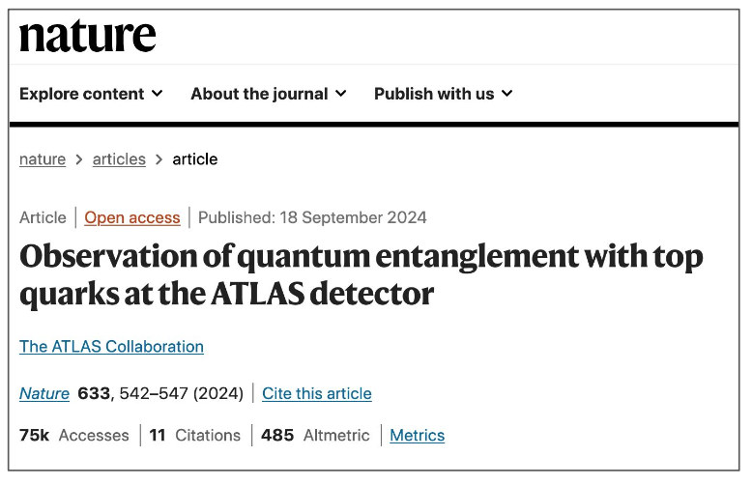
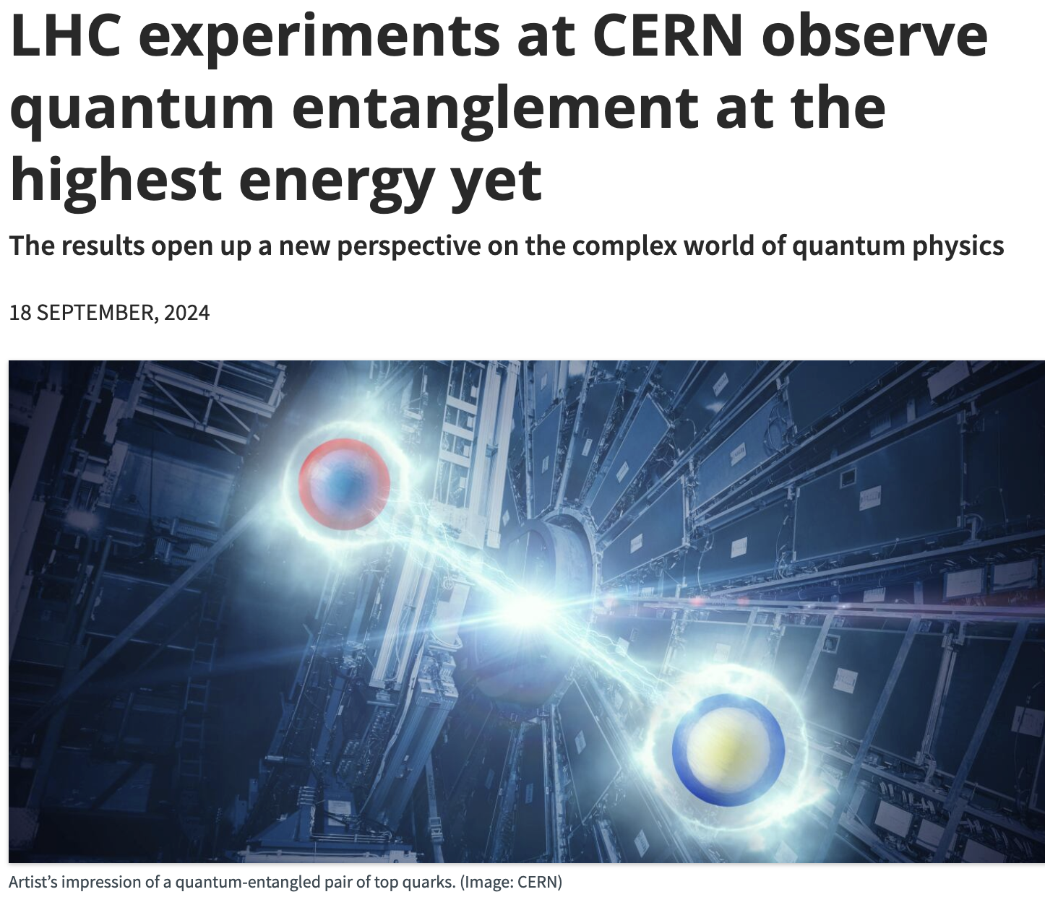
CERN press release on Sept. 19, 2024
(but not yet Bell Non-locality)
Also CMS: arXiv: 2503.22382

Slide 11
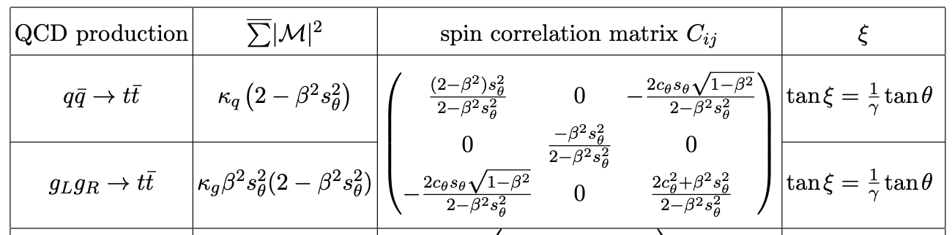
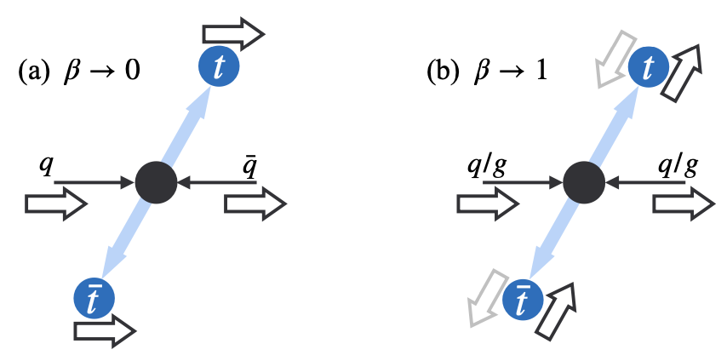
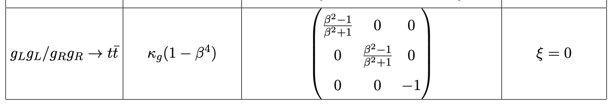
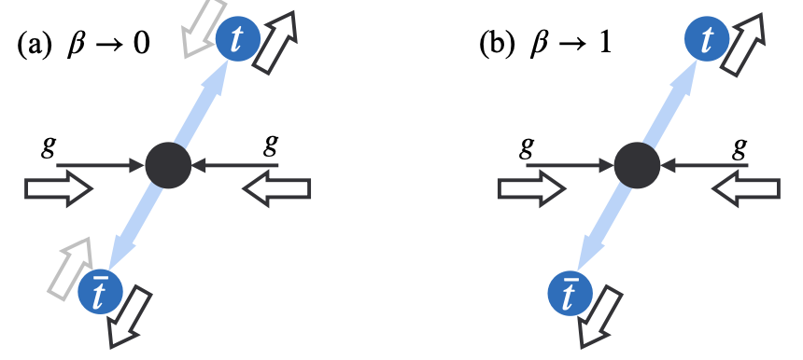
(2). Kinematic Approach for 2 → 2 Production
All C_{ij} encoded in the
production kinematics:
𝚹 & 𝛃=(1-4m_{t}²/m_{tt}²)^{1/2}
K. Cheng, TH, M. Low, 2410.08303.

Slide 12




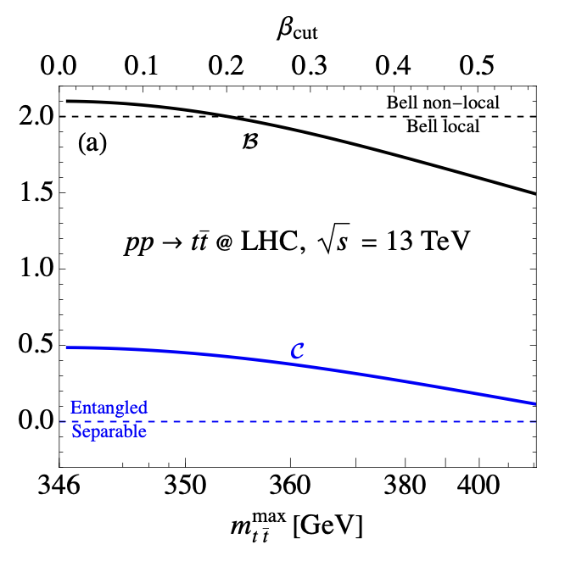
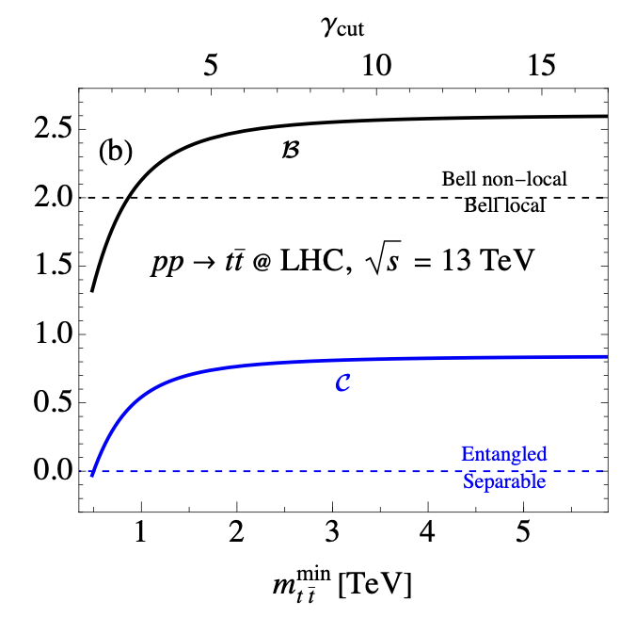
Quantum Entanglement from production:
without decay measurement

Slide 13

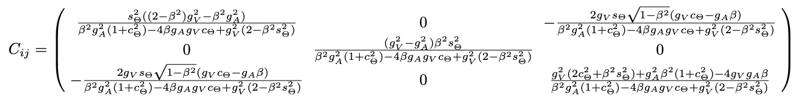
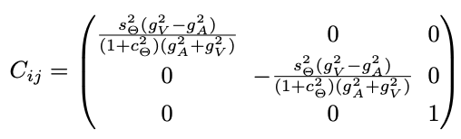
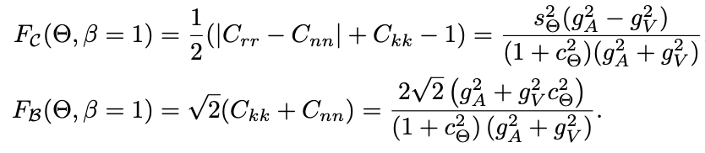
Quantum Entanglement from production:
With stable particles
Taking 𝛃 =1 →
K. Cheng, TH, M. Low, arXiv:2410.08303

Slide 14
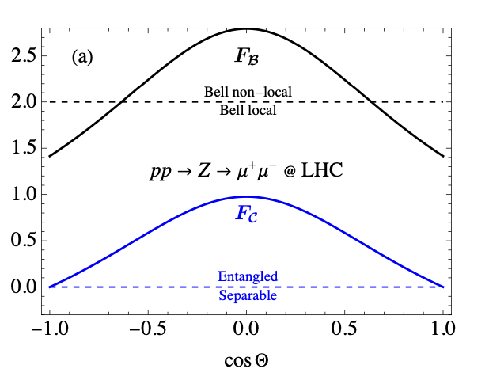
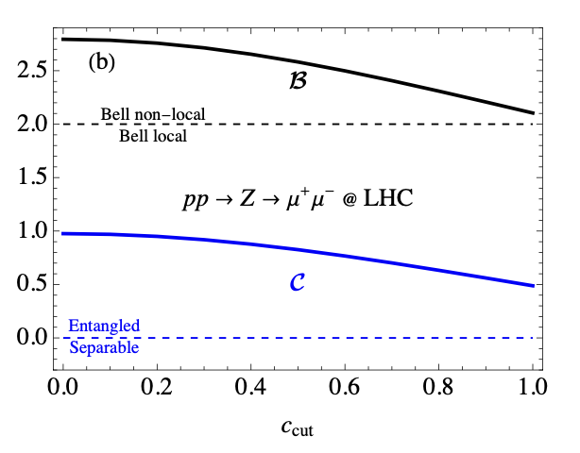
Such a simple process, simple kinematics!
K. Cheng, TH, M. Low, arXiv:2410.08303

Slide 15
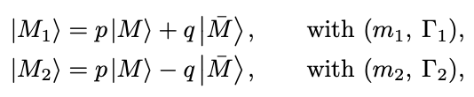

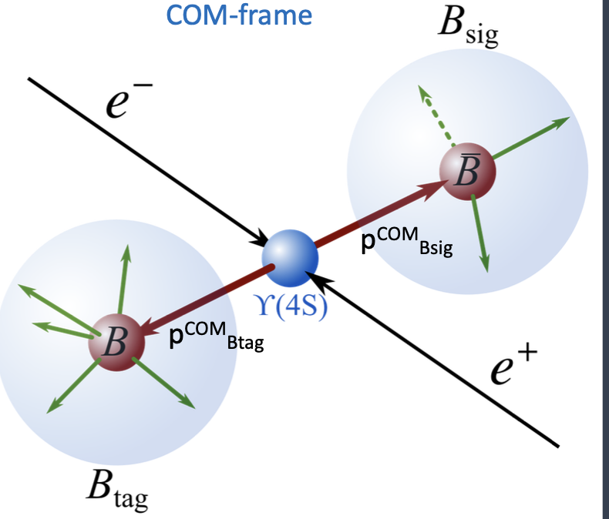
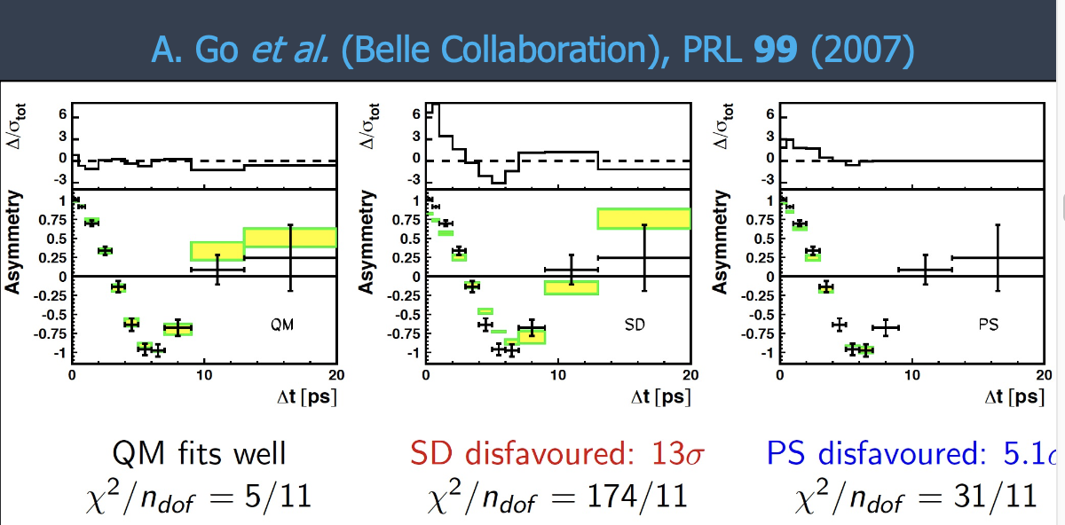
Quantum Tomography
in flavor-oscillations
For a neutral meson – anti-meson system:
such as
There is a quantum-mechanical mixing/oscillation
Belle measurements on entanglement & Bell non-locality test
SD=Spontaneous Disentanglement
PS=Pompili-Selleri hidden variable model

Slide 16
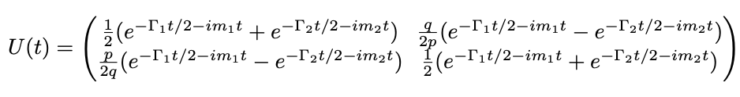

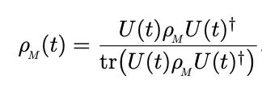
Quantum Tomography
in flavor-oscillations
K. Cheng, TH, M. Low, A. Wu, arXiv:2507.xxxxx.
For a neutral meson – anti-meson system:
such as
we can treat them as 2-qubit systems:

Slide 17





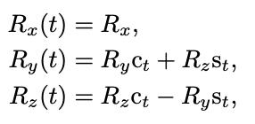
A Single State M
The density matrix:
The Bloch vectors R_{i} specify the quantum state (quantum tomography).
Flavor eigen-states by Bloch vectors R^{init} = (0,0,±1)
so that:
Mass eigen-states by Bloch vectors R^{init} = (±1,0,0)
State evolution:
Oscillatory Precession solution:
Thus: R_{y}^{init} (0) or R_{z}^{init} (0) → R_{y, z}(t), but not R_{x}(t).

Slide 18
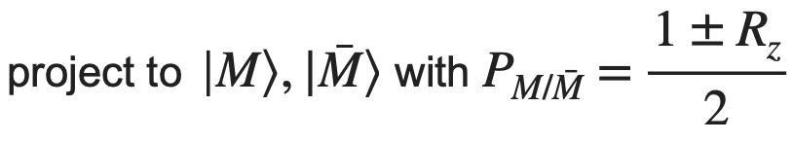








In practice, consider decays
(a) Decaying to non-CP states ( e.g., )
Thus: R_{y}(0) or R_{z}(0) → R_{y, z}(t), but not R_{x}(t).
(b) Decaying to CP eigen-states (e.g., ):
Thus R_{x}(t) determined → full quantum tomography R_{i}(t)!

Slide 19



A M⁰ – anti-M⁰ Pair System:
The density matrix
for a 2-qubit system:
The Bloch vectors R_{i}^{A,B} , correlation matrix C_{ij} specify the full quantum tomography.
Define the correlated decay events:
(𝜺 is the CP-violation parameter -- very small)

Slide 20



Reconstruction of quantum tomography

Slide 21

Discussions:
Belle II ← complementarity → LHCb
Large data sample B_{s}, B_{d} :
~ 5x10¹⁰
well-defined state 𝜰(4s),𝜰(5s)
Larger data sample
Many bb pairs in detectable region
Not well-defined states
fragmentation?
CP violation effects:
Rather small on quantum entanglement
Additional information, combine with channels
More precision

Slide 22

Conclusions
Collider experiments produce a large number of quantum states at the unprecedented energy regime.
Various quantum numbers to explore: spin, flavor …
Hope to establish the quantum tomography & QI: Entanglement, Bell variables, Discord, Magic …
Understand quantum & seek for BSM effects.
QIS @ colliders → new observables & rich physics!

Slide 23
Backups

Slide 24


Slide 25


Slide 26


Slide 27



_
Kinematic approach
equally applicable to e⁺e⁻ → f f
C_{ij} ~

Slide 28





Observability: Error Estimation
Kinematic Approach:
Decay Approach:
Kinematic approach is optimal!
Ultimately, systematic dominance!
perhaps ~ 1% level

