Slide 1
Physikalisches Kolloquium, Universität Siegen
Neutrino physics and astronomy with KM3NeT (and other neutrino telescopes)
Uli Katz
Erlangen Centre for Astroparticle Physics
Friedrich Alexander University Erlangen-Nürnberg
16 January 2025

Slide 2
The plan for the next 45 minutes
Motivation: Why build neutrino telescopes?
How do neutrino telescopes work?
KM3NeT design, technelogy, performance
Neutrino telescopes: An overview
Selected results and perspectives (IceCube & KM3NeT)
  Cosmic neutrinos and their sources
  Neutrino oscillations
  A special KM3NeT event
Take-away messages

Slide 3
Motivation –
Why bulid neutrino telescopes?

Slide 4
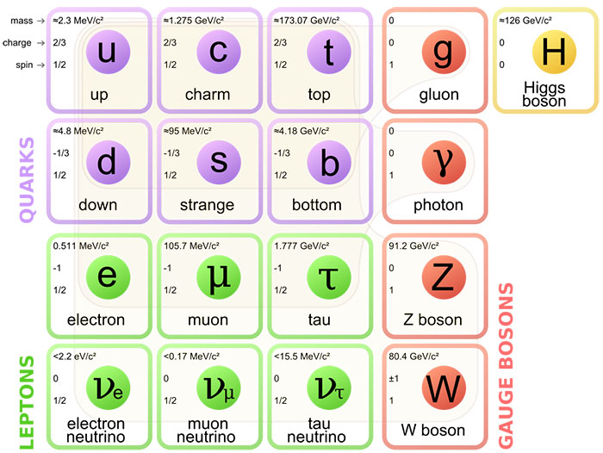
Particle physics and neutrinos – a nut shell
„Our world“:
u and d quarks form atomic nuclei
Nuclei + electrons build known matter
Neutrinos:
3 different types
Very feeble interactions

Slide 5
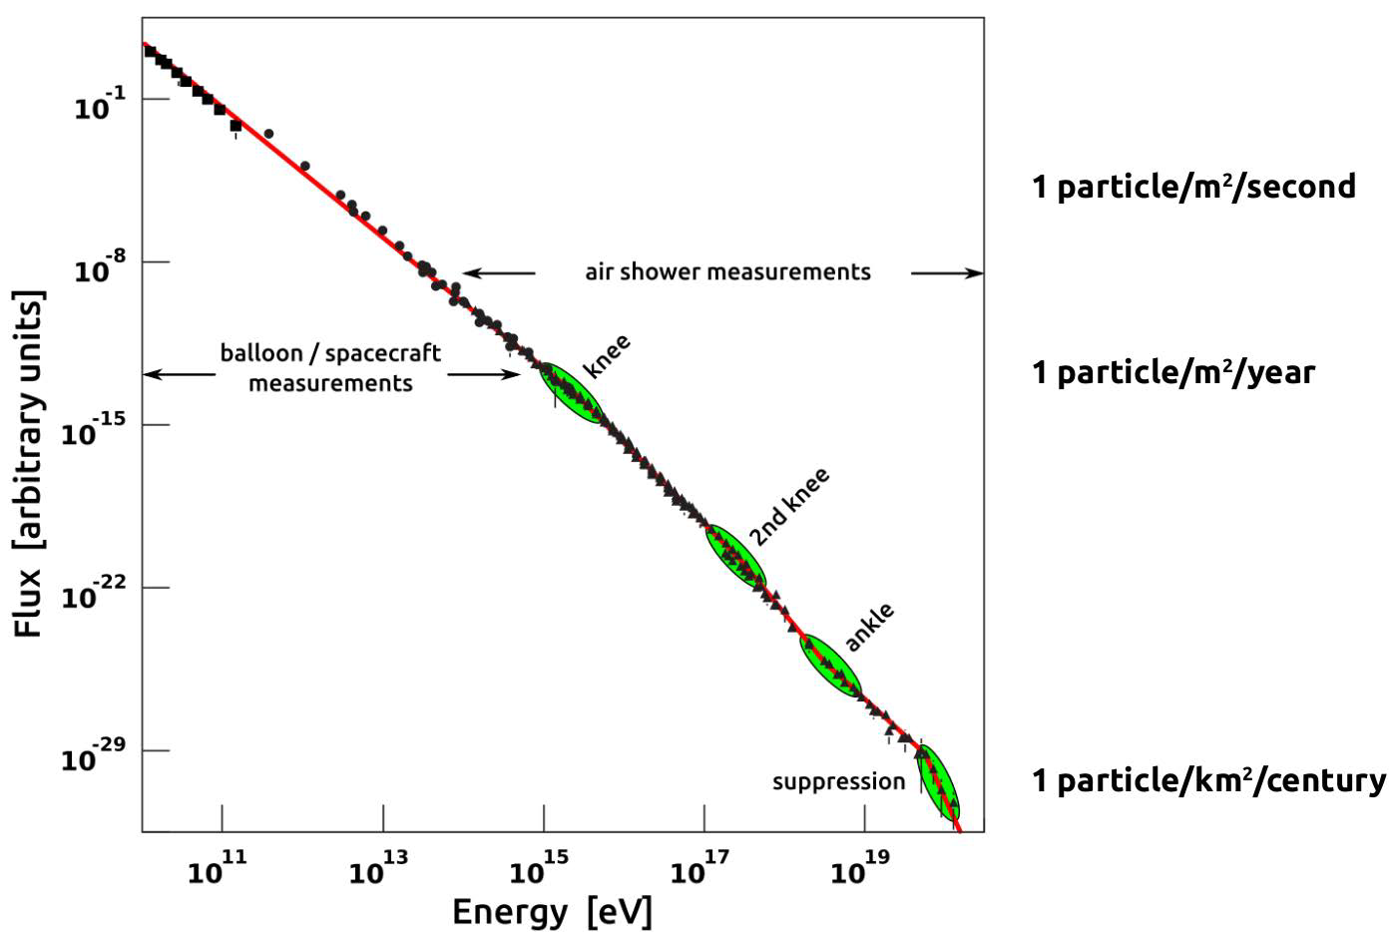
Cosmic rays and their energies
Power law with features
Non-thermal
LHC cms energy
LHC beam
Where from?
Chemical composition?
What causes suppression?
Transition galactic-extragalactic?

Slide 6
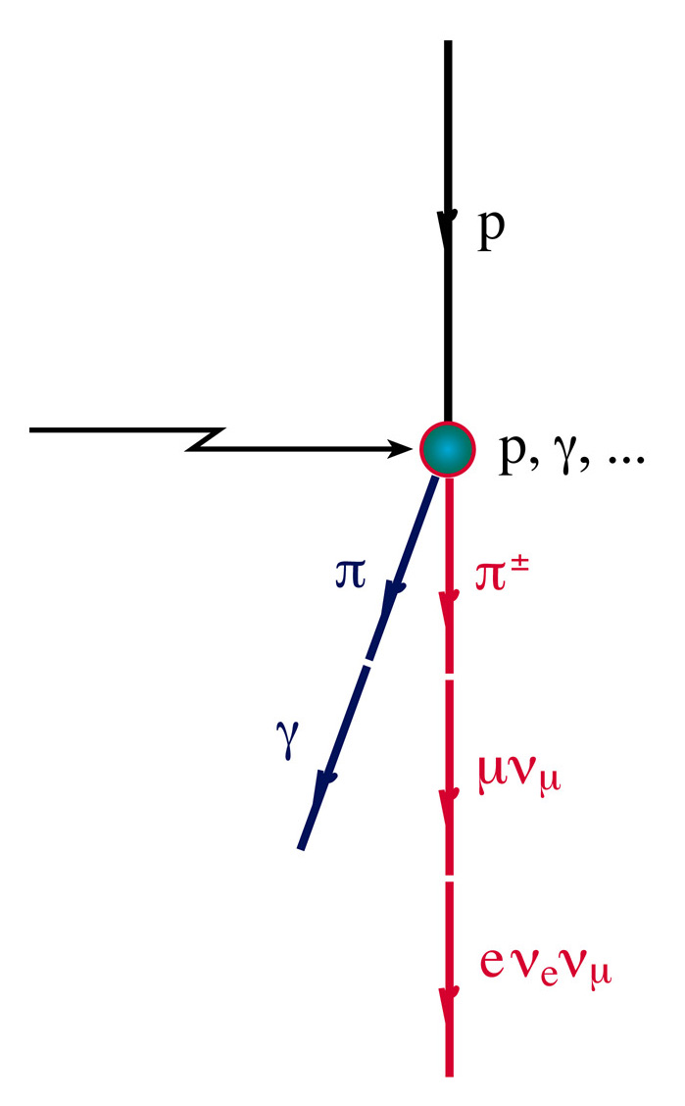
Neutrino production mechanism
Neutrinos are produced in the interaction of high energy nucleons with matter or radiation:
Cosmic rays
Simultaneously, gamma production takes place:
Cosmic rays
Cosmic ray acceleration yields neutrinos and gammas!
… but gammas also from purely leptonic processes

Slide 7
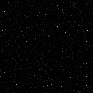
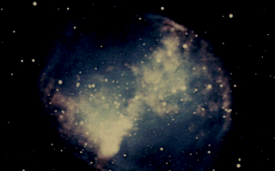

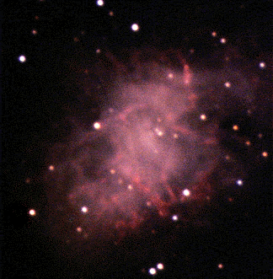
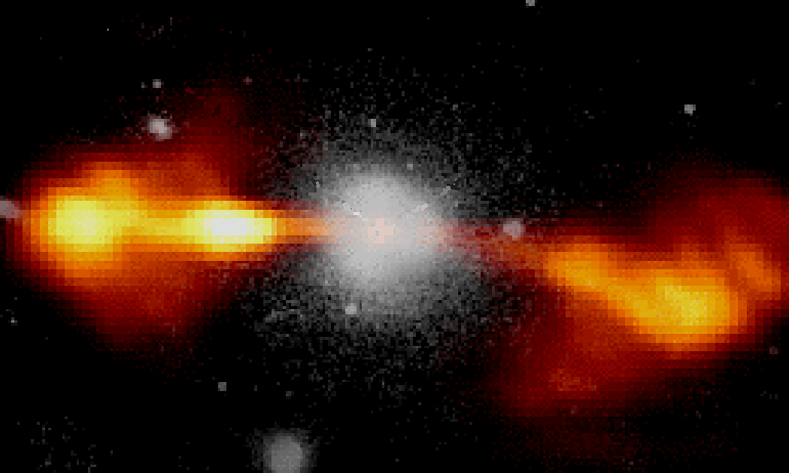
Particle propagation in the Universe
protons E>10¹⁹ eV (few 10 Mpc)
neutrinos
HE gammas (0.01 - 10 Mpc)
Cosmic accelerator
protons E<10¹⁹ eV
1 parsec (pc) = 3.26 light years (ly)
Photons: absorbed on dust and radiation;
Protons/nuclei: deviated by magnetic fields, reactions with radiation (CMB)

Slide 8
Different messengers → Multi-messenger
The exploration
of the high-energy
Universe requires
multi-messenger studies
including neutrinos!

Slide 9
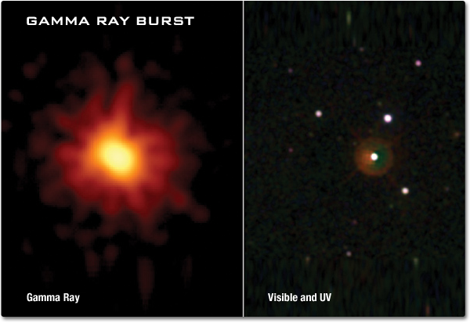
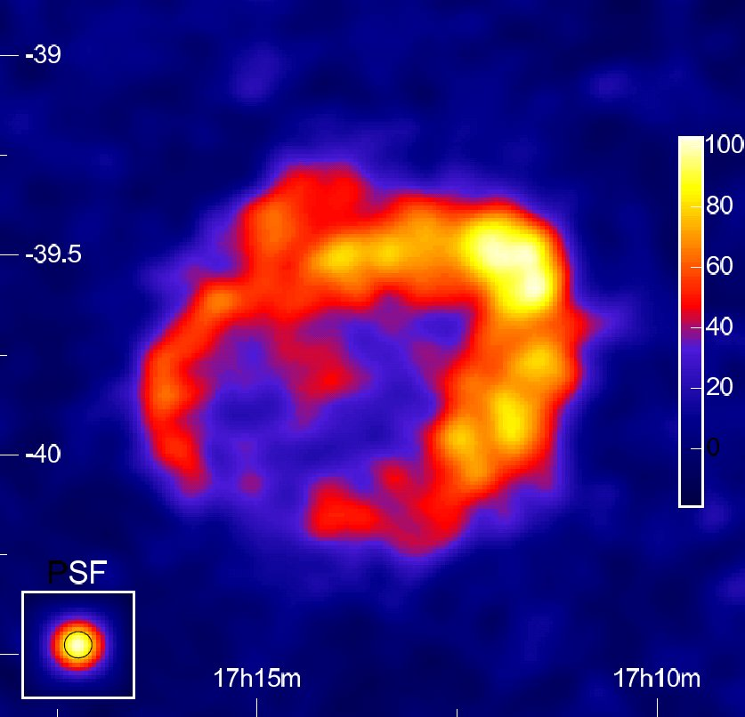
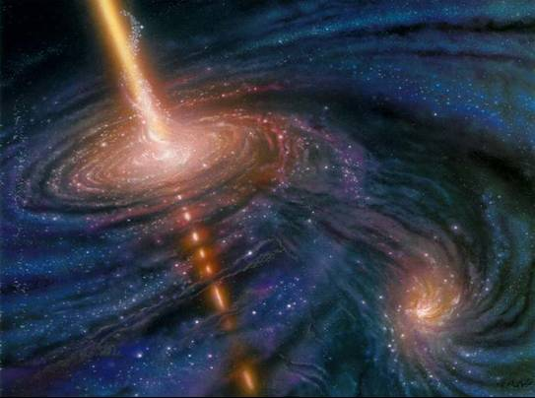
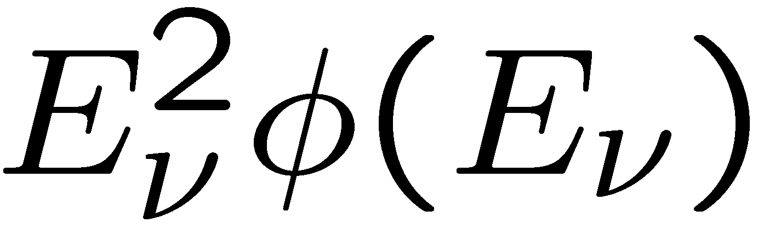

Example targets of ν astronomy
Galactic neutrino sources
including Supernovae
Extragalactic sources
Transient sources
Diffuse neutrino flux
Neutrinos from Dark Matter
annihilations
Particle physics with
atmospheric neutrinos
Search for exotics
(monopoles, nuclearites,…)
Extremely bright gamma ray flash (sec-min)
from hypernovae or BH/NS mergers or …
Isotropic distribution → extragalactic
Active Galactic Nuclei (AGN):
Super-massive black hole in centre of galaxy
with accretion disk and jet emission
Isotropic high-energy neutrino flux
above atmospheric neutrino background
from unresolved astrophysical sources
or of cosmogenic origin (GZK)
Example: Supernova remnant RX J1713
Gamma observation by H.E.S.S.

Slide 10
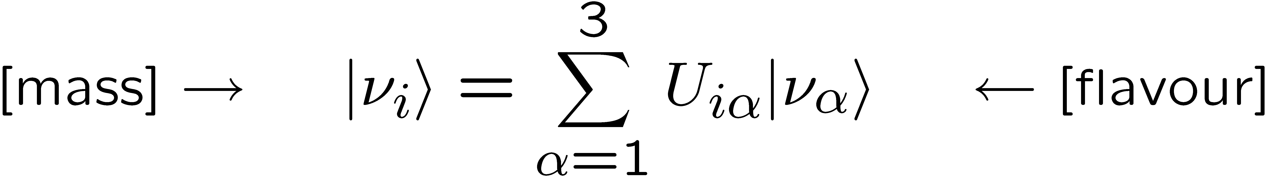
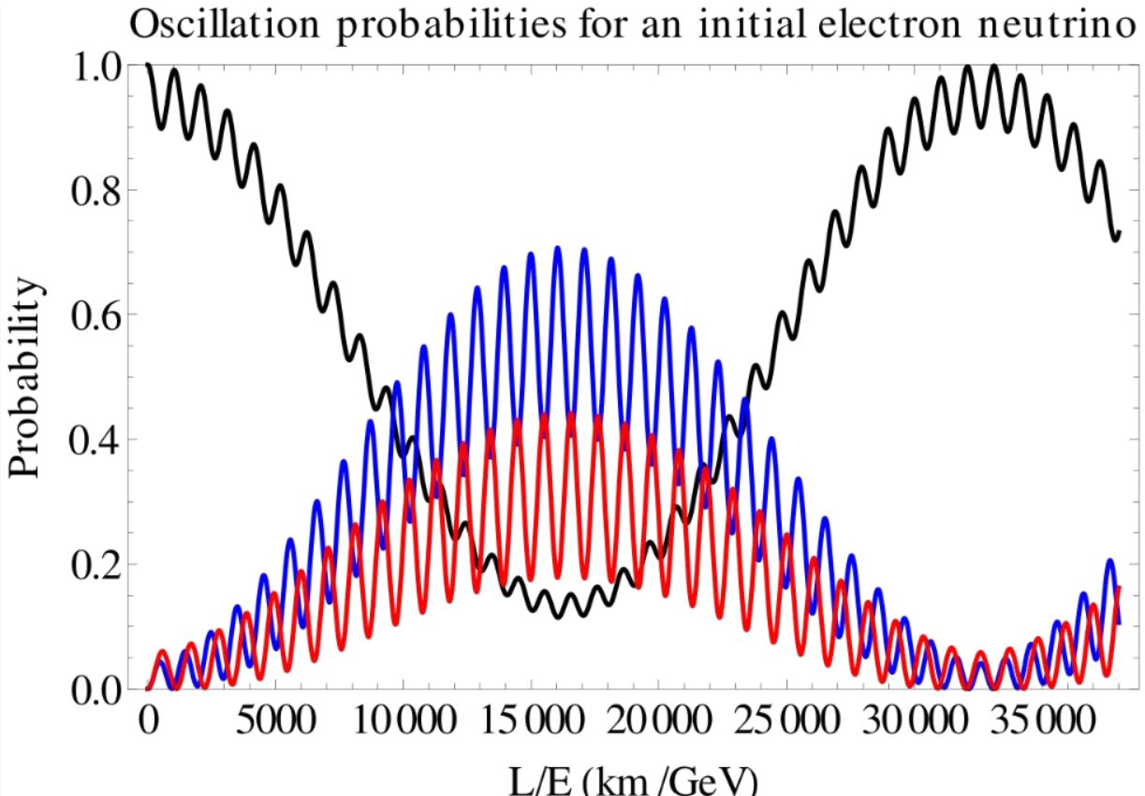
Neutrino oscillations
Neutrino flavour and mass eigenstates are not the same:
Fundamental process,
relevant for particle &
nuclear physics,
cosmology, …
Governed by
3 angles, 3 masses,
1 complex phase
(+ new physics?)
Propagation through
matter modifies pattern
Neutrinos created in
atmosphere provide
laboratory for
neutrino oscillations
(propagation)
(production, reaction)

Slide 11
How do neutrino telescopes work?

Slide 12
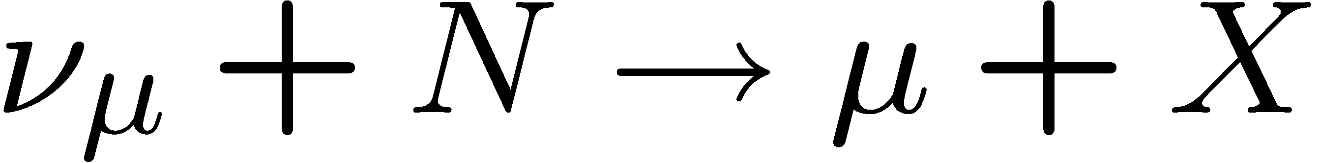
The principle of a neutrino telescope
Neutrino interacts in the
(vicinity of the) telescope
Charged secondary particles cross the detector volume (water or ice) and induce Cherenkov emission
Recorded by a 3D-array of photo-sensors
“Traditional” channel:
Cascades from almost all other reaction channels
Energy range :
some GeV – some/many PeV

Slide 13
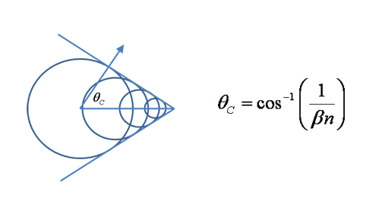
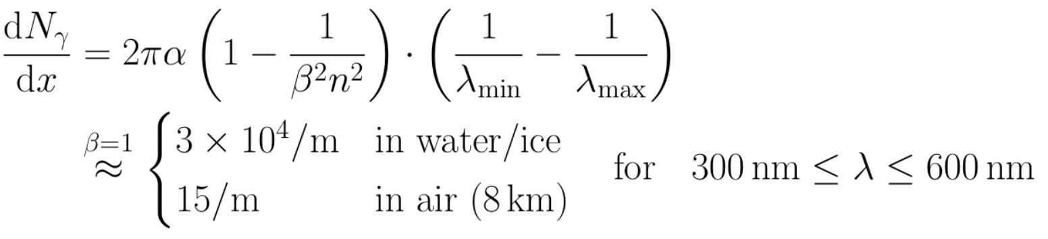
Cherenkov radiation
= ca. 42°/ 40°in water / ice

Slide 14
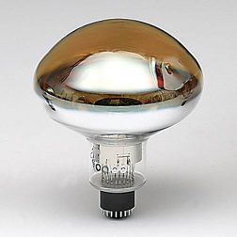
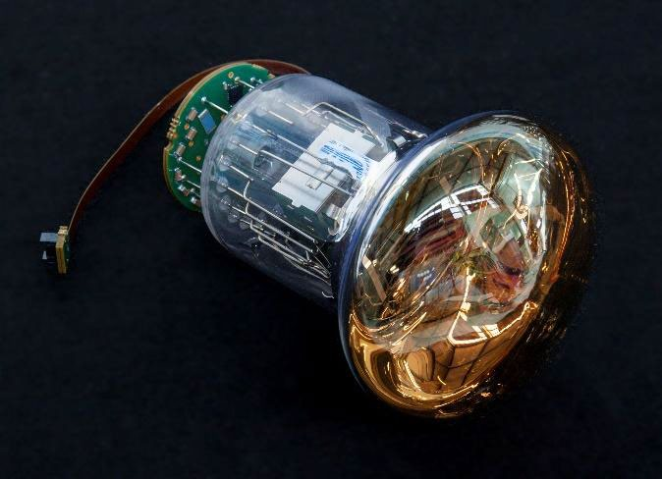
Detection of Cherenkov radiation
Hamamatsu R7081
10-inch PMT (IceCube)
Very faint light
Detection requires
    Single-photon detection
    Timing at nanosecond level to suppress backgrounds
    Low noise
Photodetectors = Photomultiplier tubes (PMTs) or SiPMs
Synchronisation of large detector arrays at sub-nanosecond precision
Position calibration of photodetectors
with ~10 cm precision
Synchronisation with ns precision
Hamamatsu R12199-02
3-inch PMT (KM3NeT)

Slide 15
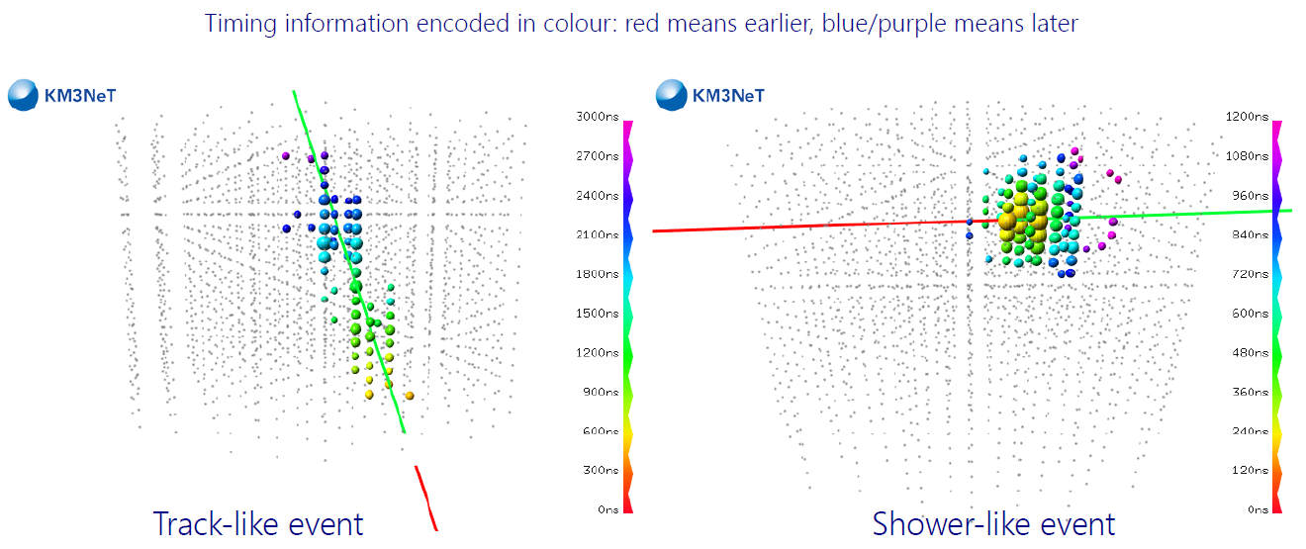
Event reconstruction
Measure arrival times and number of photons, photodetector position
Two major event topologies for energies beyond some GeV:
Event topology → flavour sensitivity,
→ determines ansatz for reconstruction
Reconstruction → direction, energy, time
Events with
high-energy muon
→
trajectories up to several km
„track-like“
Events without
high-energy muon
→
cascades (some 10m)
„shower-like“

Slide 16
What a neutrino telescope sees
Cosmic neutrinos (rare!)
Atmospheric neutrinos from cosmic-ray interactions in atmosphere
  important calibration source
  allow us to study oscillations
  indistiguishable from cosmic
  neutrinos on event-by-event basis
Atmospheric muons from cosmic-ray interactions in atmosphere above NT
  penetrate to NT
  exceed neutrino event rate by
  several orders of magnitude
Sea water: light from K40 decays and bioluminescence
➔ Sensitivity depends on source position
and neutrino energy spectrum.
p
μ
NT
Earth
ν
ν
Atmosphere
p

Slide 17
KM3NeT: Design, technology, performance

Slide 18
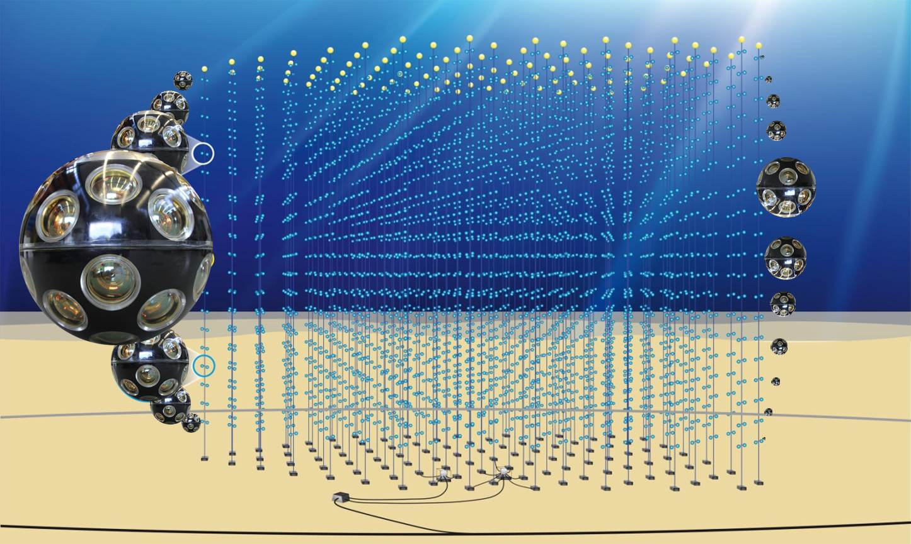
In the Mediterranean Sea: KM3NeT
31 3’’-PMTs per optical module
18 modules per string
115 DUs per building block
ARCA: 2 blocks for v astronomy
ORCA: 1 block for v oscillations
Builds on ANTARES experience

Slide 19
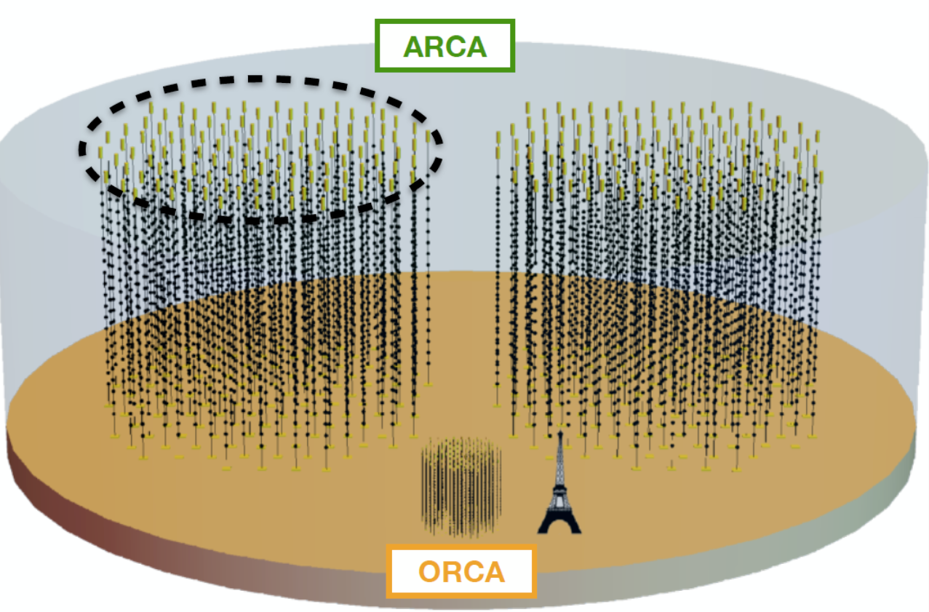
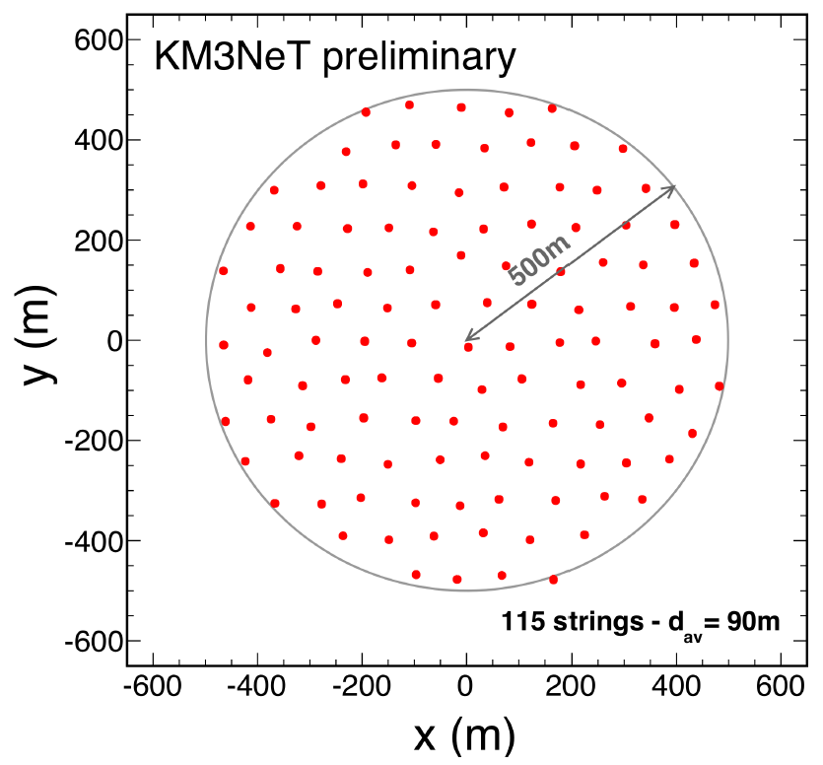
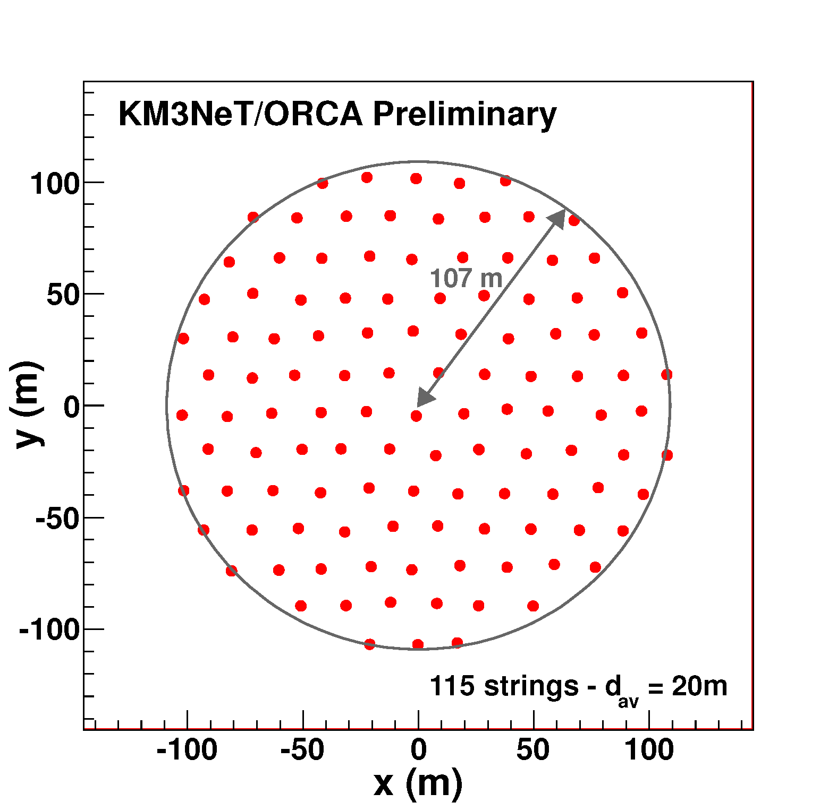
KM3NeT = ARCA and ORCA
ARCA =
Astroparticle
Research with
Cosmics in the
Abyss
500m
500m
33
+
Vertical DOM
distance = 36 m
ORCA =
Oscillation
Research with
Cosmics in the
Abyss
Currently installed
24
107m
KM3NeT 2.0 Letter of Intent:
arXiv:1601.07459 and
J.Phys. G43 (2016) 084001
Vertical DOM
distance = 9 m

Slide 20
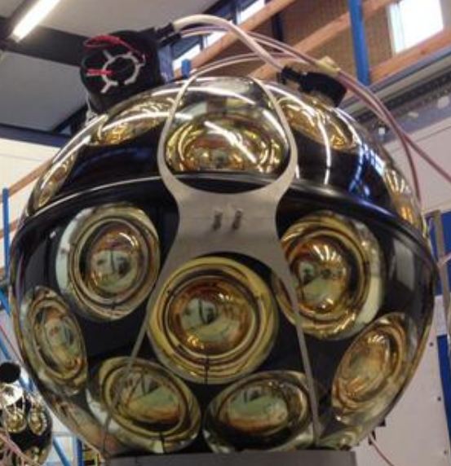
The KM3NeT Digital Optical Module
31 3-inch PMTs in 17-inch glass sphere (cathode area ~3x10-inch PMTs)
Front-end electronics, digitisation,
optical signal → glass fibre
Single penetrator
Advantages:
  Increased photocathode area
  1-vs-2 photo-electron separation
  → better detection of coincidences
  Directionality
  Cost / photocathode area
  Minimal number of penetrations
  → reduced risk

Slide 21
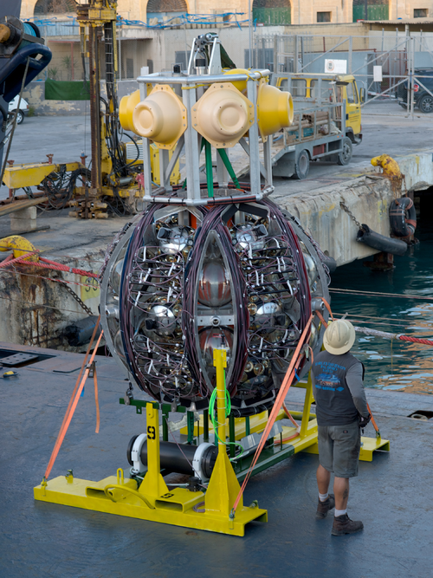
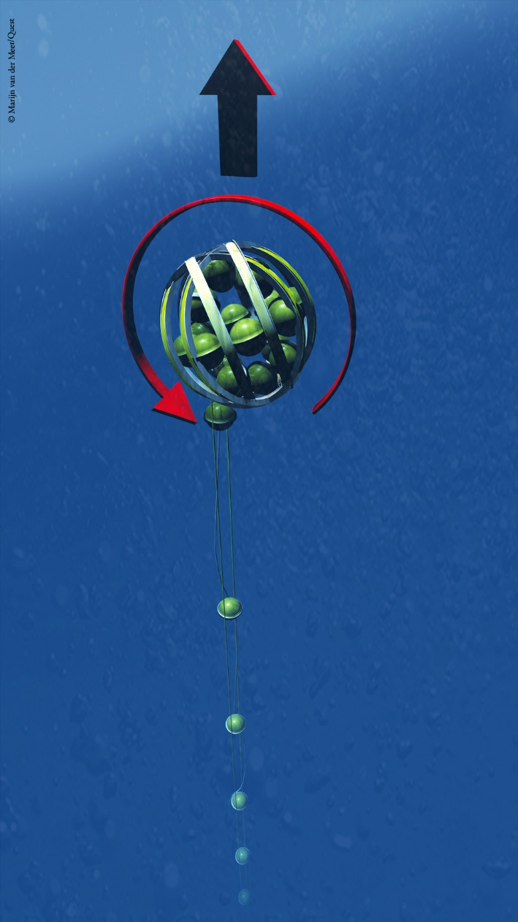
KM3NeT Deployment
← Deploy
to sea bed
Release
by ROV
Unfurl →
Collect
frame

Slide 22
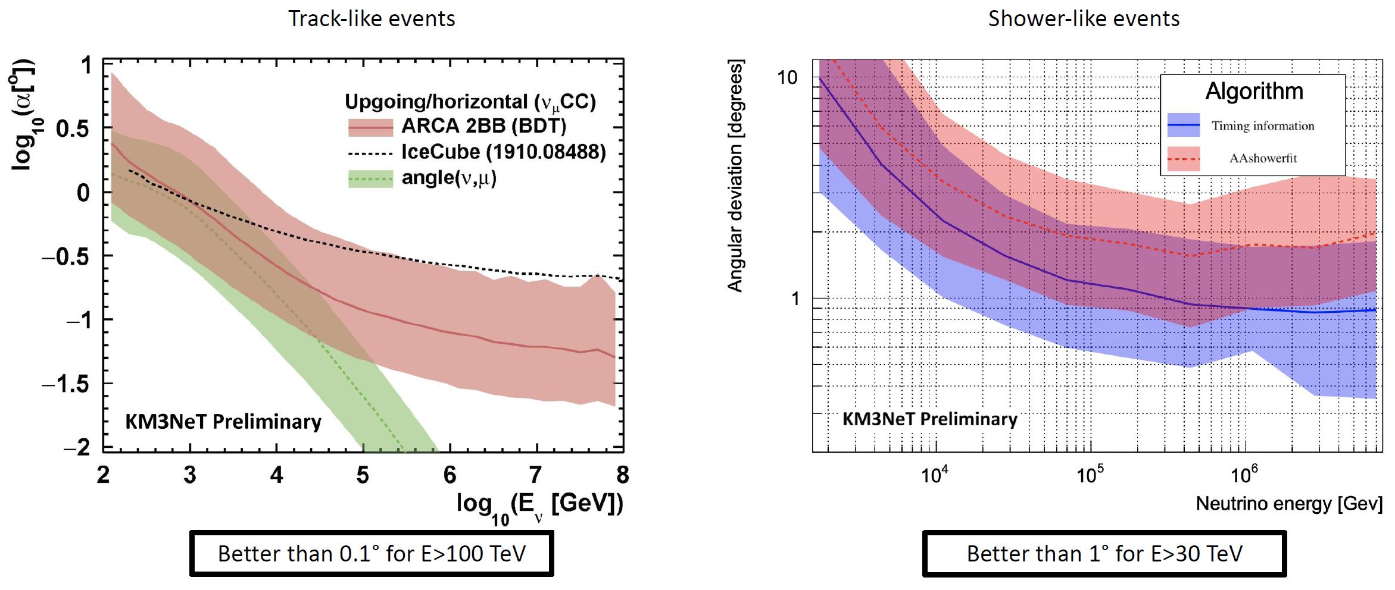
KM3NeT/ARCA: Angular resolution
PoS(ICRC2021)1077
PoS(ICRC2021)1089
Different optical properties of ice and water:
less absorption in ice, less scattering in water
Angular resolution of central importance for
identifying signals from „small“ cosmic sources

Slide 23
Neutrino telescopes: An overview

Slide 24
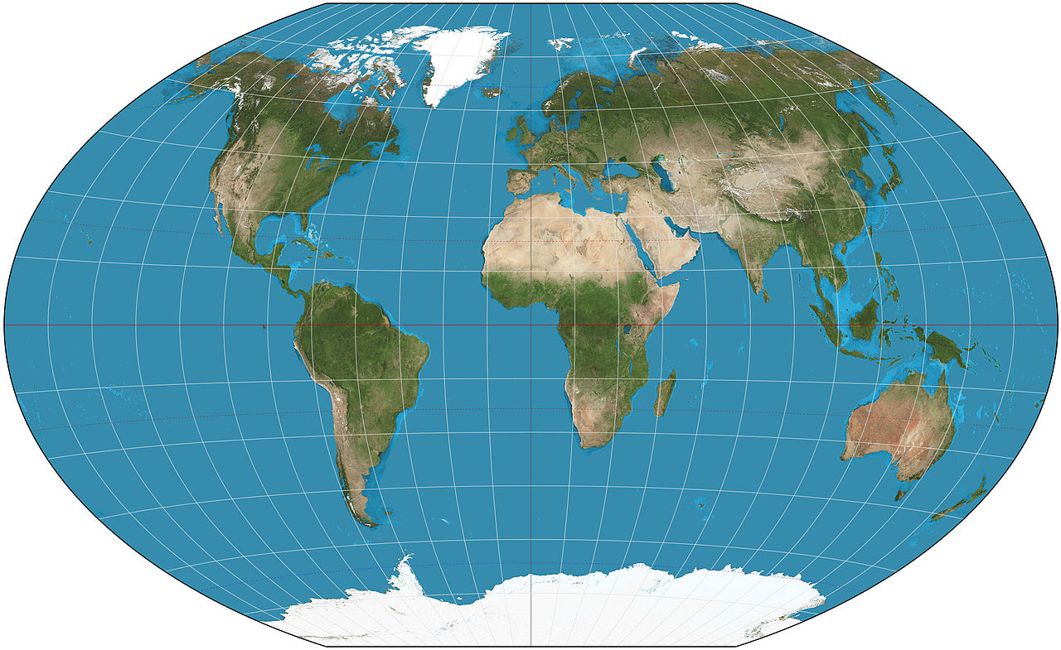





The HE neutrino telescope world map 2025
ANTARES
Deep water
0.01 km³
2008 – 2022
Baikal/GVD
Deep water
~1 km³
Construction
KM3NeT
Deep water
1 + 0.006 km³
Construction
Deep water
R&D phase
3 Chinese
proposed projects
(Trident, HUNT, NEON)
Deep water
O(10 km³) each
Early R&D
IceCube
Deep ice
1 km³
2011 –
Upgrade
next year
IceCube-Gen2
Deep ice
~10 km³
+surface
detectors
Projected

Slide 25
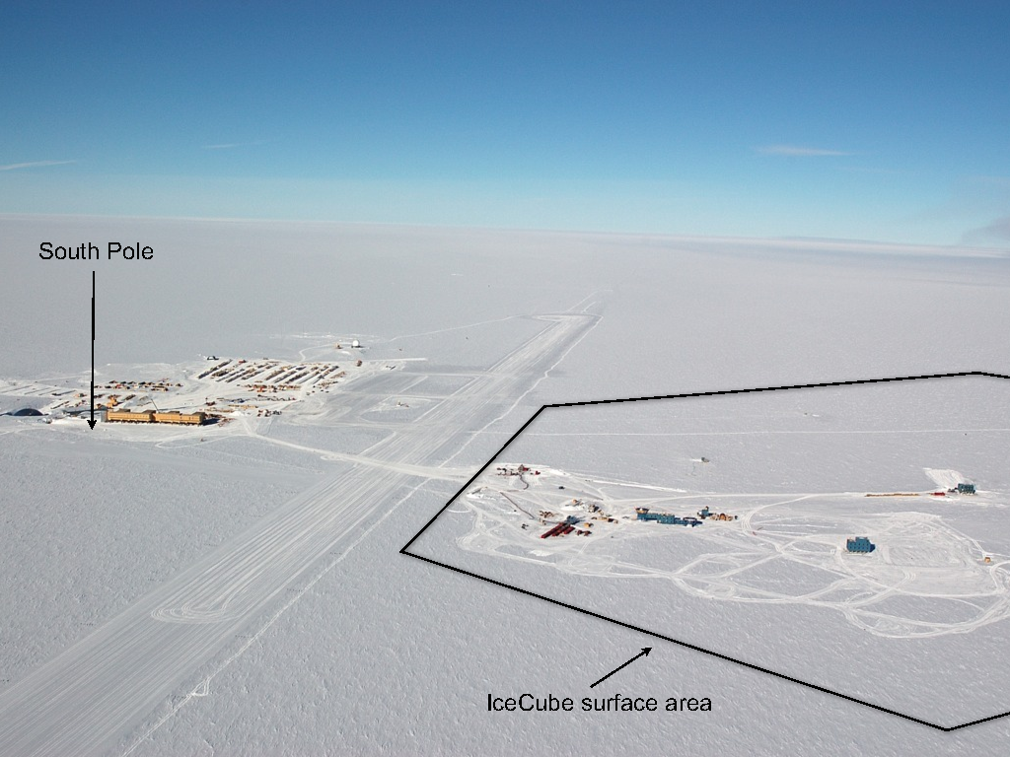
IceCube: A km³ detector in the Antarctic ice

Slide 26
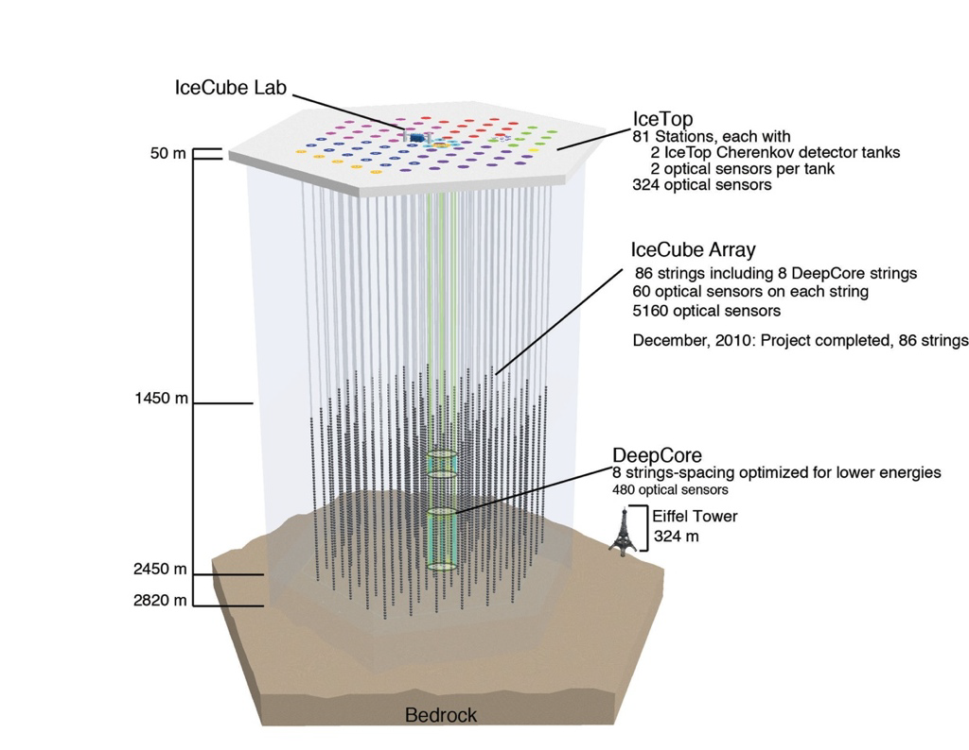
IceCube: Most sensitive v telescope to date
86 strings altogether
  125 m horizontal spacing
  17 m vertical distance
  between Optical Modules
  1 km³ instrumented
  volume, depth 2450m
Deep Core
  densely instrumented
  region in clearest ice
Completed in Dec. 2010
Extremely stable and
efficient operation since then

Slide 27
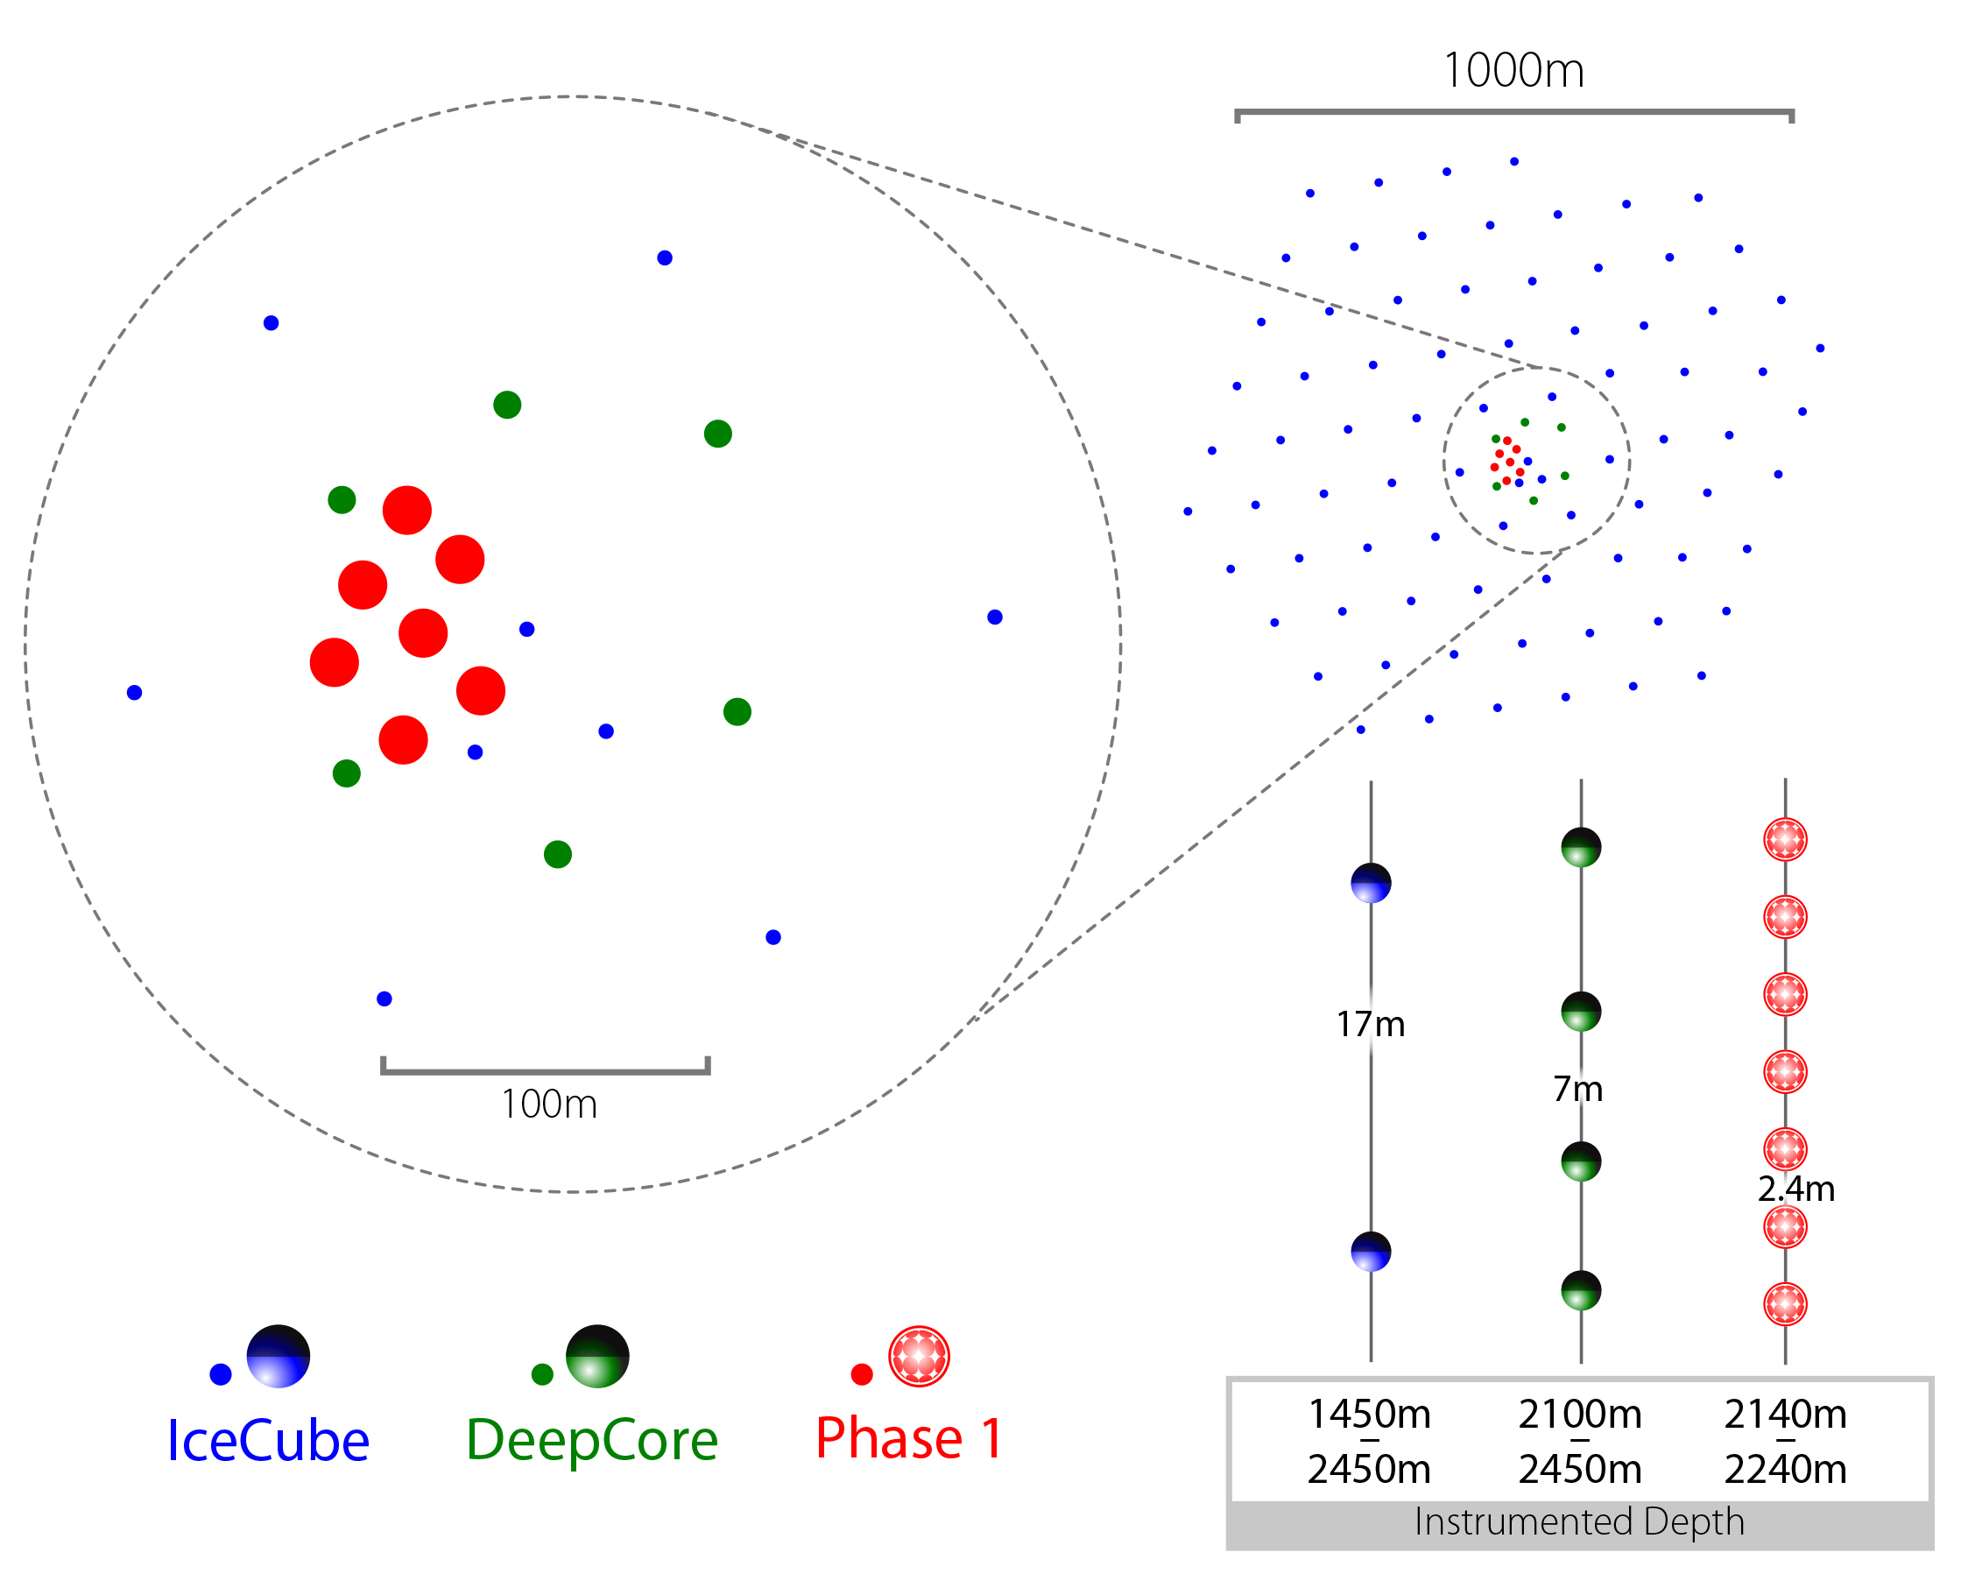
IceCube: next step = Upgrade
IceCube-Upgrade
7 additional strings in
Deep Core domain,
densely instrumented
Deployment being prepared
Objectives:
GeV neutrinos:
v_{τ} appearance,
Dark Matter, …
Improved understanding of ice
properties → better precision, reduced systematic uncertainties
Opportunity to test new
hardware developments
Fully funded
Array | String Spacing | Module Spacing | Modules / String
IceCube | 125 m | 17 m | 60
DeepCore | 75 m | 7 m | 60
Upgrade | 20 m | 2 m | 125

Slide 28
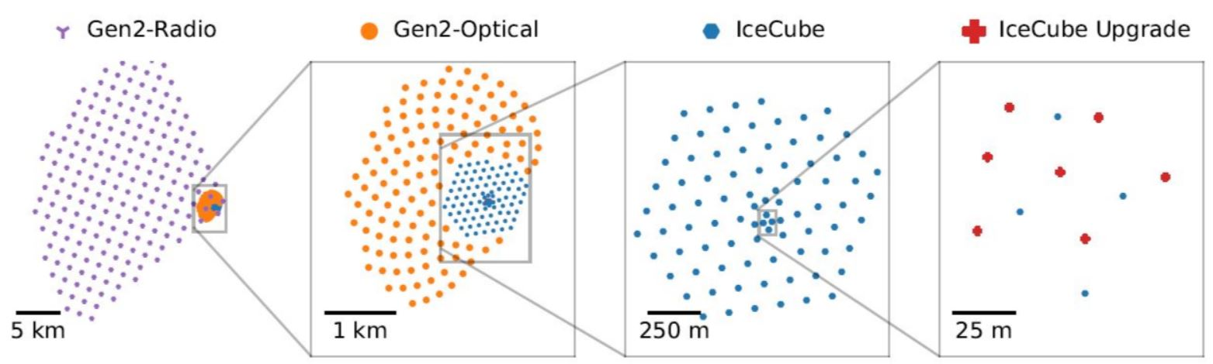
IceCube Gen2
Next-generation neutrino observatory at South Pole, with
High-energy deep-ice detector
Cosmic-ray and veto surface scintillator array
Radio array
Extend energy range, find point sources

Slide 29
Selected results (1):
Cosmic neutrinos and their sources

Slide 30
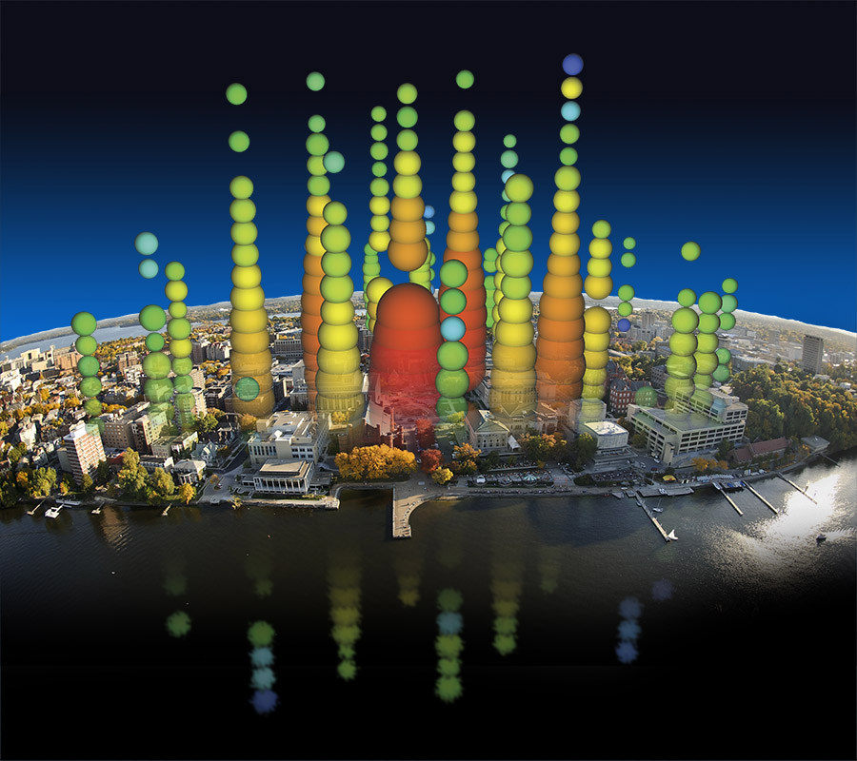
A first glimpse at cosmic ν’s
Picture by
Francis Halzen
2013: Discovery of HE cosmic neutrinos
2018: First transient neutrino source
2022: First steady neutrino source
2023: Neutrinos from the Galactic Plane
Big Bird, 2.0 PeV

Slide 31
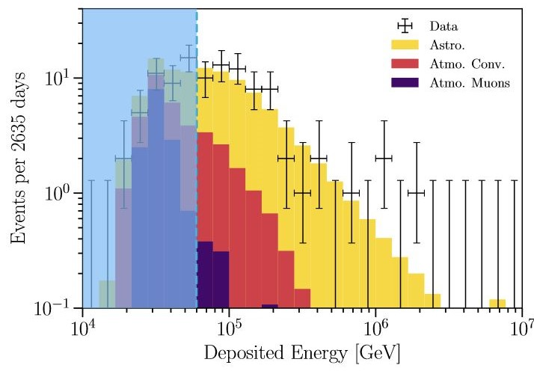
What is their energy spectrum?
HESE 7.5 years
PRD 104 022002 (2021)
Extending to PeV
Consistent with
power-law energy
spectrum ~E^{-2.87}
Neither energy nor
zenith distribution
consistent with
background-only
including prompt
neutrinos

Slide 32
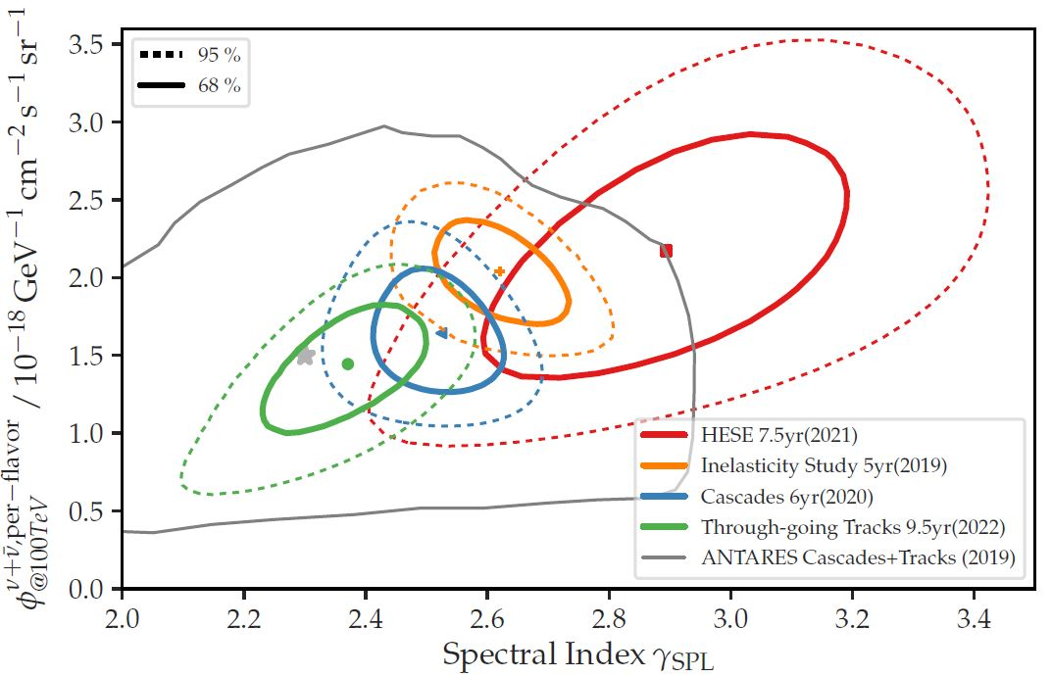
Is it a power law in E_{v}?
Important for interpreting acceleration processes / source classes
Several analyses, in particular also using through-going muons
Statistical fluctuation? Non-power-law spectra? Different source classes?
Recent results
„look a bit different“

Slide 33
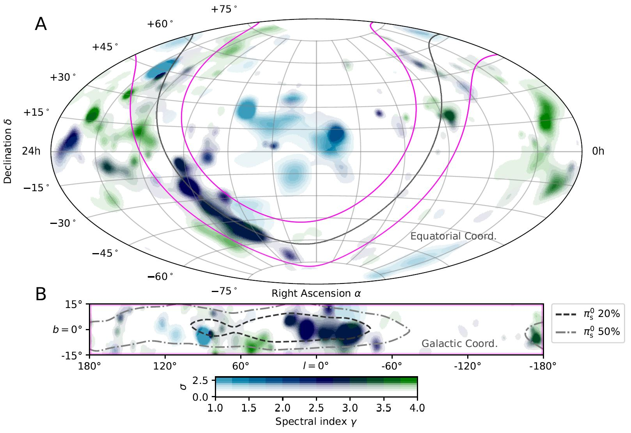
Neutrinos from the Galactic plane (1)
Rather new result
(announced 30 June 23)
Cascade channel
Significance 4.5 σ
10 years of IceCube data, analysis with improved event selection and reconstruction
Neutrinos probably from CR interactions (or from unresolved point sources)
Science 380 (2023)

Slide 34
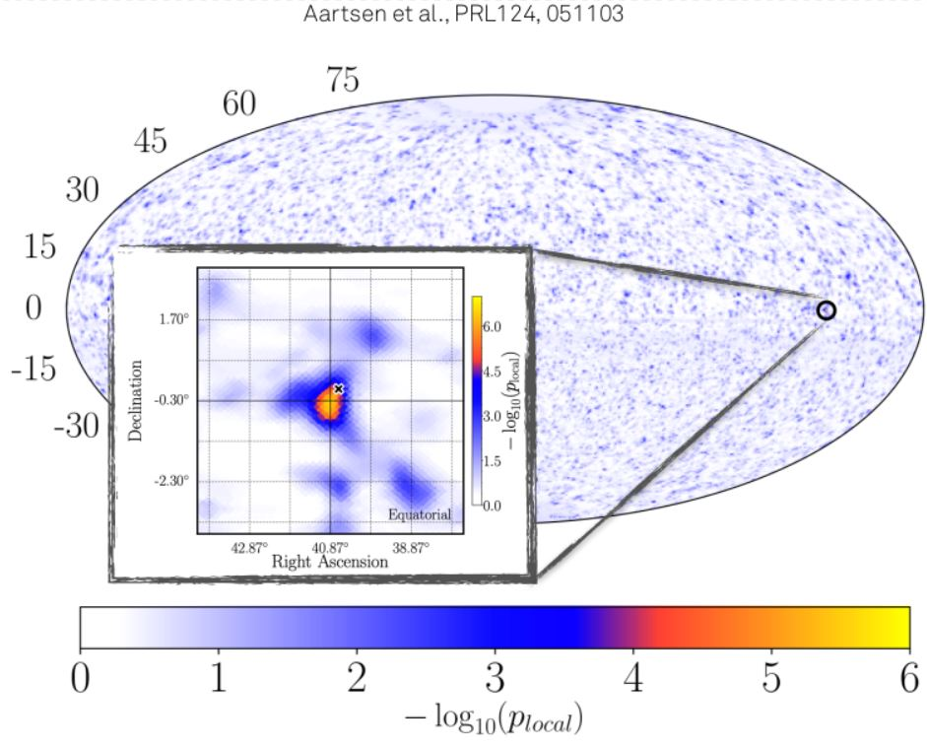
Are there steady neutrino “point sources”?
Status Sept. 2022:
Searches for event excess from specific celestial directions
(track events from
Northern sky)
Also: Constrained
to predefined list
of gamma-ray sources
Most significant signal (2.9σ) very close to NGC 1068
(a Seyfert-II galaxy)

Slide 35
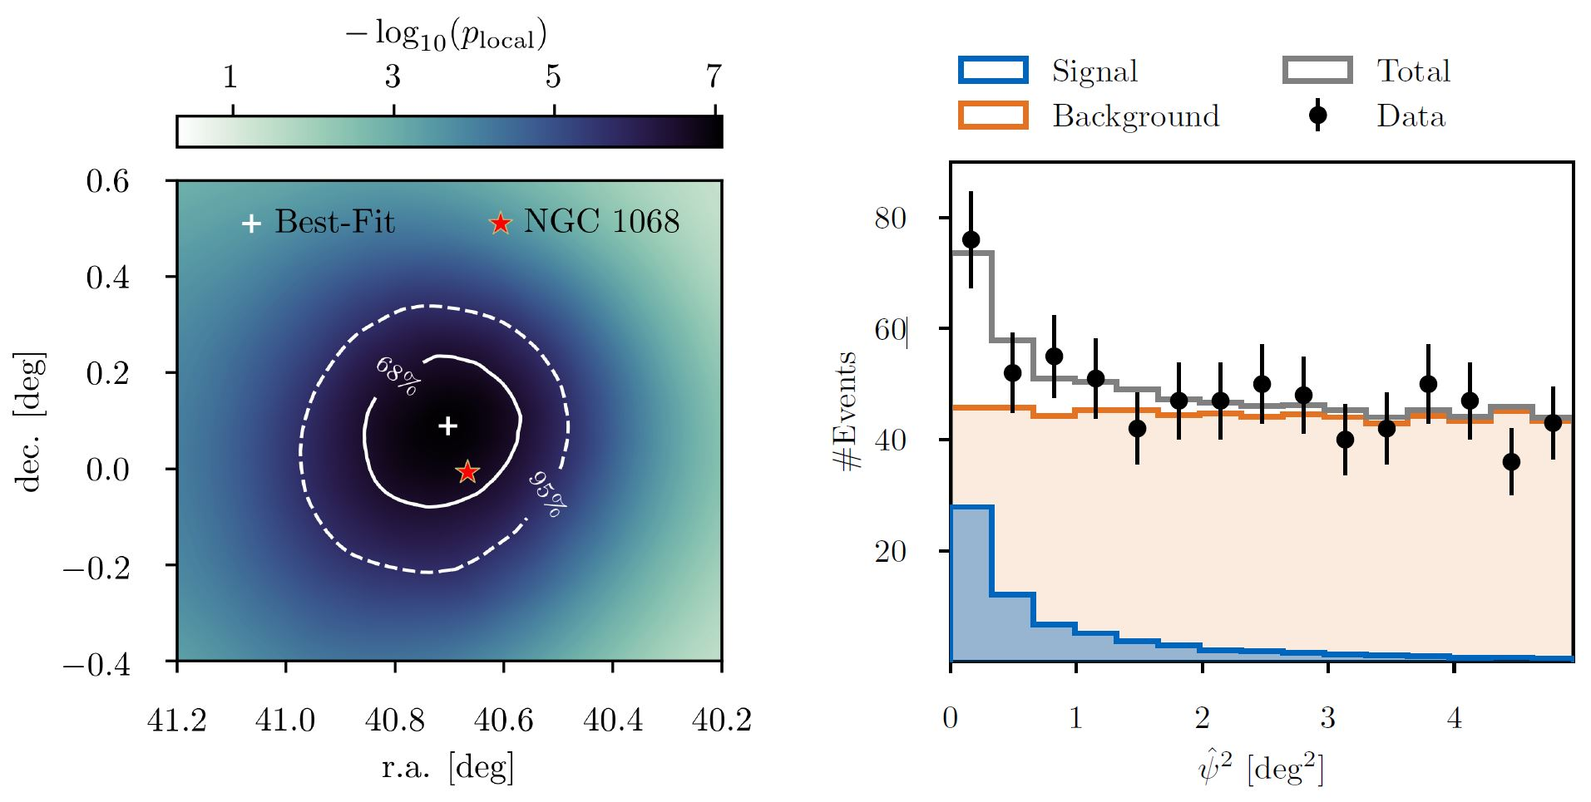
… yes, NGC 1068!
Science 378 (2023) 538
Improved analysis, 10 years of IceCube data
Significance 4.2 σ, steady source → more data to come
No strong gamma-ray counterpart (as expected for Seyfert-II)

Slide 36
KM3NeT progress and expectation

Slide 37
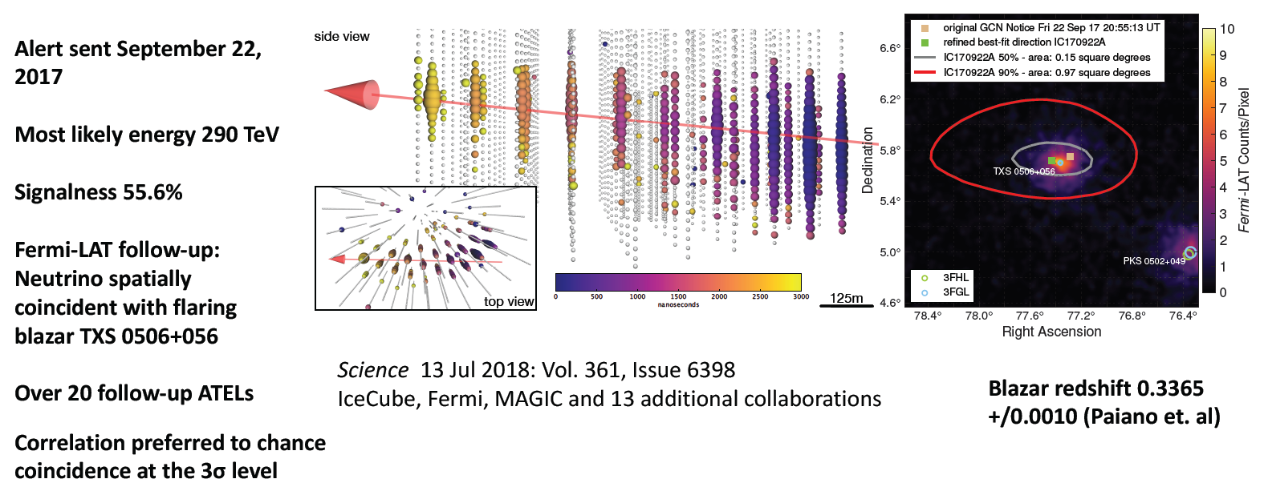
The neutrino from TXS 0506+056 – a first glimpse at a transient source …
Slide copied from Dawn Williams, RICH 2018
Also detected by MAGIC (energies up to 400 GeV)
Further 13±5 events Sept. 2014 - March 2015 in archival IceCube data
First compelling evidence for neutrino-source association
Begin of multi-messenger astronomy with neutrinos&gamma-rays !?

Slide 38
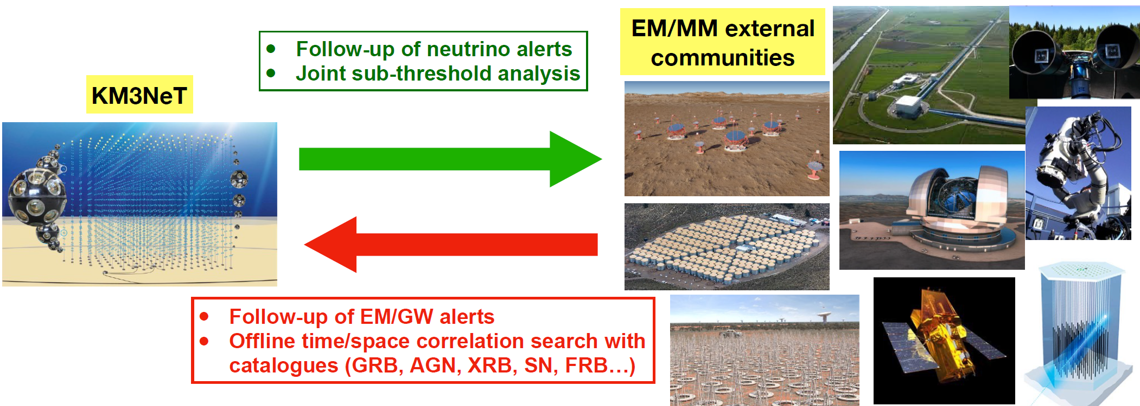
KM3NeT: Participating in alert systems
Requires (fast) online event reconstruction
Requires participating in alert networks
Incoming alerts: Analysis offline, but online filter optimisation targeted
Also: KM3NeT is part of Supernova Early Warning System (SNEWS)

Slide 39
Selected results (2):
A special KM3NeT event

Slide 40
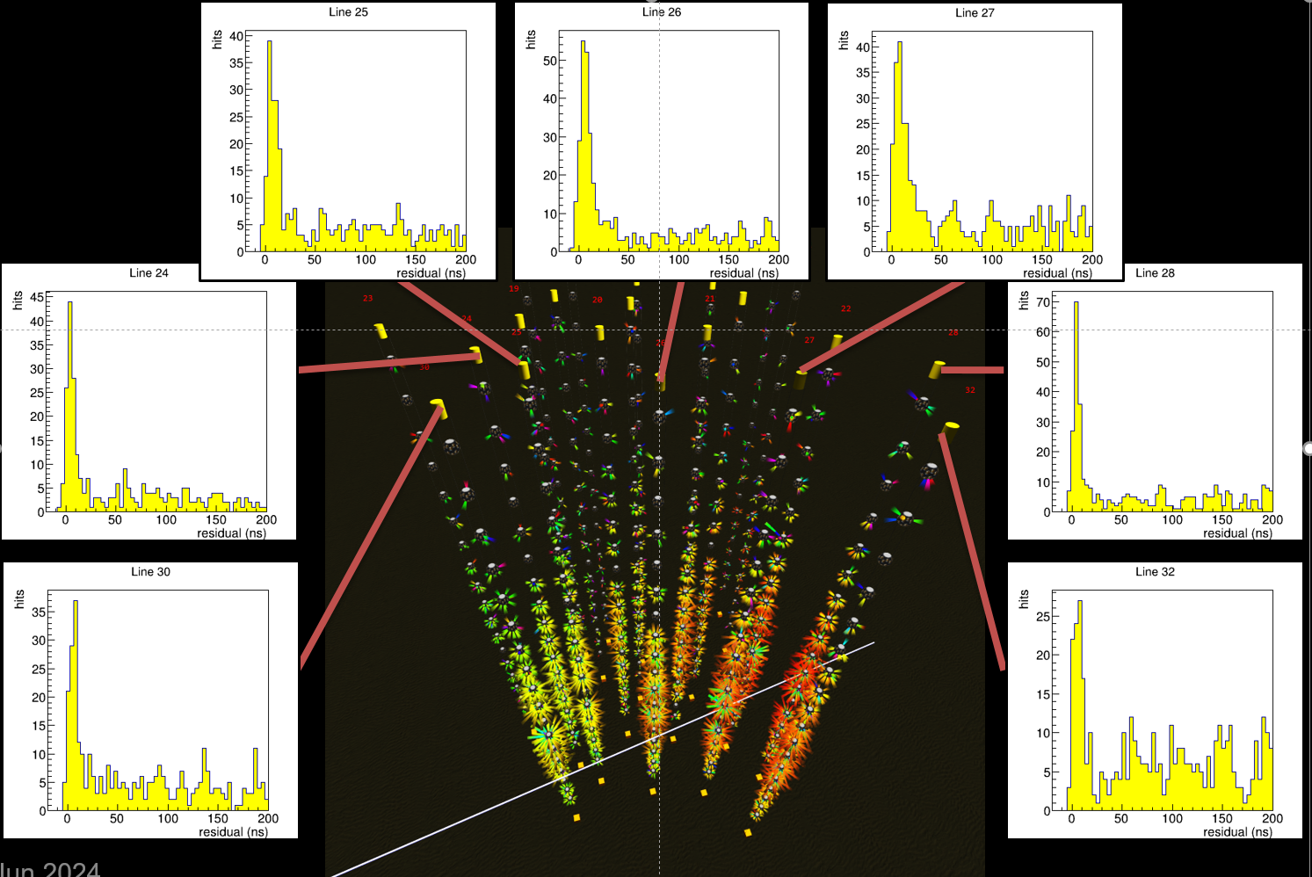
Highest-energy neutrino ever observed ?!
Investigate:
V_{µ} disappearance
V_{τ} appearance
Determine
θ₂₃ vs. Δm²₂₃
Most sensitive
result from
DeepCore
Improvement
expected from
Upgrade

Slide 41
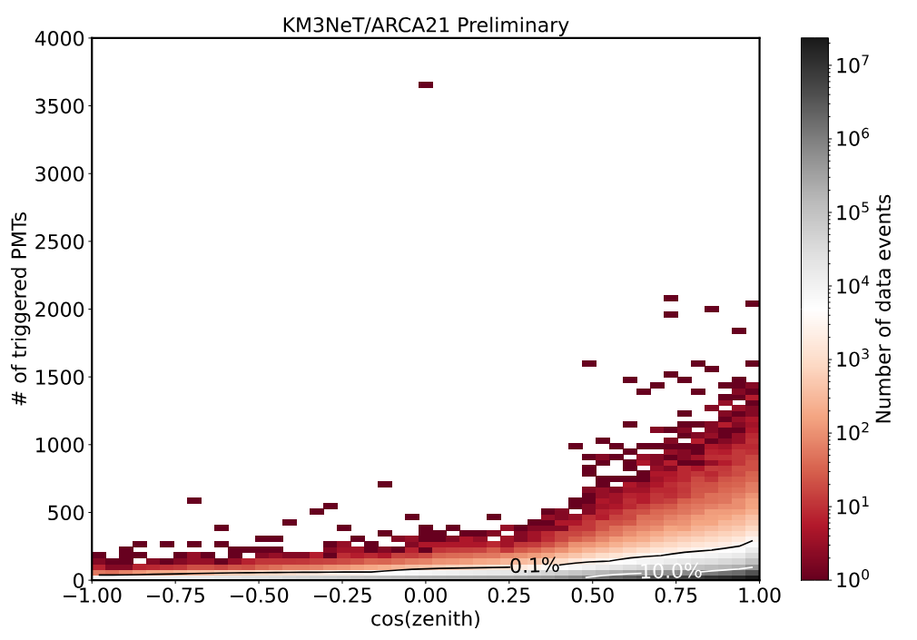
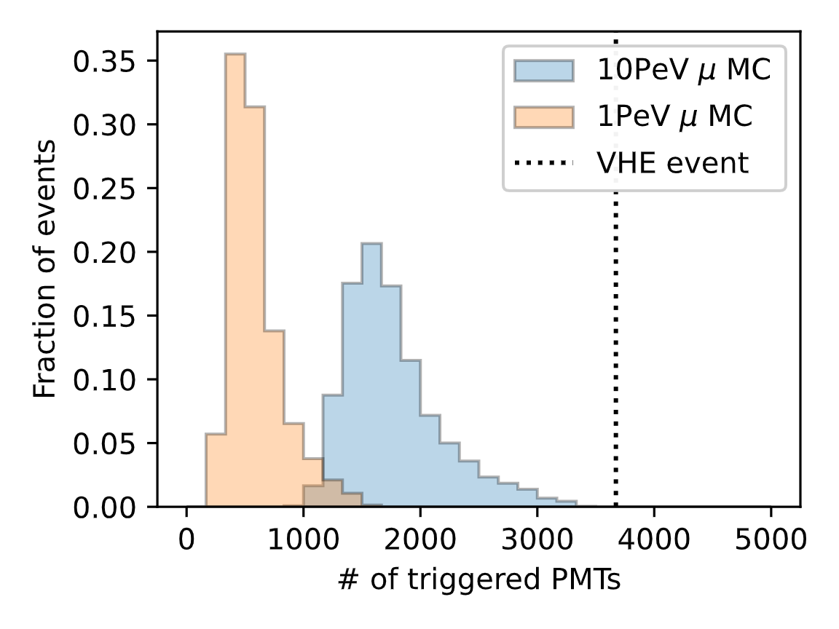
What I may present (1)
Event with huge amount of light (3672 PMTs (35%) were triggered)
Horizontal event (1°above horizon) reconstructed as muon
Muons simulated at 10 PeV almost never generate this much light
→ Likely multiple 10’s of PeV
More in publication coming soon
KM3NeT Preliminary
1 in 110 million data events

Slide 42
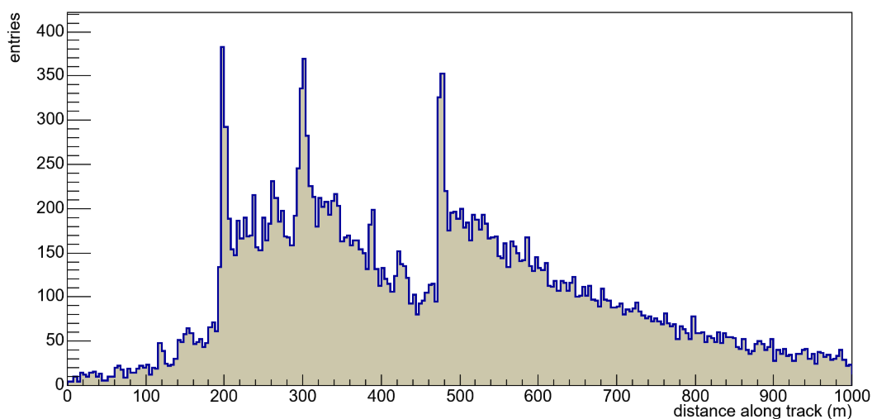
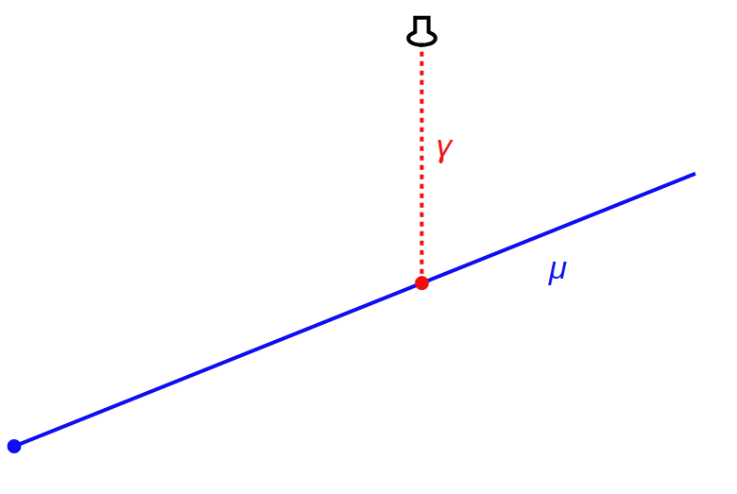
Uncharted Territory
What I may present (2)
Light profile consistent with at least 3 large energy depositions along the muon track
Characteristic of stochastic losses from very high energy muons
KM3NeT Preliminary
Position of light emission along track
consistent with hit time assuming direct light
t_{hit}
t₀
x

Slide 43
Selected results (3):
Neutrino oscillations

Slide 44
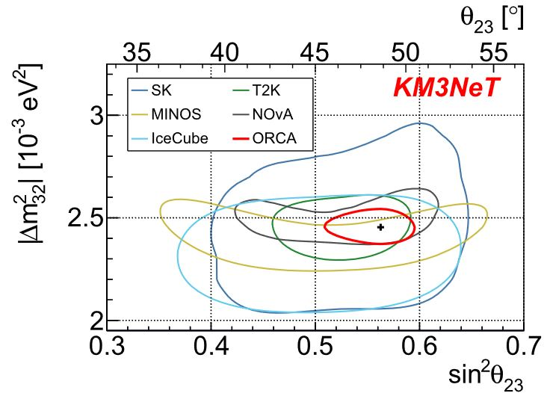
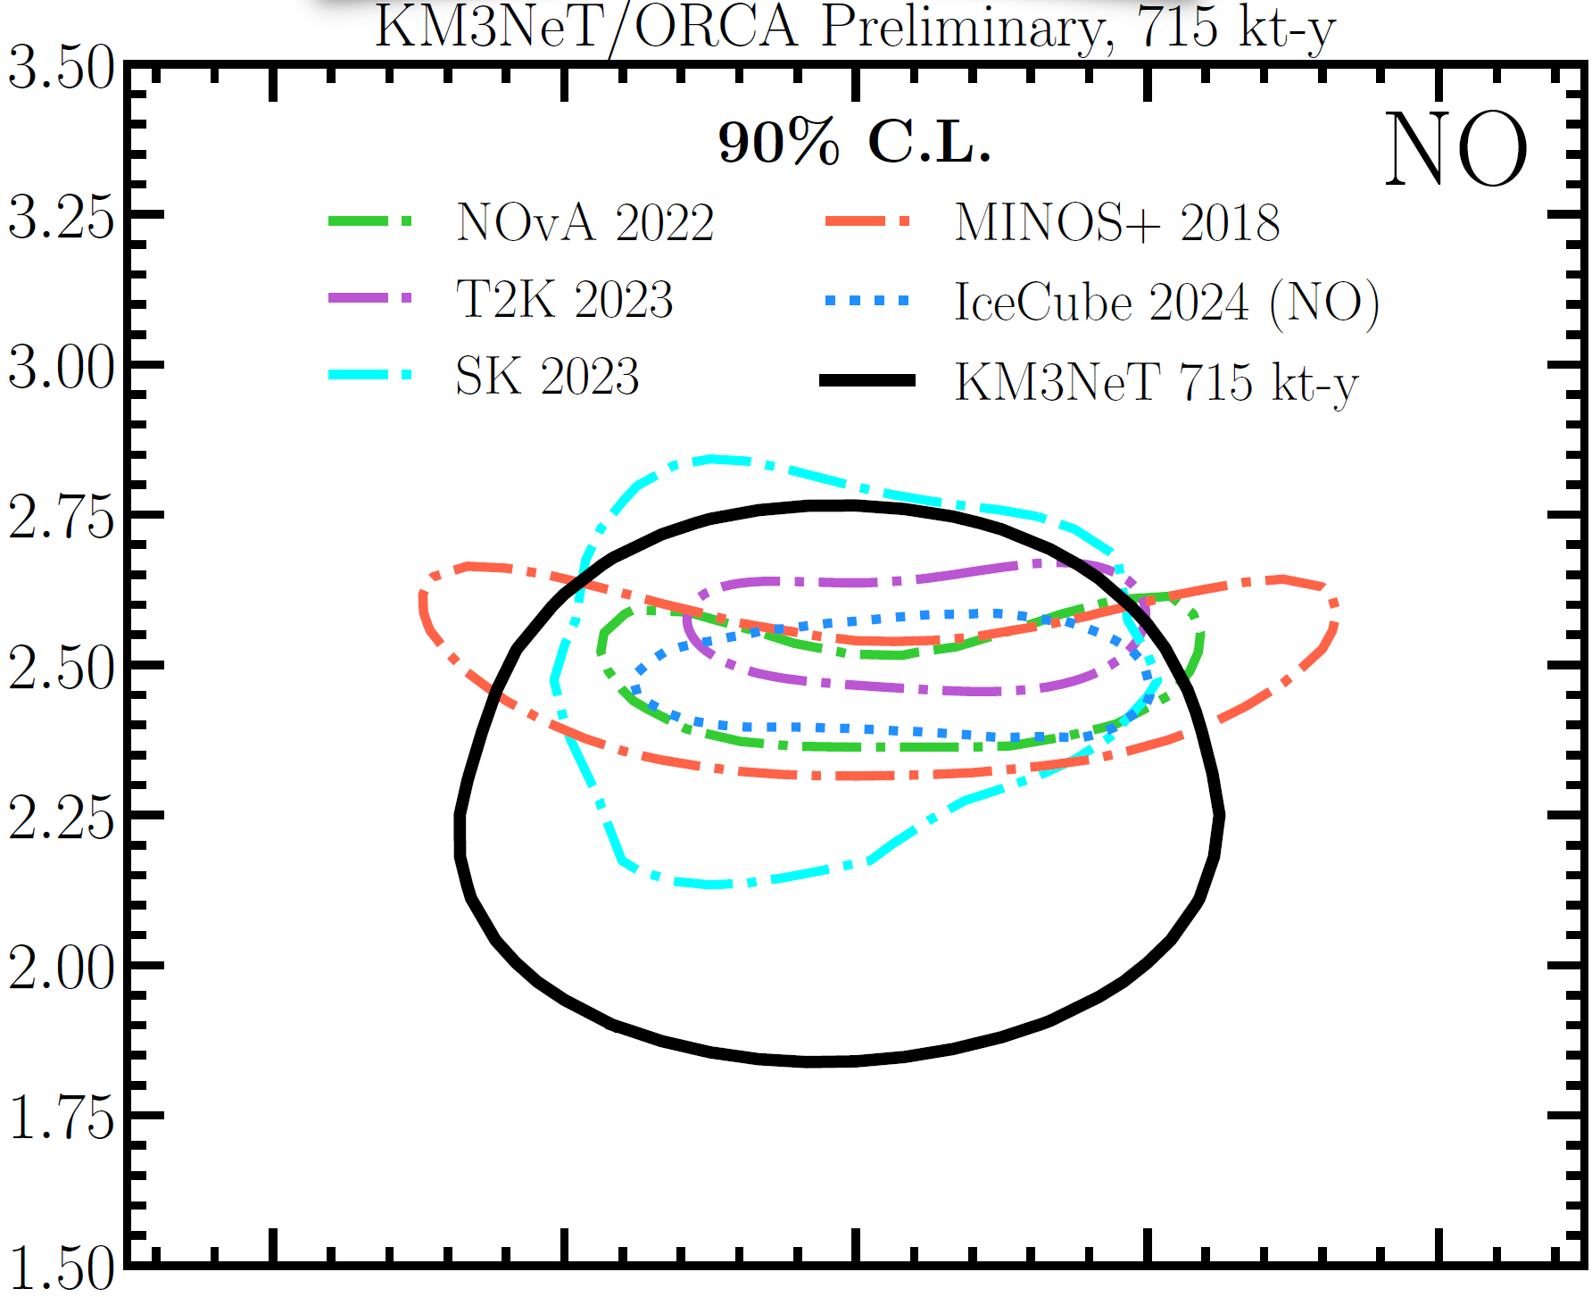
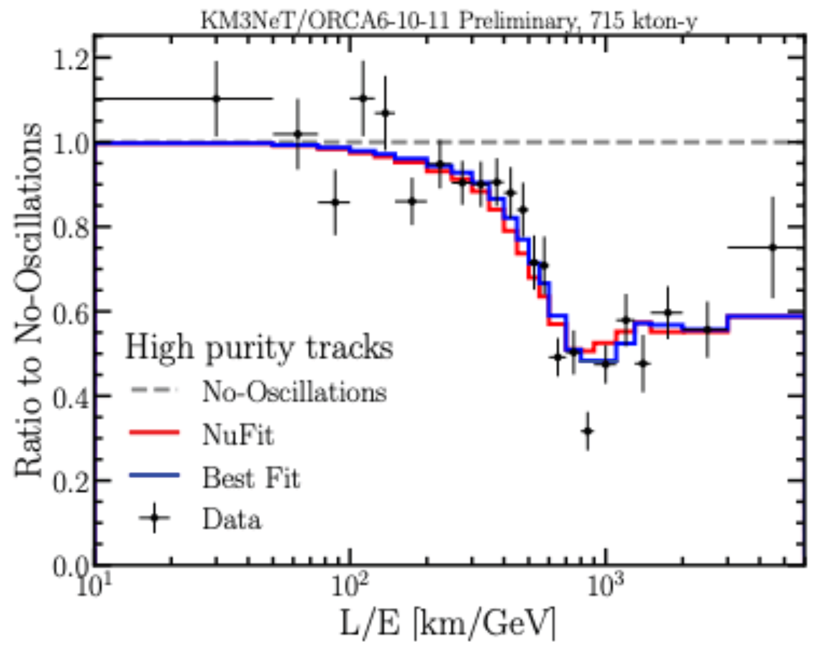
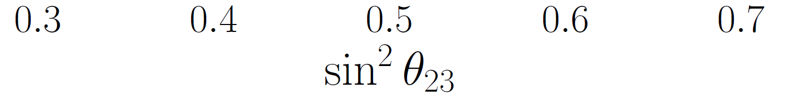
KM3NeT/ORCA sensitivity & first results
6-11/115 detection units, < 2 years of operation:
Eur. Phys. J. C82 (2022) 26
(3 years ORCA)
PoS (NuFact2021) 64
Clear demonstration of sensitivity
Also detected: ν_{τ} appearance
Result after 3 years with full ORCA highly competitive
(Note: Expectation compared to current results of other experiments)

Slide 45
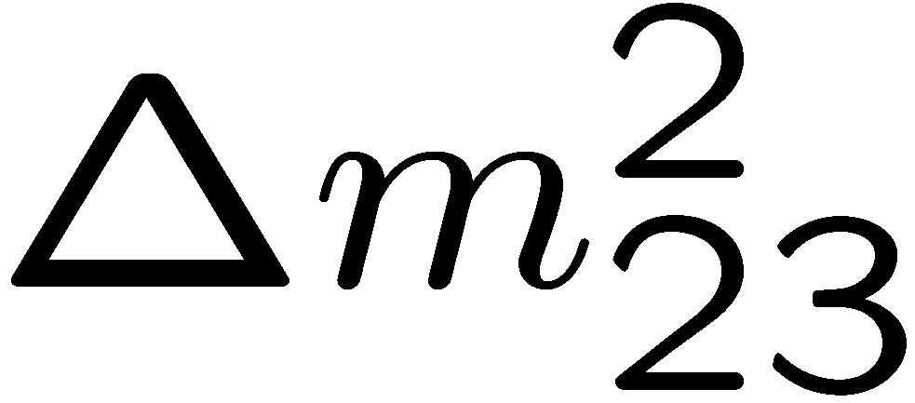

The neutrino mass ordering (NMO)
Depending on sign of :
“normal ordering” or “inverted ordering”
(NO) (IO)
Knowledge required to investigate neutrino CP violation;
important for cosmology

Slide 46

Towards measuring the NMO
Can be measured
using propagation of atmospheric neutrinos through
Earth matter
Different oscillation
patterns for NO / IO
Alternative: Reactor
neutrinos (JUNO)
KM3NeT and JUNO
are complementary
in systematics (see
arXiv:2108.06293)

Slide 47
Take-away messages

Slide 48

Neutrinos from the Galactic plane (2)
Investigate consistency with models of ν flux from CR interactions
Models use Fermi γ-ray data and assumptions on matter dynamics in Galactic Plane
Significant signal for each model investigated
Deviations models/data in flux normalisation
Data do not yet allow for precise determination of
E_{v} spectrum
748
276
211
Signal
events
Science 380 (2023)

Slide 49
Science with neutrino telescopes, 2025
Lots of progess in neutrino astronomy:
Transit from from searches to measurements
First cosmic neutrinos and neutrino sources
Neutrinos from the Galactic Plane
More data coming in, new telescopes becoming active
Highest-energy neutrino event ever
Major contributions to neutrino physics:
Precision measurement of oscillation parameters
Towards exploring neutrino mass ordering
Many further exciting science perspectives
Ambitious future plans

Slide 50
Back-up material

Slide 51

Overall: A very broad science spectrum
Further opportunities:
Combination with neutrino beams
Deep-sea sciences for marine neutrino telescopes
Environmental research and technologies

Slide 52


IceCube: Sensor developments
  Multi-PMT optical module (mDOM)
  24× 3” PMTs (e.g. Hamamatsu 12199-02)
  14” borosilicate glass vessel rated @ 700 bar
  Based on proven KM3NeT design
  Baseline design for Upgrade
  “D-Egg”
  2 x 8” PMTs
  UV-transparent glass
  and gel
  R&D and production by
  Japanese groups
Further light sensor
technologies under study

Slide 53
The Baikal GVD
First results from 2016+17 data:
→ Understanding atmospheric muons
→ Seeing atmospheric neutrinos
→ Limits on v flux from GW170817
→ A 157 TeV cascade event
525 m
120 m
700 m
Project to construct a Gigaton (=km³) detector in Lake Baikal, Russia
Phase 1 (GVD-1): 8 clusters, 0.4 km³, completed 2021
Meanwhile 12 clusters, goal 1 km³
Data taking & analysis in progress
Next-generation extension in preparation

Slide 54


Other future plans
P-ONE
Pacific Ocean, offshore Canada
Mainly US, Canadian, German groups
Uses existing deep-sea network and expertise
R&D phase, first pathfinder deployments, site characterisation
Trident, HUNT, NEON
Chinese proposals for neutrino telescopes in South China Sea
Site proposed and explored,
first R&D activities
arXiv 2207.04519
www.asatronews.com

Slide 55

Systematic search for such events …
Select events interacting
inside the detector only
No light in the veto region
Veto for atmospheric
muons and neutrinos
(which are typically
accompanied by muons)
Energy measurement:
total absorption calorimetry
→ “High-energy starting
events” (HESE)
Meanwhile further analyses

Slide 56


Where do they come from?
HESE
7.5 years
PRD 104 022002
(2021)
Absorption in Earth above some 10 TeV
60 events, expected background 0.9/9.1 atmospheric µ/v
No significant clustering or correlation with Galactic Plane
More events from Southern than from Northern sky

Slide 57


Detecting core-collapse supernovae
Note : E_{v} < some 10 MeV, individual events not reconstructed
IceCube
Eur.Phys.J.
C82(2022)26
PoS(ICRC2021)108
Detection by increased
hit rate on DOMs
Advantage: Low-noise environment
Detection by increased rate of multiple coincidences between PMTs in DOM
Overcomes bioluminescence and K40 noise

Slide 58

… earlier neutrinos from TXS 0506+056
Search in archival IceCube data for neutrinos from same source
Excess of 13±5 events found between Sept. 2014 and March 2015
Background-only hypothesis excluded at 3.5 σ
But: No flare of the blazar during that period → interpretation intricate

Slide 59

Neutrino oscillations with IceCube
Investigate:
V_{µ} disappearance
V_{τ} appearance
Determine
θ₂₃ vs. Δm²₂₃
Most sensitive
result from
DeepCore
Improvement
expected from
Upgrade
PoS (NuFact2012) 64

